Slide 1
浅谈CALIS与北美东亚图书馆的合作 Cooperation and Collaborations between CALIS and East Asian Libraries in North America
—— 以服务换取服务
Services for Services
王燕@CALIS
Yan Wang @ CALIS
Mar. 2012

Slide 2
About CALIS
CALIS
中国高等教育文献保障系统
China Academic Library & Information System
经国务院批准，教育部领导
1000多个成员馆
eduChina
CALIS门户
一期、二期重在“建设”，三期重在“服务”

Slide 3
About CALIS
CALIS
A nationwide academic library consortium in China
China Academic Library & Information System
Funded by the Chinese Government and under the leadership of Ministry of Education
Has over 1000 member libraries
eduChina
CALIS’s official web portal
The 1st and 2nd phases focus on development. The 3rd phase focuses on service.

Slide 4
CALIS三期的七大服务系列
合作编目与书目配送——编目
协调采购与资源建设——采访
公共检索与资源导航——门户
文献传递与原文获取——借阅
代查代检与专题咨询——咨询
软件共享与技术支持——系统
业务培训与资格认证——人力

Slide 5
Seven Types of Services from the 3rd Phase of CALIS
Cooperative Cataloging
Collaborative Collection Development
OPAC and Web Portal
Interlibrary Loan & Document Delivery
General and Specialized Reference Services
Software Sharing & Technical Support
Professional Training & Certification

Slide 6
合作宗旨
以服务换取服务
尽量不涉及经费结算
依用户驱动、使用效果及用户量等因素，决定开展服务的优先顺序
将海外服务纳入CALIS体系中，以支持大陆高校的服务

Slide 7
Collaboration Objectives
Services for services
Avoid budgeting and money transactions in the services
Service priority order is based on user demands, results, number of users and other factors.
Integrate oversea services into the CALIS, in order to support services for universities in mainland China.

Slide 8
北美地区合作状况
下载MARC数据
哈佛燕京图书馆
文献传递
哈佛燕京图书馆
芝加哥大学东亚图书馆（协议签定中）
普林斯顿大学东亚图书馆（协议签定中）
资源交换及其它服务
CALIS“学苑汲古”数据库对哈佛开放访问
哈佛燕京向CALIS提供古籍元数据
哈佛大学向CALIS提供“无版权图书的按需复制”服务(试运行中)

Slide 9
Current Collaborations with Libraries in North America
MARC Download
Harvard-Yenching Library
Document Delivery
Harvard-Yenching Library
East Asian Library at the University of Chicago – under negotiation
East Asian Library at the Princeton University – under negotiation
Resource Sharing & Other Services
CALIS grants access to the Xueyuan jigu Database “学苑汲古” to Harvard-Yenching Library
Harvard-Yenching Library provides metadata of rare books in their collections to CALIS.
Harvard-Yenching Library offers a trial service of on-demand photocopying of out-of-copyright books to CALIS.

Slide 10
七个领域的合作意向
免费提供Z39.50数据下载
文献传递
辅助中文图书采访系统
批量加工数据服务
特色馆藏
联合咨询台
馆员交流计划

Slide 11
Desirable Areas of Collaborations in Seven Fields
Free Z39.5 Download
文献传递
辅助中文图书采访系统
批量加工数据服务
特色馆藏
联合咨询台
馆员交流计划

Slide 12
免费提供Z39.50数据下载
中文记录
数量：300多万条书目数据，近3000万条馆藏数据
近百个高校成员馆实时提交原编书目数据
为供北美图书馆下载，CALIS已将CNMARC转成MARC21
但：主题和分类是中国标准，用户可选择屏蔽这两个字段
境外下载CALIS中文书目数据
KERIS成员馆
香港中文大学图书馆
香港浸会大学图书馆
澳门科技大学图书馆
哈佛大学燕京图书馆

Slide 13
Free Z39.5 Download
Chinese Records
3,000,000 bibliographic records and 30,000,000 records of library holdings.
Original cataloging records contributed by nearly 100 university libraries.
To facilitate downloading by libraries in North America, CALIS has converted CNMARC to MARC21.
Subject headings and classification are based on the Chinese scheme, but users can choose to filter the two fields.
Download of CALIS Bibliographic Records by Oversea Libraries
KERIS member libraries
CUHK Library
Hong Kong Baptist University Library
Macau University of Science and Technology Library
Harvard-Yenching Library

Slide 14
CALIS与OCLC的合作
2011年11月，CALIS与OCLC 签署合作备忘录
有效期一年
CALIS将出版年在1987-2003年间的中文书目记录中有ISBN的数据（50万条）免费赠予OCLC，CALIS负责MARC格式转换
OCLC将数据导入数据库，并在全球范围内使用、传播和供他人访问
在著作权法范围内，互相向对方提供文献传递服务，500笔/年（还未正式开始）
目前，OCLC已完成数据导入，数据可供下载
040 CALIS ≠c CALIS
040 XXX ≠c XXX ≠d CALIS

Slide 15
CALIS/OCLC Cooperation
CALIS and OCLC signed a cooperative agreement in November 2011.
Valid for one year
CALIS provides 500, 000 Chinese bibliographic records which were published from 1987 to 2003 and contain ISBN to OCLC for free. CALIS is responsible for the conversion of MARC format.
Provides document delivery services to each other under the copyright law. 500 transactions per year. (Not started yet.)
All records have been added to WorldCat by OCLC and can be downloaded.
040 CALIS ≠c CALIS
040 XXX ≠c XXX ≠d CALIS

Slide 16
哈佛燕京图书馆案例
哈佛燕京图书馆可在Aleph客户端通过Z39.50协议下载CALIS数据
下载后，可依工作流程，选择在Aleph或OCLC客户端编辑后，实时提交到OCLC

Slide 17
Harvard-Yeching Library Case
Harvard-Yenching Library can download CALIS records via Z39.50 on their Aleph client.
After downloading, they can choose to edit records on Aleph or OCLC client and then submit them to OCLC.

Slide 18
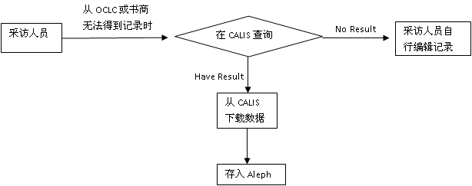
采访人员流程 Workflow for Acquisition

Slide 19
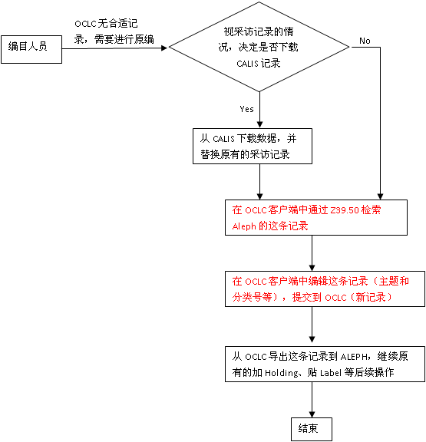
编目人员流程 Workflow for Cataloging
红色部分也可选择在本地客户端(Aleph)中编辑记录后提交到OCLC
For procedures highlighted in red, people can choose to edit on Aleph and then submit to OCLC.

Slide 20
七个领域的合作意向
免费提供Z39.50数据下载
文献传递
辅助中文图书采访系统
批量加工数据服务
特色馆藏
联合咨询台
馆员交流计划

Slide 21
Desirable Areas of Collaborations in Seven Fields
免费提供Z39.50数据下载
Document Delivery
辅助中文图书采访系统
批量加工数据服务
特色馆藏
联合咨询台
馆员交流计划

Slide 22
文献传递（1）
CALIS没有实体书，只有书目记录和文章目次信息
中文期刊
万方、同方、维普等提供目次，或提供PPV方式下载原文
CALIS文献传递/馆际借书服务网
CALIS高校成员馆
上海图书馆
中国国家图书馆
外国教材中心
KERIS成员馆
哈佛燕京图书馆

Slide 23
Document Delivery (1)
CALIS does not contain full-text books. It only contains bibliographic information and table of contents.
Chinese Journals
Wanfang, CNKI and VIP provide table of contents or full text via PPV.
CALIS Document Delivery/Interlibrary Loan Network
CALIS member libraries
Shanghai Library
National Library of China
Foreign Teaching Materials Center of China Education Ministry
KERIS member libraries
Harvard-Yenching Library

Slide 24
文献传递（2）
与北美图书馆的合作
在版权允许的范围内，互相做免费的文献传递
可限制在一年200篇
使用CALIS馆际互借/文献传递系统
免费租用系统，图书馆无需提供硬件，无需维护
需要向CALIS管理中心申请
发出文献传递请求
在CALIS的资源检索系统中检索
如查到结果，则直接在检索系统中提交文献传递请求
如未果，则可在系统中提交“全文获取”或“代查代检”请求

Slide 25
Document Delivery (2)
Collaboration with Libraries in North America
Provides free document delivery to each other under the copyright law.
Has a limit of 200 transactions.
Using CALIS Interlibrary Loan / Document Delivery System
Free rental of the system. Libraries do not need any hardware or maintenance.
Need to apply via CALIS Administrative Center
Sending Document Delivery Requests
Search in the CALIS online catalog
If found in CALIS, submit document delivery requests directly in the system.
If not, send a request for full text or ask for help.

Slide 26
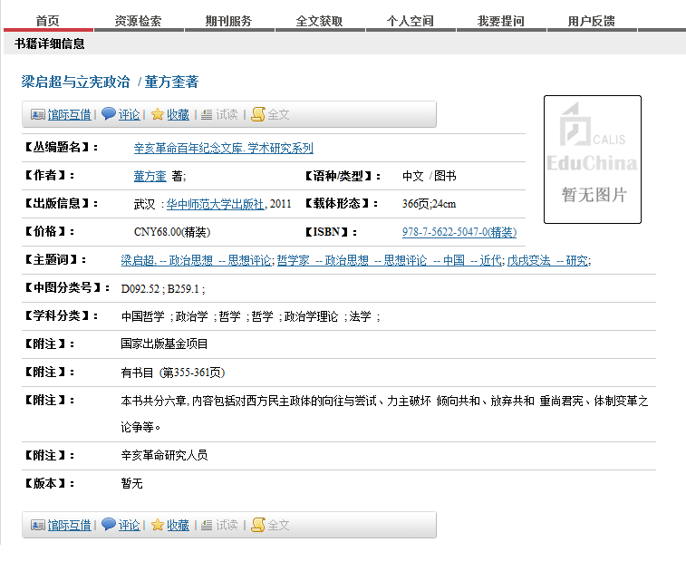
提交文献传递请求 Submit a Document Delivery Request

Slide 27
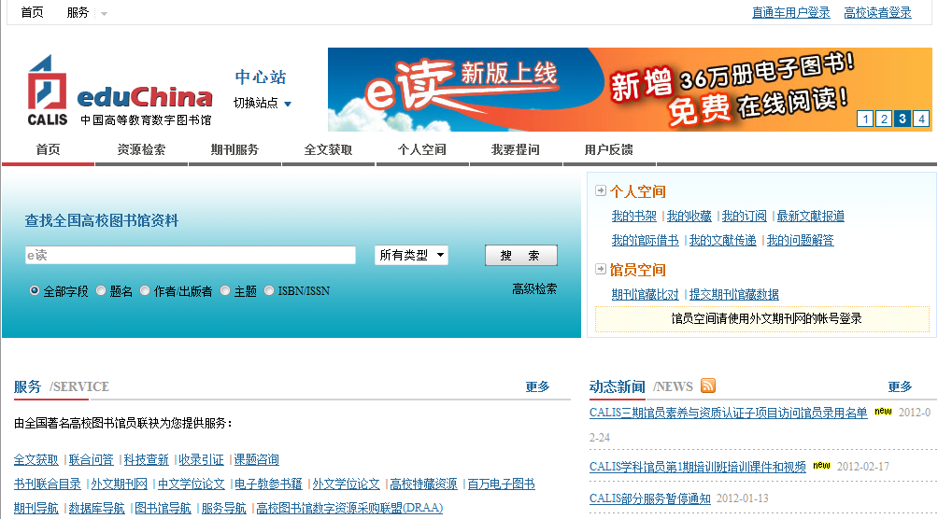
全文获取 Request for Full Text

Slide 28
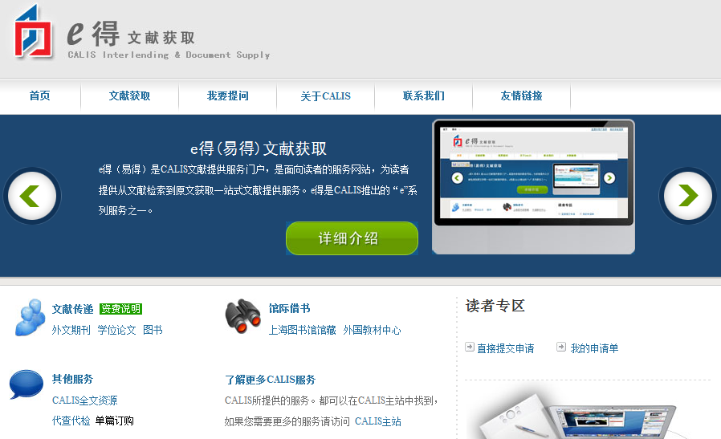
代查代检（e得文献获取）Ask for Help
http://yide.calis.edu.cn/

Slide 29
七个领域的合作意向
免费提供Z39.50数据下载
文献传递
辅助中文图书采访系统
批量加工数据服务
特色馆藏
联合咨询台
馆员交流计划

Slide 30
Desirable Areas of Collaborations in Seven Fields
免费提供Z39.50数据下载
文献传递
Acquisition System Supplemental to
Chinese Publications
批量加工数据服务
特色馆藏
联合咨询台
馆员交流计划

Slide 31
辅助中文图书采访系统（1）
目前在国内，70多家图书馆使用CALIS外文图书订购系统
该平台实现了国内高校外文图书的联合采购
专家推荐订购图书
可自行设定采购方式及经费额度
自主采购
系统不查重
系统生成订单后直接提交到进出口公司系统中
协调采购：
系统查重，同一本外文书只允许一个图书馆购买
系统生成订单后提交审核，审核通过后，订单提交到进出口公司系统

Slide 32
Acquisition System Supplemental to Chinese Publications (1)
Over 70 libraries use CALIS acquisition system for books in foreign languages in China.
The platform facilitates consortium purchase among university libraries in China.
Subject specialists recommend titles
Can customize acquisition system and set up a budget limit.
Individual Purchase
The system will not check duplication.
Purchase orders will be submitted to the vendors after they are created in the system.
Consortium Purchase
The system will check duplication. One title can only be purchased by one library.
Purchase orders needs to be reviewed when they are created in the system. Once approved, orders are submitted to the vendors.

Slide 33
辅助中文图书采访系统（2）
CALIS与版本图书馆合作
版本图书馆（ China Archives of Publications），隶属新闻出版总署
大陆出版社出版的图书都必须呈缴一份给版本图书馆，它保存的书比国家图书馆多，是保存大陆出版图书的总书库
签订了5年合同，回溯数据给3年，目前已得到2009—2011年大陆出版的所有中文数据约76万多条
从2012年开始每月提供更新数据
之后5年，每年约24万条中文数据
可为北美图书馆提供中文图书的订购
可在系统中挑书后生成订单
可跟踪某些图书馆的采购意向，以决定本馆是否购买

Slide 34
Acquisition System Supplemental to Chinese Publications (2)
CALIS / China Archives of Publications Collaboration
China Archives of Publications are under the leadership of PRC’s General Administration of Press and Publication.
Every publication published in mainland China needs to send a copy to the China Archives of Publications. It is the biggest place to keep publications published in mainland China.
Signed a five-year contract. Provides retrospective data for three years. Currently has obtained around 760, 000 records of Chinese publications in mainland China from 2009 to 2011.
Provides monthly data since 2012
Around 240, 000 Chinese records per year after five years
Can provide acquisition services of Chinese publications to libraries in North America
Can select books and create purchase orders afterwards in the system.
Can help with purchase decisions according to libraries’ profile.

Slide 35
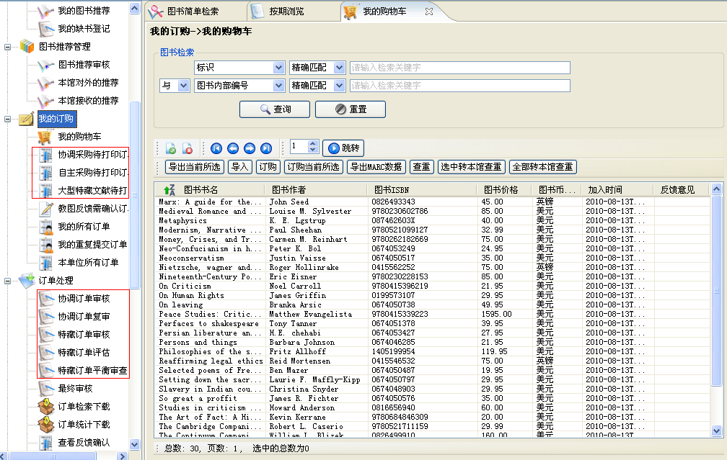
协调采购界面 Interface for Consortium Purchase

Slide 36
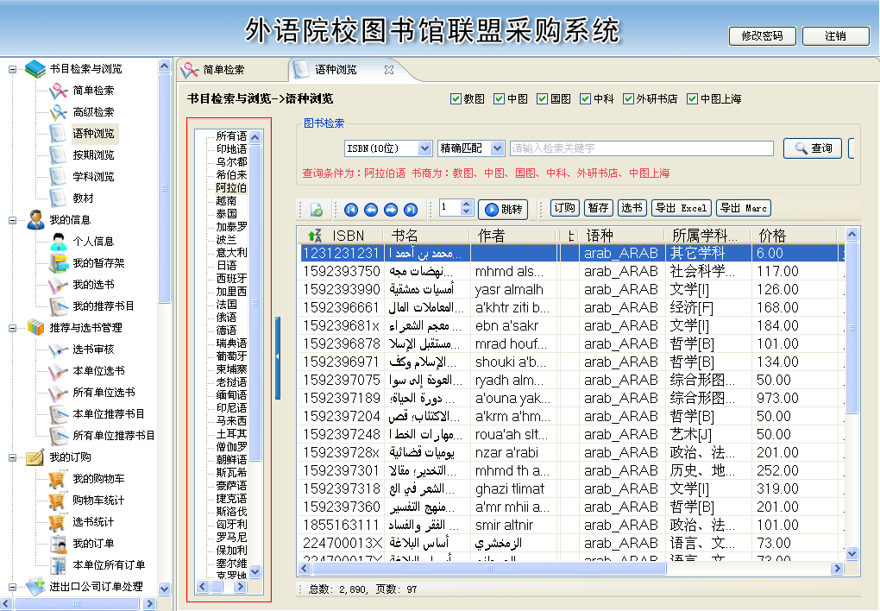
特色:小语种书目检索浏览 Search Interface for Catalogs of Books in Less Popular Languages

Slide 37
七个领域的合作意向
免费提供Z39.50数据下载
文献传递
辅助中文图书采访系统
批量加工数据服务
特色馆藏
联合咨询台
馆员交流计划

Slide 38
Desirable Areas of Collaborations in Seven Fields
免费提供Z39.50数据下载
文献传递
辅助中文图书采访系统
Data Processing Services
Special Collections
Reference Consortium
Librarian Exchange Program

Slide 39
批量加工数据服务
CALIS可代为加工中文图书书目数据
可只有Excel表
可只有简单MARC记录
案例（香港中文大学）
香港中文大学购买的超星面向海外发行的70万中文电子书，没有MARC，只有超星提供的Excel基本信息，而且其中很多信息混杂
香港中文大学委托CALIS为其生成MARC21格式的书目数据（由于是电子书有全文，著录方面可以比纸本目录简单）
主题和分类自行维护
处理结果
一部分记录是从CALIS数据库中比对命中后进行格式转换，如是详编记录仍保留中国汉语词表主题和中图法（简编记录无主题和分类）；
比对不到的记录则根据所提供的Excel信息进行解析（并对其中混在信息做了处理）后生成了MARC21的简编记录
香港中大对这批数据的反映很好

Slide 40
Data Processing Services
CALIS can help to process Chinese bibliographic records.
Excel spreadsheets
Basic MARC records
Case: CUHK
CUHK purchased over 700, 000 e-books from Superstar which do not have MARC records except for basic information in the Excel spreadsheets.
CUHK asked CALIS to create MARC21 records for these e-books. It is easier to create records for e-books as they are in full text.
CUHK worked on subject headings and classification.
Results
Some records were converted from matching records in the CALIS database. For full-level cataloging records, Chinese subject headings and classification were still kept. (No subject headings and classification for basic cataloging records. )
Analyzed those records that could not be matched in the CALIS database according to the Excel spreadsheet and created basic MARC21 afterwards.
CUHK was satisfied with the data.

Slide 41
特色馆藏
CALIS有意针对某一类特色资源，将东亚图书馆的中文资源与大陆高校图书馆相关资源整合起来，联合开发中文资源的特色数据库，如：
古籍
民国图书、民国刊
丧失在国外的文献（可由北美图书馆提出合作项目）
先整理出完整目录
互相开展文献传递服务
共同探讨如何共享，如何服务

Slide 42
Special Collections
CALIS can help to integrate special collections in the libraries in North America with those in the university libraries in mainland China to develop new databases, such as
Rare books
Books and journals published during the Republican Period
Chinese works collected by overseas institutions（Libraries in North America can propose a cooperation project regarding this matter.)
Create a complete catalog
Provide document delivery services to each other
Discuss on how to share and offer services

Slide 43
联合咨询台
对图书馆员开放的咨询台
表单咨询（离线）
相互解答问题
信息沟通（图书馆界动态）等

Slide 44
Reference Consortium
A platform open to librarians
Reference request form (off-line)
Answer questions collaboratively
Information sharing (current trends in the library fields, etc.)

Slide 45
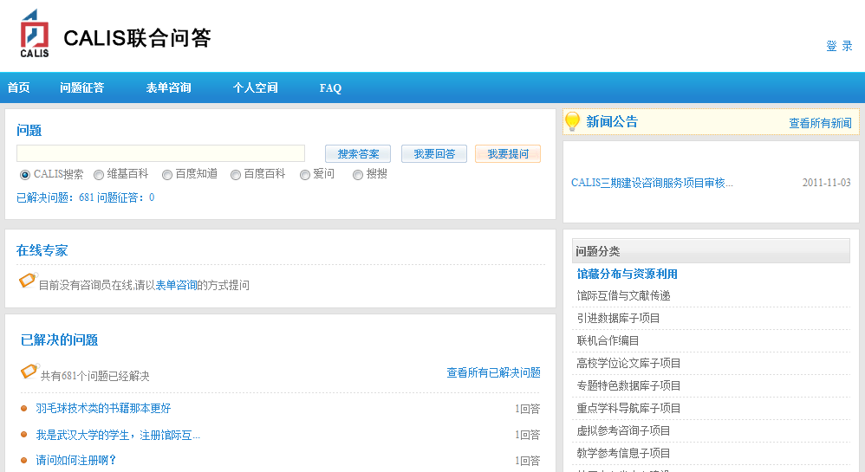
e问（面向图书馆员和读者的互动交流平台） eAsk (An Interactive Platform for Librarians and Readers)
http://cvrs.calis.edu.cn

Slide 46
馆员交流计划（1） Librarian Exchange Program (1)
目前已在国内开展“访问馆员项目”，详情见 (Current librarian exchange programs in mainland China)：http://www.calis.edu.cn/educhina/viewnews.do?newsid=120
接收馆名称 | 访问主题
中山大学图书馆 | 2,9,10
浙江大学图书馆 | 1,11,12
武汉大学图书馆 | 1,2,7
西安交通大学图书馆 | 1,2,3
清华大学图书馆 | 不定
复旦大学图书馆 | 1,2,4
南京大学图书馆 | 2,4,6
上海交通大学图书馆 | 1,4,7
厦门大学图书馆 | 1,3,4,6,7
重庆大学图书馆 | 3,4,5
四川大学图书馆 | 1,2,4
吉林大学图书馆 | 1,2,6
哈尔滨工业大学图书馆 | 2,3,4,6
中国农业大学图书馆 | 1,2
北京大学图书馆 | 3,6,13
访问主题 | 提供人数
（1）高校图书馆学科化服务； | 9
（2）高校图书馆信息素养教育； | 9
（3）图书馆资源整合与揭示； | 5
（4）数字图书馆相关技术应用； | 7
（5）高校图书馆组织与管理； | 1
（6）高校图书馆基础服务与创新； | 5
（7）高校图书馆资源建设与组织； | 3
（8）高校图书馆RFID技术应用； | 0
（9）古籍整理与编目； | 1
（10）古籍保护与修复； | 1
（11）数字图书馆； | 1
（12）读者服务; | 1
（13）图书馆宣传推广 | 1

Slide 47
馆员交流计划（2）
与北美东亚图书馆进行互派馆员访问
促进东亚馆馆员与大陆高校馆员的交流合作
结束时对访问馆做出评价和建议

Slide 48
Librarian Exchange Program (2)
Send librarians in university libraries in mainland China to East Asia libraries in North America for exchange and vice versa
Promote cooperation between East Asian librarians in North America and librarians in university libraries in mainland China
Provide feedback and suggestions to host libraries when it is done

Slide 49
附：eduChina中国高等教育数字图书馆 eduChina: Digital Library for Chinese Higher Education
e读
e得
e问

Slide 50
CALIS资源一览（1）
e读：CALIS学术搜索引擎
http://www.calis.edu.cn
http://www.yidu.edu.cn
包括中外文图书、期刊、文章、学位论文、古籍等特色资源

Slide 51
CALIS Resources（1）
eDu：CALIS scholarly search engine
http://www.calis.edu.cn
http://www.yidu.edu.cn
Includes books in Chinese and foreign languages, journals, theses and dissertations, rare books, etc.

Slide 52
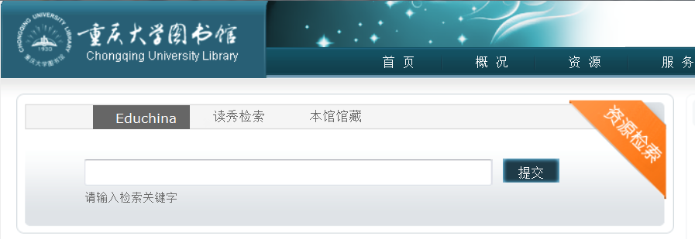
e读的本地化服务 Local services for eDu

Slide 53
CALIS资源一览（2）
学位论文：http://etd.calis.edu.cn
包含国内80余所高校的博硕学位论文
目前数据量约172万条

Slide 54
CALIS Resources （2）
Theses and Dissertations：http://etd.calis.edu.cn
Includes master theses and doctoral dissertations from 80 universities in mainland China
Currently has about 1,720,000 records

Slide 55
CALIS资源一览（3）
古籍（学苑汲古）：http://rbsc.calis.edu.cn/aopac/index.htm
24个图书馆的古籍目录数据
有书影

Slide 56
CALIS Resources （3）
Chinese Rare Books （Xueyuan jigu）：http://rbsc.calis.edu.cn/aopac/index.htm
Includes bibliographic records of rare books from 24 libraries
Contains scanned images of the title page

Slide 57
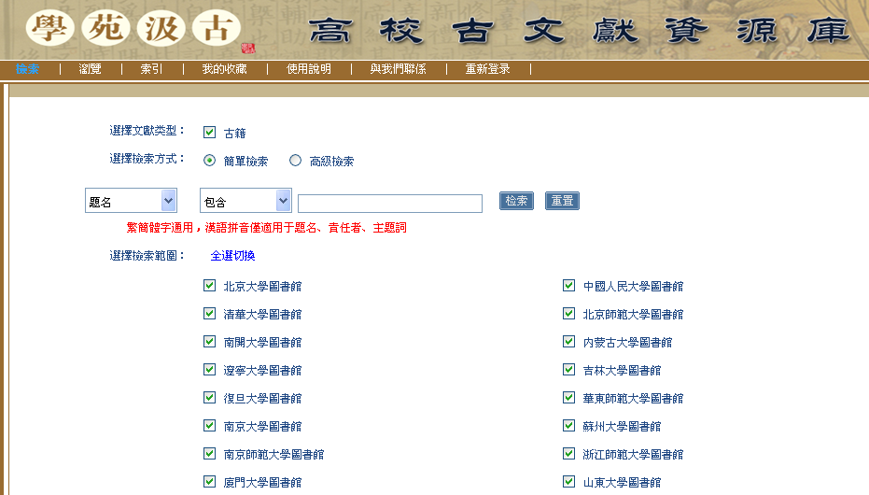

Slide 58
CALIS资源一览（4）
特色库：http://tsk.cadlis.edu.cn/tskopac/
特色库一览（60多个数据库）：
http://tsk.cadlis.edu.cn/tskopac/baseNavigation.do?sortby=tskname
东北亚研究数据库
中国科技史数字图书馆资料库
北大名师多媒体特藏数据库
建筑艺术与技术资料库
河南地方文献数据库
河洛文化文献专题数据库
潮汕文献数据库
红色江西特色数据库
长江资源库
高校古文献资源库
高校音乐教育资源数据库
……

Slide 59
CALIS Resources（4）
Special Collections：http://tsk.cadlis.edu.cn/tskopac/
List of special collections (Includes over 60 databases)：
http://tsk.cadlis.edu.cn/tskopac/baseNavigation.do?sortby=tskname
东北亚研究数据库
中国科技史数字图书馆资料库
北大名师多媒体特藏数据库
建筑艺术与技术资料库
河南地方文献数据库
河洛文化文献专题数据库
潮汕文献数据库
红色江西特色数据库
长江资源库
高校古文献资源库
高校音乐教育资源数据库
……

Slide 60
Thank you！
Contact me
Harvard-Yenching Library(through Aug. 2012)
Email: yanwang@fas.harvard.edu
Tel: 617-496-5381
CALIS Administrative Center
Email: wangy@calis.edu.cn
Tel: +86 10 62744702
Add: Peking University Library, Beijing, China 100871

