Slide 1

Harvard Library Transition
James K.M. Cheng
Librarian
Harvard-Yenching Library
Harvard University

Slide 2











Harvard Library Held-in-Common Functions
Provost
(Chair of Library Board)
Sr. Associate Provost
Harvard Library
Executive Director
Head of
Head of
Affinity
Affinity
Affinity
Affinity
Affinity
Information
Preservation
Head of
Chief
Group 1
Group 2
Group 3
Group 4
Group 5
& Technical
& Digital
Access
Financial
Head
Head
Head
Head
Head
Services
Imaging
Services
Officer
Services
* Several functions remain to be designed in the new organization, e.g., Office for Scholarly Communication, Library Lab, Library IT, Development
Harvard Library Transition Program
Sept 2011

Slide 3
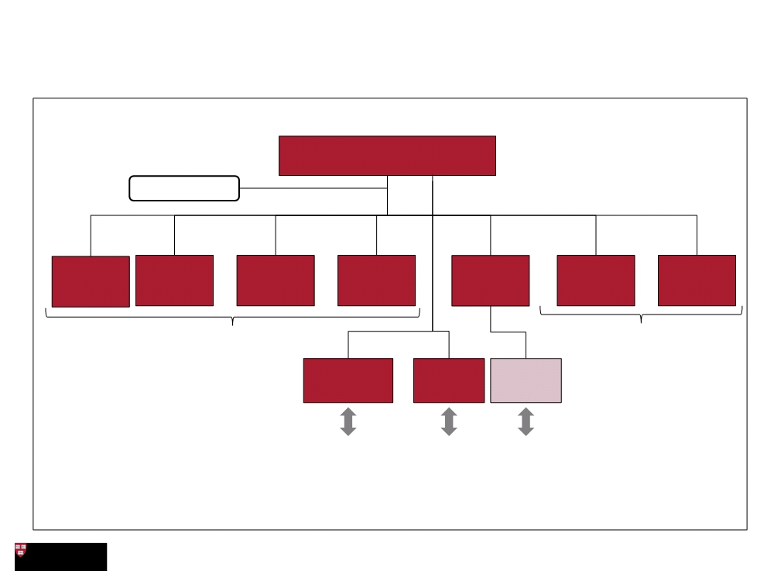
Harvard Library Held-in-Common Functions
Executive Director
5 Affinity Group
Heads
Preservation,
University Access
Archives Services
Technical Conservation
IT
Projects &
Finance
Services & Digital
Programs
Imaging
Shared Services
Support Functions
Communications
Human
Resources
Managing
Director
Library IT
Harvard Central Administrative Services
February 2012

Slide 4
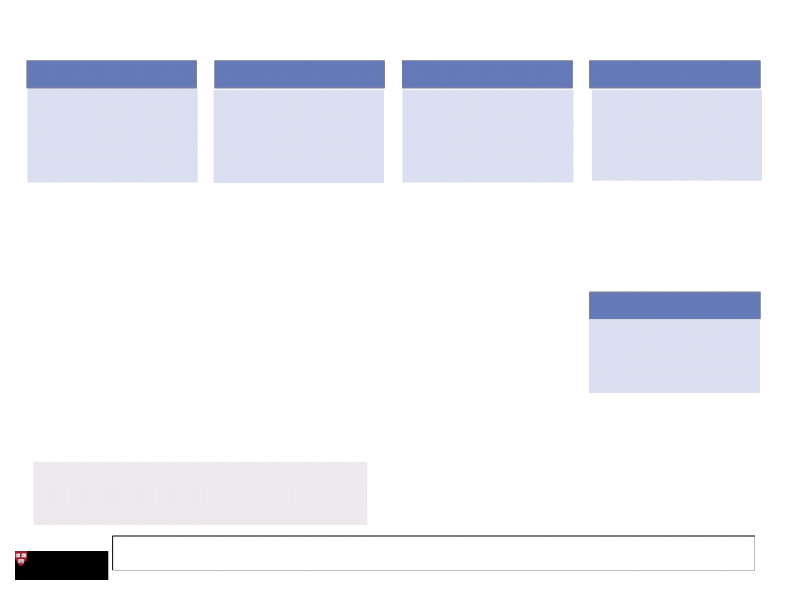
Proposed Allocation of Libraries to Affinity Groups
Group 1
Group 2
Group 3
Group 4
Members concerned with
Members focus on physical
and life sciences and, because
they often share research
Members focus on similar
content areas (i.e., humanities,
social sciences) and will benefit
from collaboration on
Creation of a group focused on
arts and culture ensures these
libraries have a voice. Materials
and patron needs make
application of theory in
practice; place similar levels of
emphasis on pedagogy to serve
the needs of faculty & students
at their professional schools
priorities, will benefit from
collaboration
collection development and
potential management groups
libraries unique, highly-
oriented to pedagogy & access
● Loeb Design Library
● Harvard Law School Library
● Medical School Library
● Widener
● Fine Arts Library
● Loeb Music Library
● Maps Collection
● HBS Knowledge and Library
● Henry Coe Meadow Library
● Lamont
Services
● Cabot Science Library
● Celtic Dept. Library
● Gutman Education
● Birkhoff Mathematical
● Smyth Classics
● HKS Library and Knowledge
● Chemistry
● Child English Library
● Milman Parry Oral Lit. (TBD)
● Theatre Collection
Services
● Physics
● Linguistics Dept. Library
● Tozzer (TBD)
● Medieval Studies Library
● Film Archive
● Wolbach Astrophysics Library
● Sanskrit Dept. Library
Group 5
● McKay Engineering & Blue
● NELC Assyriology
Hill Observatory
● NELC Judaica
Members face challenges
specific to special collections;
opportunity to streamline user
experience and making
materials accessible
● Harvard Forest Library
● Gibb Islamic Library
● Oakes Ames Botany
● History of Science
● Farlow Botany
● History Dept. Library
● Oakes Ames Orchid
● Ukranian Research
● University Archive
● Houghton Library
● Schlesinger Library
● Ernst Mayer / MCZ
● Robbins Philosophy
● Arboretum Library
● Harvard-Yenching
● Gray Herbarium
● Andover Harvard Theo.
● History of Medicine (TBD)
● Berenson Library (Italy) (TBD)
● Hellenic Studies (DC)
Libraries not included:
● Dumbarton Oaks (DC) (TBD)
● House libraries (13)  Development Office
● Fung  HBS Special Collections / Archives
● Career Reference Library  Property Information Library
● AAAS Raines  HLS Special Collections / Archives
● Nieman Foundation Library
● Grossman Library  Other Special Collection Units in
libraries
Harvard Library Transition Program
Sept 2011

Slide 5
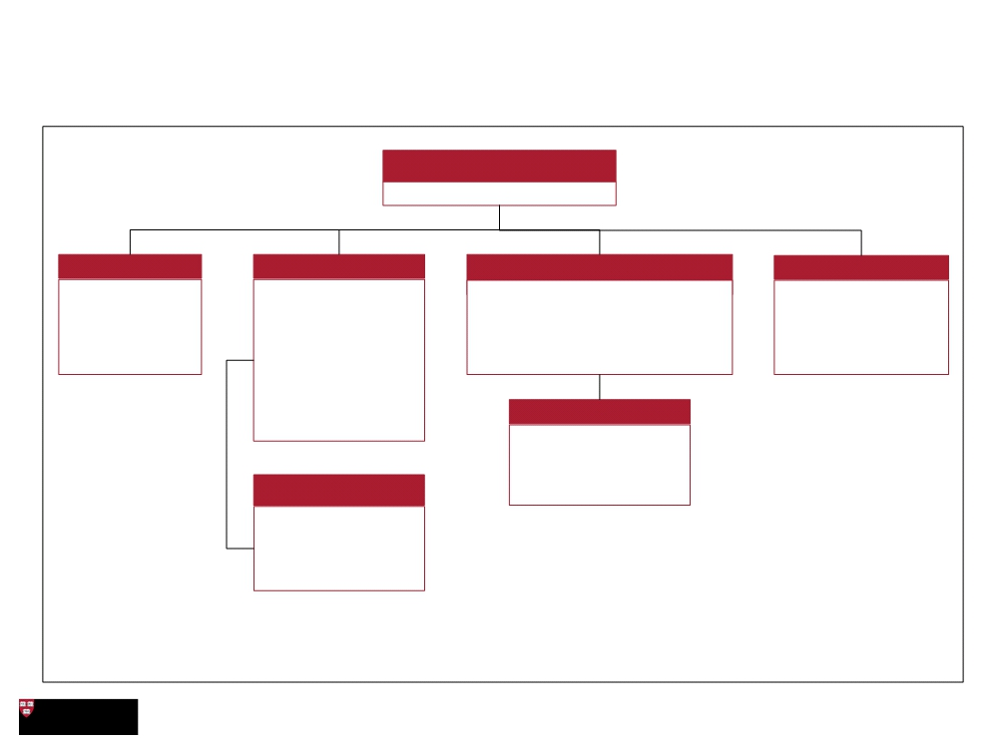
Harvard Library Shared Services: Access Services -
Functional Overview
Head of Access Services
Matthew Sheehy
Circulation
Resource Sharing
Collection Management / Library Logistics
Access Services Support
Main public
Responsible for
Responsible for preparing material
Responsible for
service point
borrowing and lending
for transfer, and major library moves
managing privileges for
where material is
material between
projects
non-Harvard scholars,
checked-out and
Harvard libraries and
fines, and student
returned
others
hiring and training
Includes Inter-Library
loan, Borrow Direct,
HD Operations
and Scan and Deliver
Responsible for the
accession, retrieving,
and refiling materials at
Logistics
HD
Responsible for the
movement of material
between the libraries,
including HD
February 2012

Slide 6
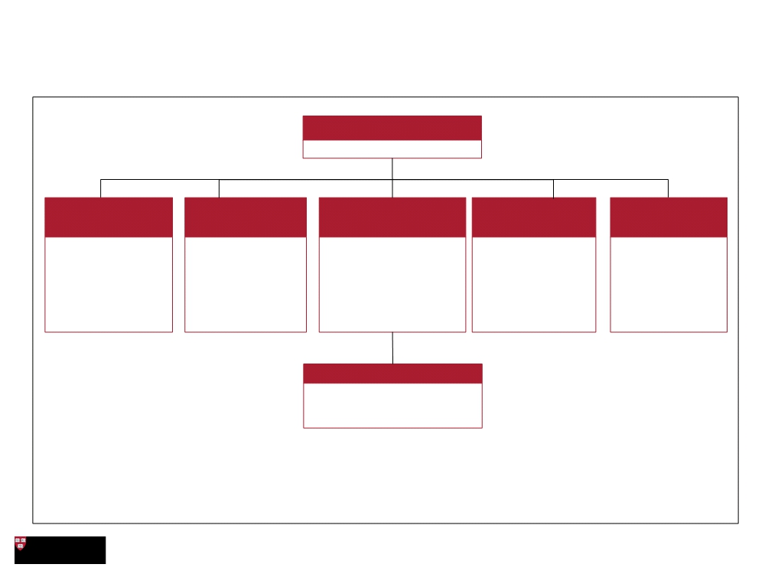
Harvard Library Shared Services: Technical Services -
Functional Overview
Head of Technical Services
Scott Wicks
Batch Processing & Original
Receiving & Copy/Deferred
Cataloging
E-Resources
Serials & Government
Docs
Metadata Management Cataloging
Works with large Creates original
Brings new titles into the
collection and updates
Lead the negotiation,
purchase, usage
Manages
groups of records to records that allow
subscriptions and
the acquisition of
state and Federal
government
add to or update the Harvard library users
records to help users find
them; including
rights, and records
for digital titles added
to the collection; incl.
acquisitions
library catalogue; and to find publications
organize knowledge in or objects within the
acquisitions
new forms e.g. Linked collection
data
publications
Shelf-Preparation
Marks new volumes with shelf
locations
February 2012

Slide 7
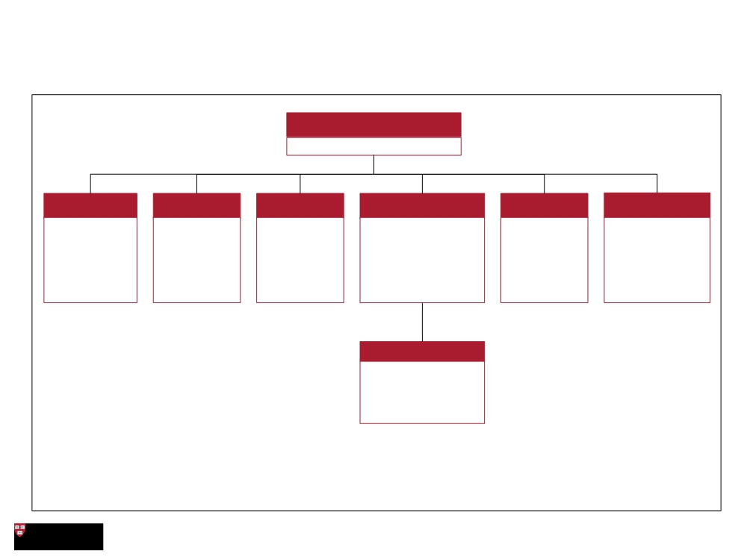
Harvard Library Shared Services: Preservation,
Conservation & Digital Imaging (PDI) - Functional Overview
Malloy-Rabinowitz
Preservation Librarian
Franziska Frey
Research Admin/
Digital Imaging Collections Care
Weissman Preservation/
Multi Media Digital Preservation
Admin Services
Conservation
Responsible for
management of
research and
sponsored
Responsible Responsible
Responsible for high
quality preservation
and conservation
Responsible Responsible for
for a range of for collections
for strategic guidance
collections care program
preservation of and strategic
reformatting for circulating
services
multi media relationship
programs
services collections
materials building in digital
preservation
Preservation Review
Responsible for
collection
assessments,
training, and outreach
February 2012

Slide 8
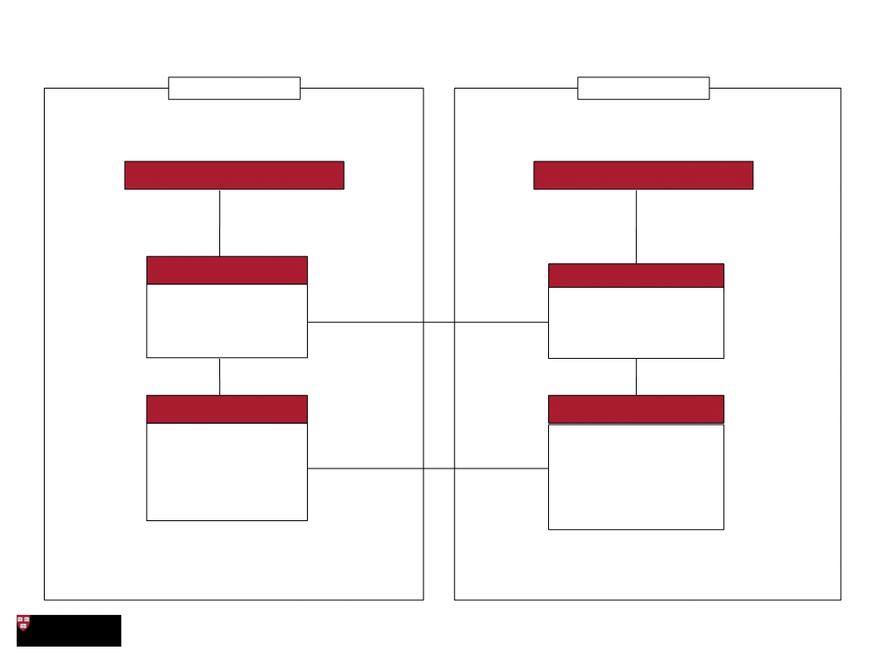
Proposed Harvard Library IT Organization Structure
Harvard Library
HUIT
Executive Director
UCIO
Library CTO
Managing Director Library IT
• Plan and execute Library IT
strategy
• Provides input into project
prioritization
• Triages IT projects
• Collaborates with HL to
define IT solutions to user
• Understands Library
enterprise architecture
needs
Library User Needs Analysts
Harvard Library IT
• Assesses and provides
expertise on Library user
• Develops & maintains Library
software and systems, data
needs
warehouse, web tools &
platforms
• Develops functional and
business requirements
• Provides help desk support
for Library systems
• Liaises between users and
HUIT
• Provides IT Training for
Library software
February 2012

Slide 9
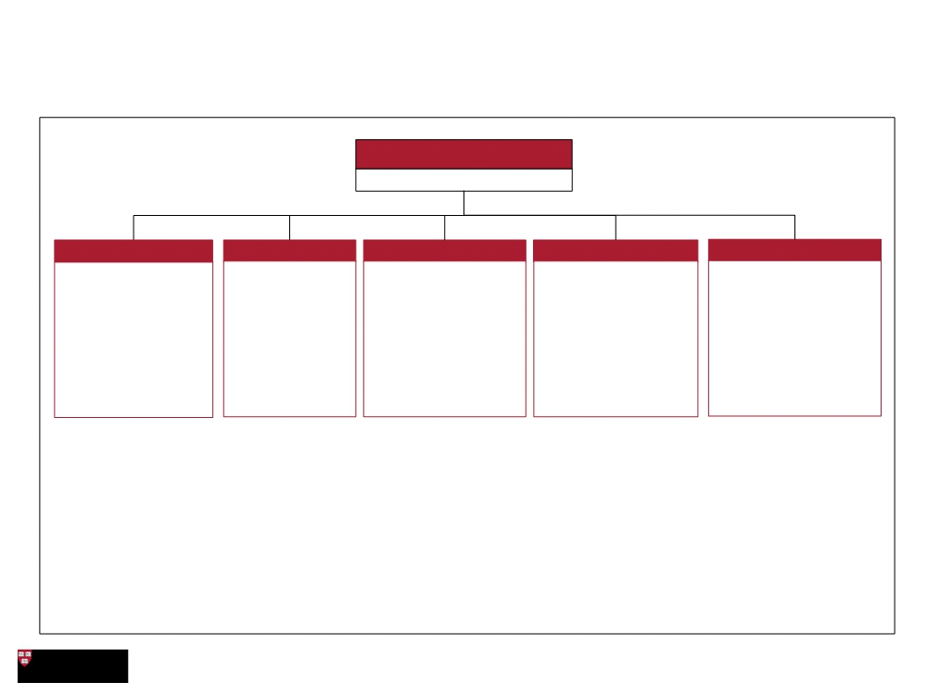
Harvard Library Support Functions
Office of the Executive Director
Helen Shenton
Communications Human Resources
Finance
Information Technology
Projects & Programs
- Plan, develop and - Deliver HR
- Responsible for
- Responsible for IT
- Work with HL
deliver internal and programs and
organizational
performance
management
function & enabling
strategic direction for
Harvard Library
Leadership and Shared
Services Leads to
external services
communication -Serve as liaison
manage projects as
- Serve as liaison to to central Harvard
- Conduct financial
analysis
- Includes user needs
analyst
investment/innovation
central Harvard HR
Communications
opportunities
- Benchmarking
- Serve as liaison to
Harvard IT
- Work with other
- Operations including
functions to coordinate
PMO approach
SLAs and Budget
February 2012

