Slide 1
Digitization at Harvard-Yenching Library: Strategies and Technical issues
Mikyung Kang
Harvard-Yenching Library, Harvard University

Slide 2
Title selection
Initially selected by NLK after reviewing by NLK rare book specialists
Added more books later by HYL recommendations
All approved by NLK
Beginning: Total 469 titles/961 volumes
Final: Total 473 titles/963 volumes
Notes:
Objectives for instruction and expected results and/or skills developed from learning.

Slide 3
Strategies
Preservation review first by experts from the Weissman Preservation Center
One batch includes about 80~100 books for review
Preservation experts visit HYL, once in about 2 mo.
One batch includes about 10 vol. (less than 1,500 scanned images)
Delivery of one batch per week

Slide 4
Strategies
Priorities:
Single volume titles first
Less than five volume set titles second
More than five volume set titles third
Oversized items last

Slide 5
Strategies
Flagging special notes for scanning staff in Imaging Services
Colored flags for the Korean rare book project
Flags for special notes:
Note: “Please do not scan back pages”
Note: “two shots” or “three shots”
Insert blank white sheets if too transparent

Slide 6
Strategies
Record Management at the same time:
Correcting cataloging records when errors found
Replacing labels if wrong call numbers found
Correcting volume numbers in bib and holding records
Indicating missing volumes in records
Marking correct information in the The Annotated Catalogue of Korean Rare Books at the Harvard-Yenching Library, Harvard University for future revision

Slide 7
Preservation review
Selecting any damaged items for preservation treatment
Disbinding/resewing if too tight for scanning
Remaking cases (containers) if too tight for books for long term
Ironing if folded too much and texts are hidden by folded papers

Slide 8
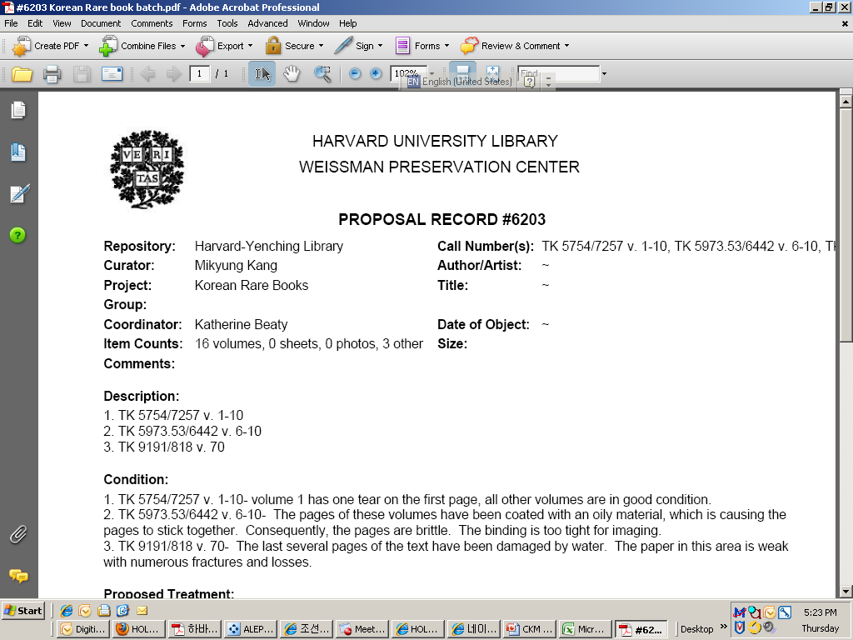
Strategies

Slide 9
Preparation and Quality Control
Before scanning:
Check each page for any special handling cases and insert note flags if necessary
Create a label file for each batch
After scanning:
Check each image to see whether correctly scanned
If problems found, send e-mails to Imaging Services to correct
Missing pages: re-scan
Duplicated pages: ask them to delete, etc.

Slide 10
Public Access

Slide 11
Table of Contents

Slide 12
Special handling items
Too thin papers – transparent
Two pages in one image
Unknown location for attached tags
Inserted notes – attached
Inserted notes – detached
Inserted notes in envelops
Large sheets
Oversized maps
Disbound/Resewn items
Bound-with items

Slide 13
Too thin papers – transparent

Slide 14
Two pages in one image if connected

Slide 15
Unknown location for attached tags

Slide 16
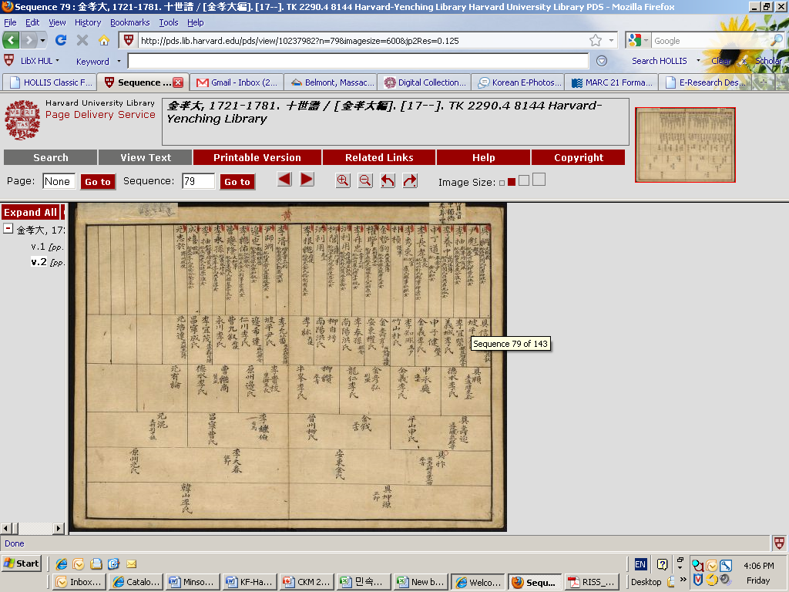
Inserted notes – attached (2 shots)

Slide 17
Inserted notes - detached

Slide 18
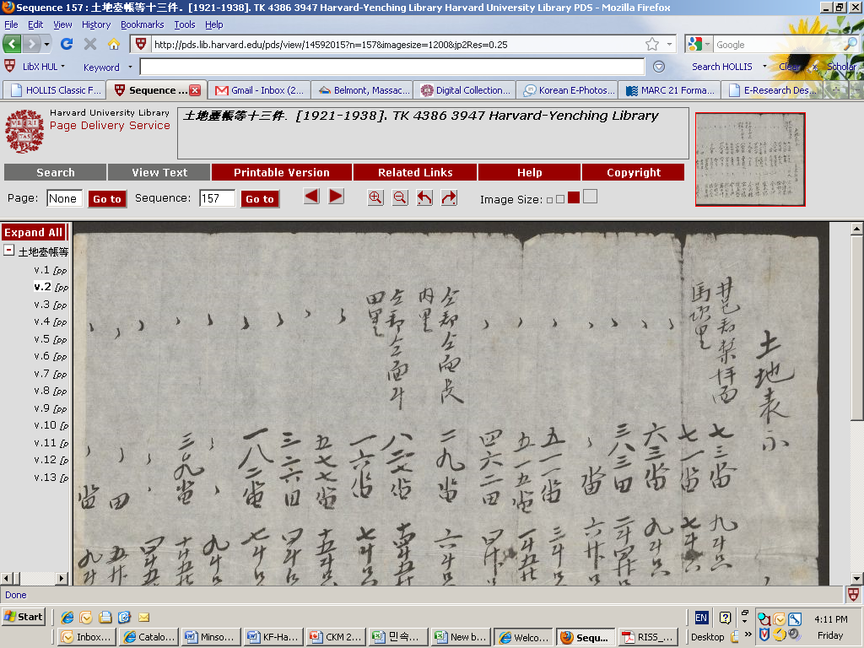
Inserted notes in envelops

Slide 19
Large sheets

Slide 20
Oversized items (e.g. 104 x 53 cm)

Slide 21
Disbound/Resewn items

Slide 22
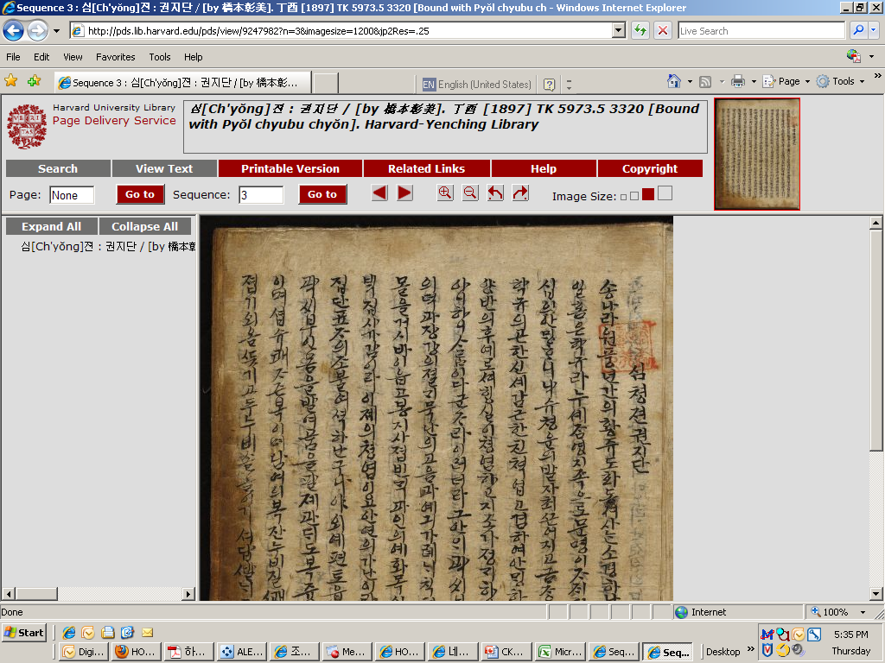
Bound-with items
First title
Second title

Slide 23
Taedong yŏjido 大東輿地圖
22 volumes all connected together
Two separate links for this title
Provides access to overview of entire map compiled from 22 volumes
Provides access to page images of entire 22 volume work

Slide 24
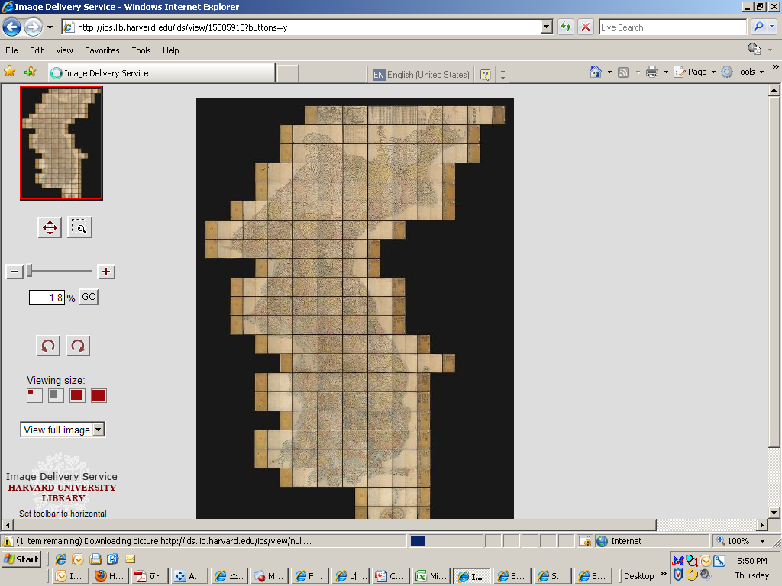
Overview of Entire Map

Slide 25
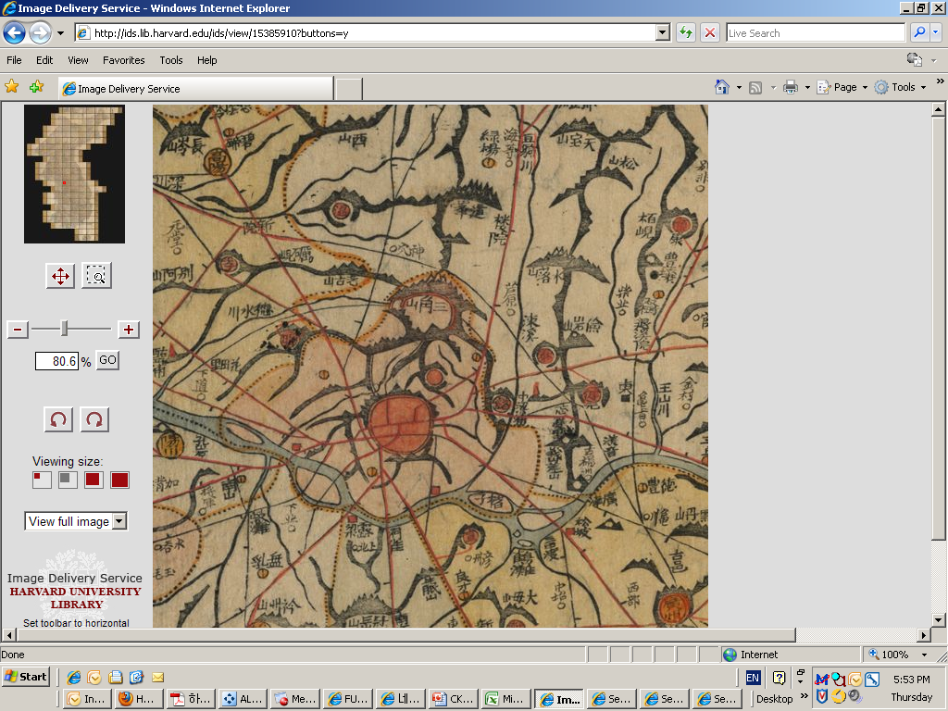
Zoom-in view of Seoul

Slide 26
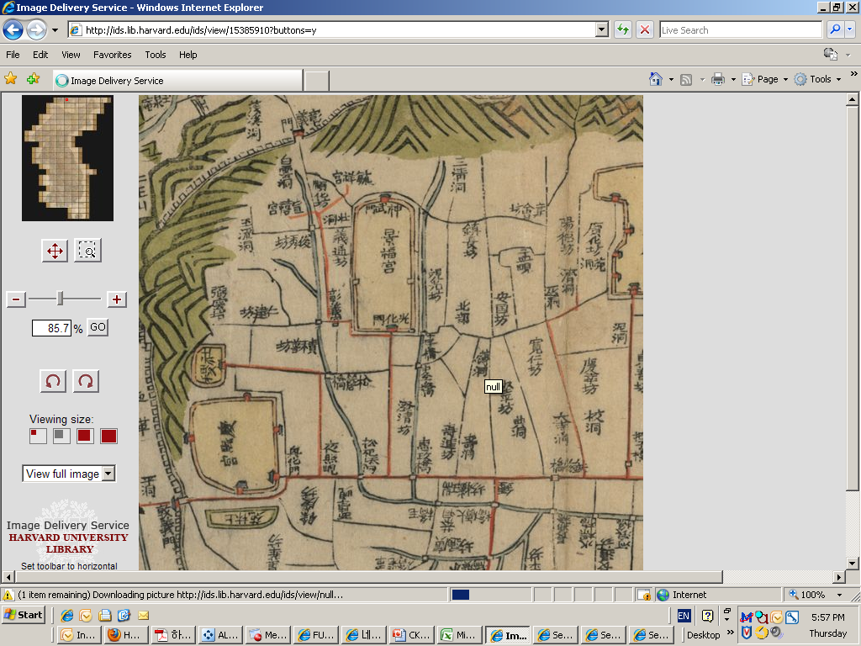
Zoom-in view of Seoul downtown

Slide 27
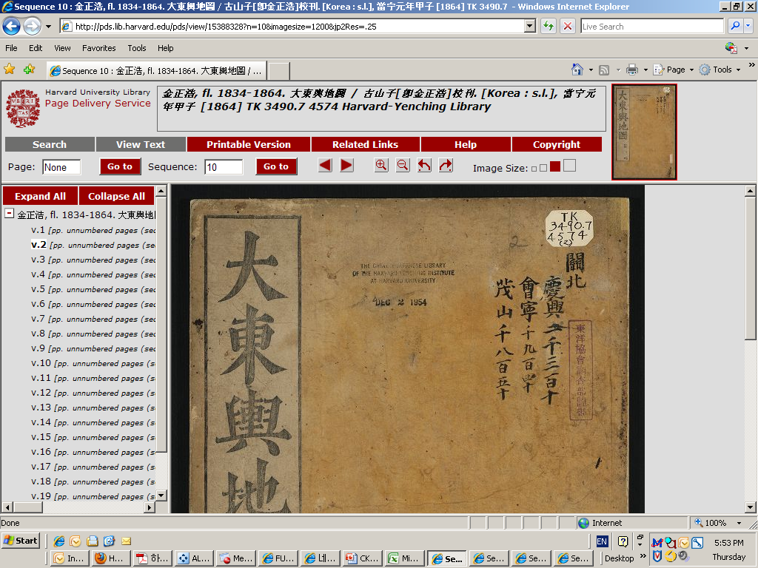
page images of entire 22 volume

Slide 28
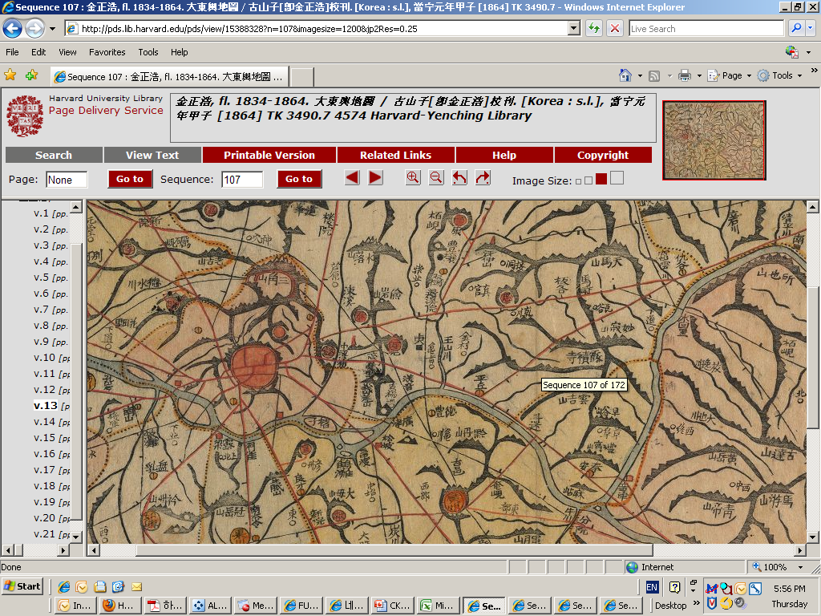
View of Seoul in page images

Slide 29
Thank you very much!!
Mikyung Kang

