Slide 1
Overview of the Google Books digitized from the University of
Michigan Library collection: its impact to Korean Studies scholars
-- Yunah Sung, University of Michigan
March 25, 2010

Slide 2
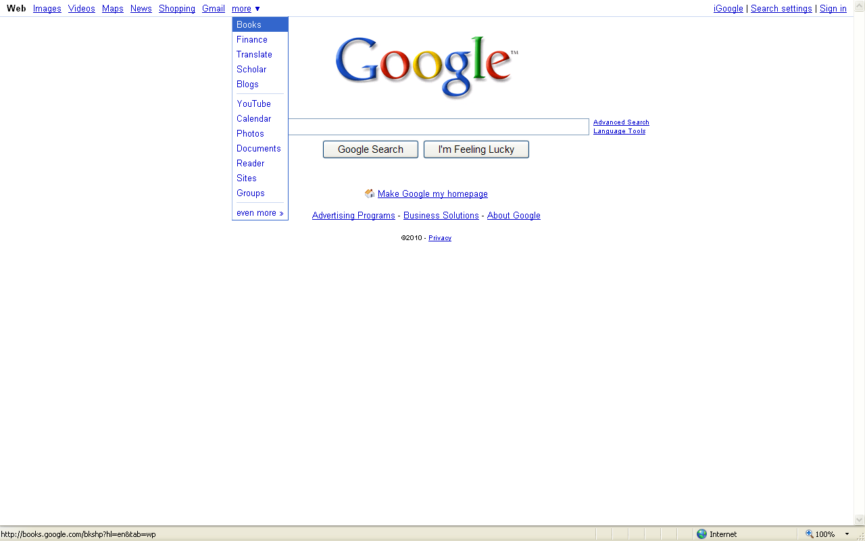
Google Books

Slide 3
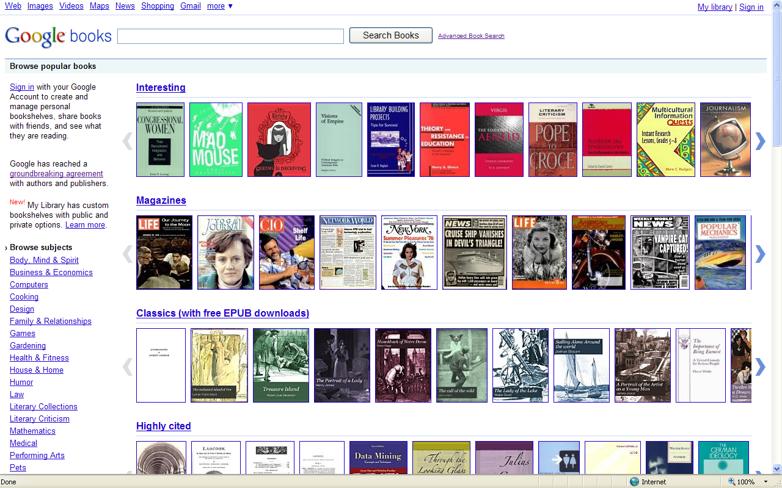
http://books.google.com

Slide 4
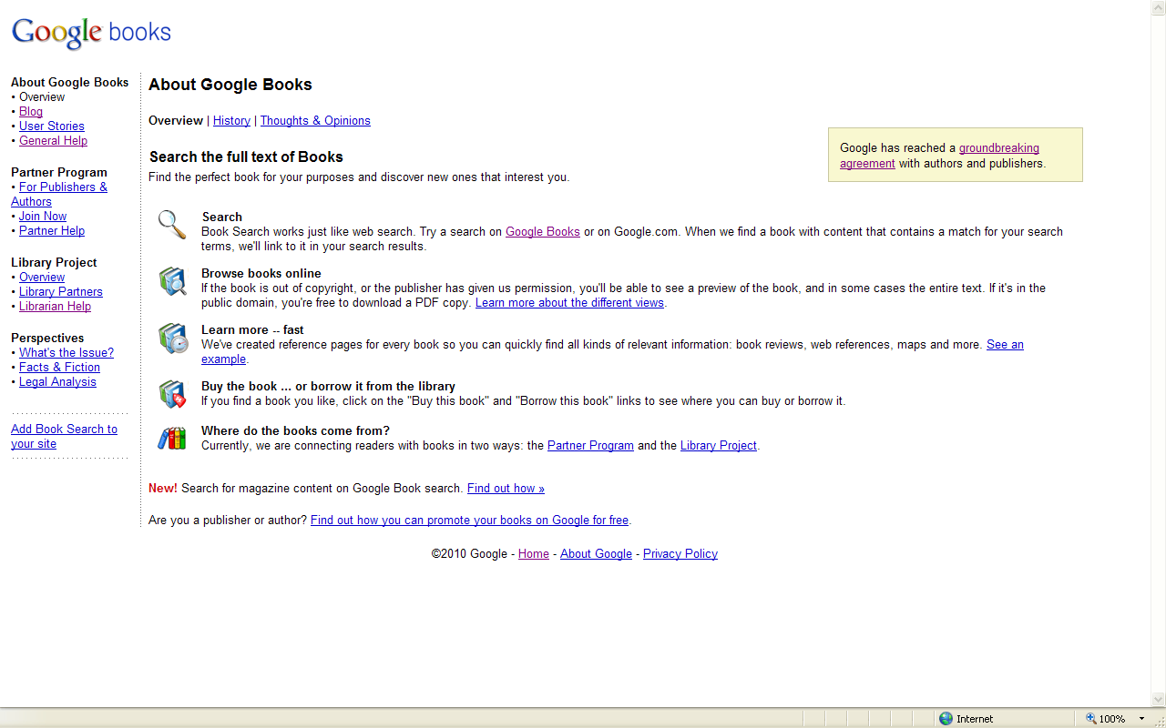
About Google Books

Slide 5
Overview of Google Book Search
Library Project
Partner Program

Slide 6
Overview of Google Book Search
Library Project
In December 2004, five participating libraries agreed to loan a book to Google for scanning, in exchange, the libraries receive a digital copy of the book.
    University of Michigan
    Harvard
    Stanford
    New York Public Library
    Oxford

Slide 7
21 Participating libraries in US, 2010

Slide 8
8 participating libraries outside US, 2010
Country Institution
Belgium Ghent University Library
England Oxford University
France Lyon Municipal Library
Germany Bavarian State Library
Japan Keio University Library
Spain National Library of Catalonia
University Complutense of Madrid
Switzerland University Library of Lausanne

Slide 9
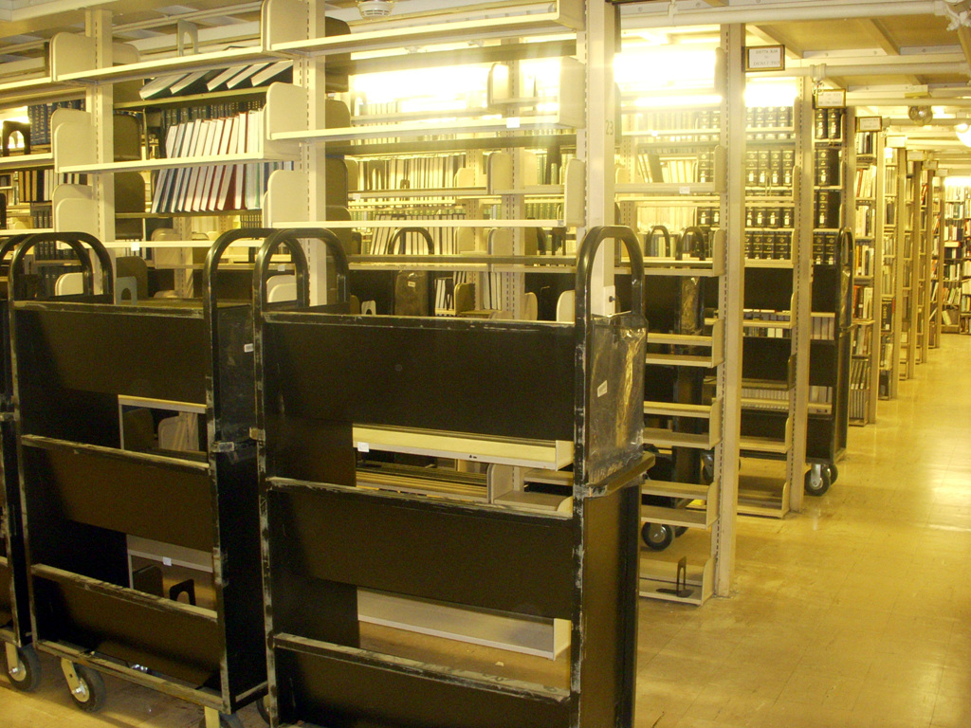
A picture of a library book stack at the University of Michigan

Slide 10
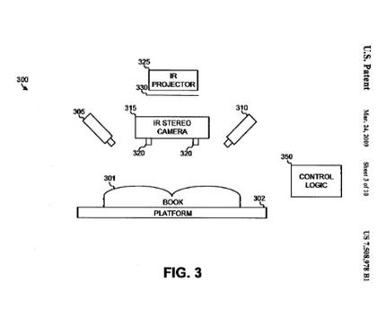
Google scanner

Slide 11
Overview of Google Book Search
Partner Program
By submitting a digital or physical copy of a
book to be displayed in Google, authors & publishers make it discoverable to Google users from around the world.
Users see a limited preview of the book, as well as a series of links to purchase the title at major online retailers or to borrow the title from a local library.
Over 10,000 publishers and authors from 100+ countries are participating in the Book Search Partner Program.

Slide 12
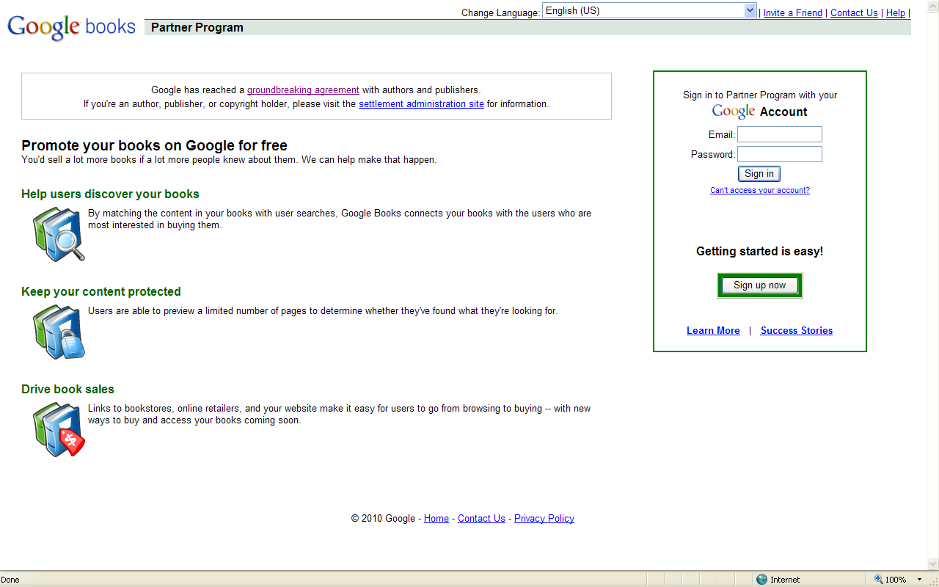
Overview of Google Book Search
Partner Program

Slide 13
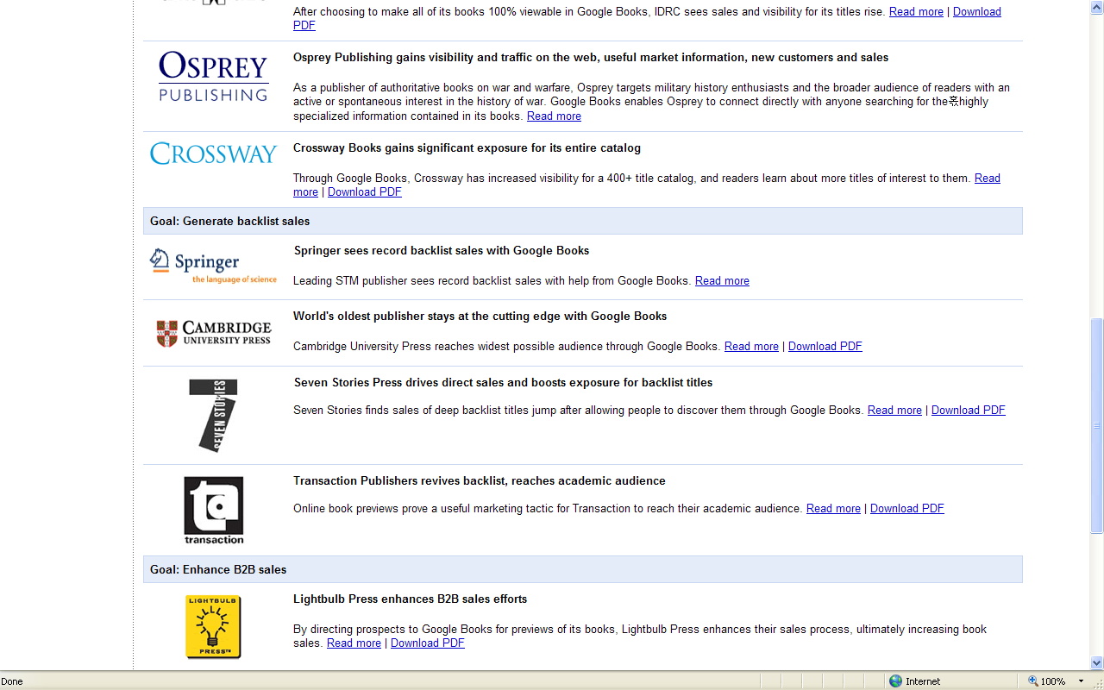
Overview of Google Book Search
Partner Program

Slide 14
Features of Google Books Search
Search options
View options
Download
Search from an entire content of a book
Get This book (Buy or Borrow)
Maps
Other editions

Slide 15
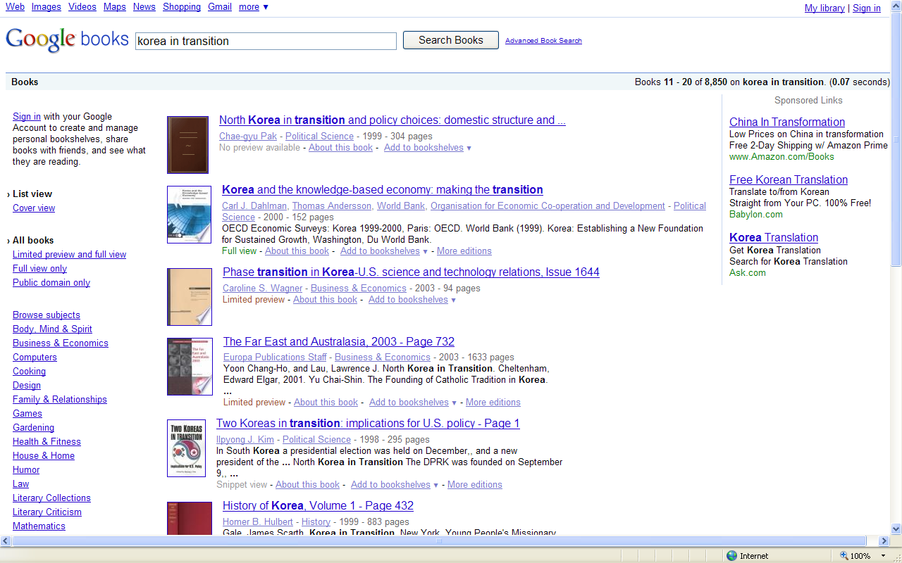
Search in original scripts
(English, Han’gul, Hancha, etc.)

Slide 16
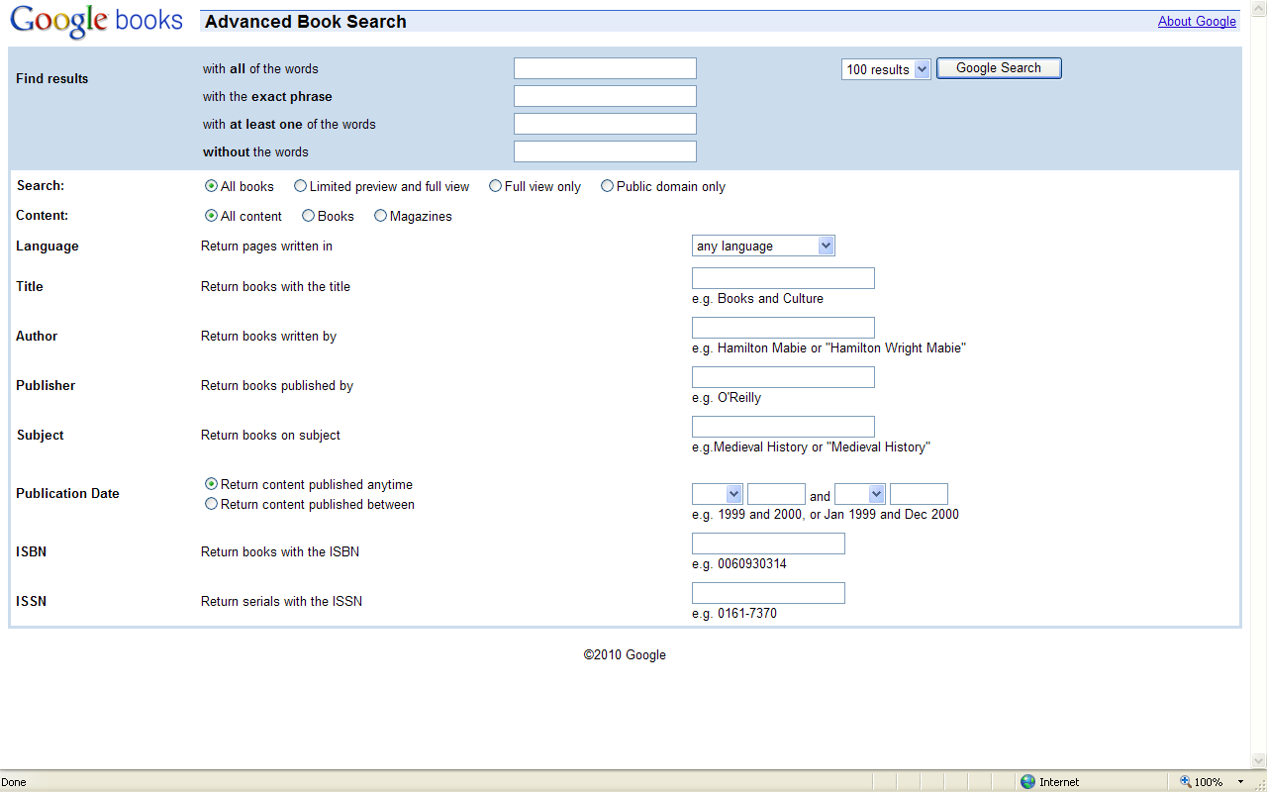
Advanced Book search
Keyword
Language
Title
Author
Publisher
Subject
Publication dates
ISBN
ISSN

Slide 17
4 different view options
Full view
Snippet view
Limited view
No preview

Slide 18
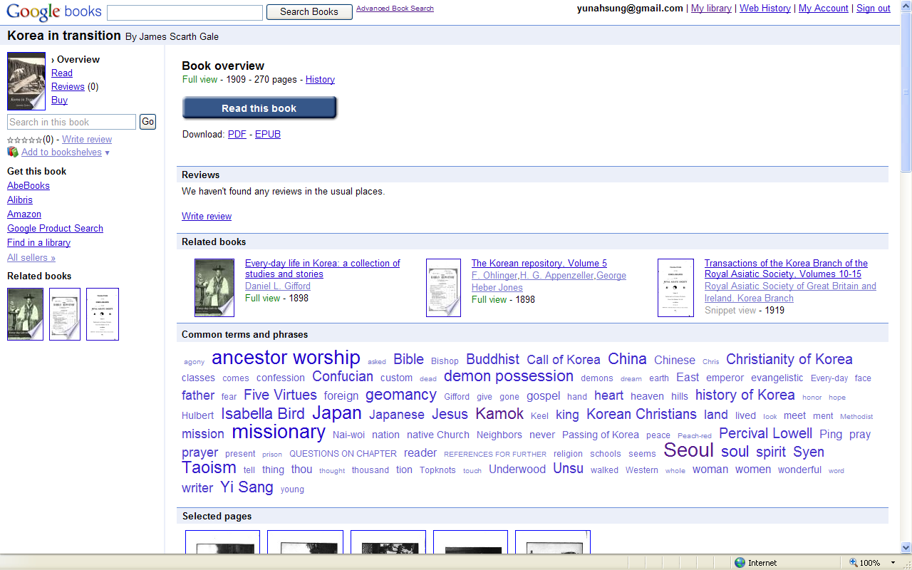
Features in Full view option ex) Korea in transition by James Scarth Gale published in 1909
Read
Download
Reviews
Related books
Common terms and phrases

Slide 19
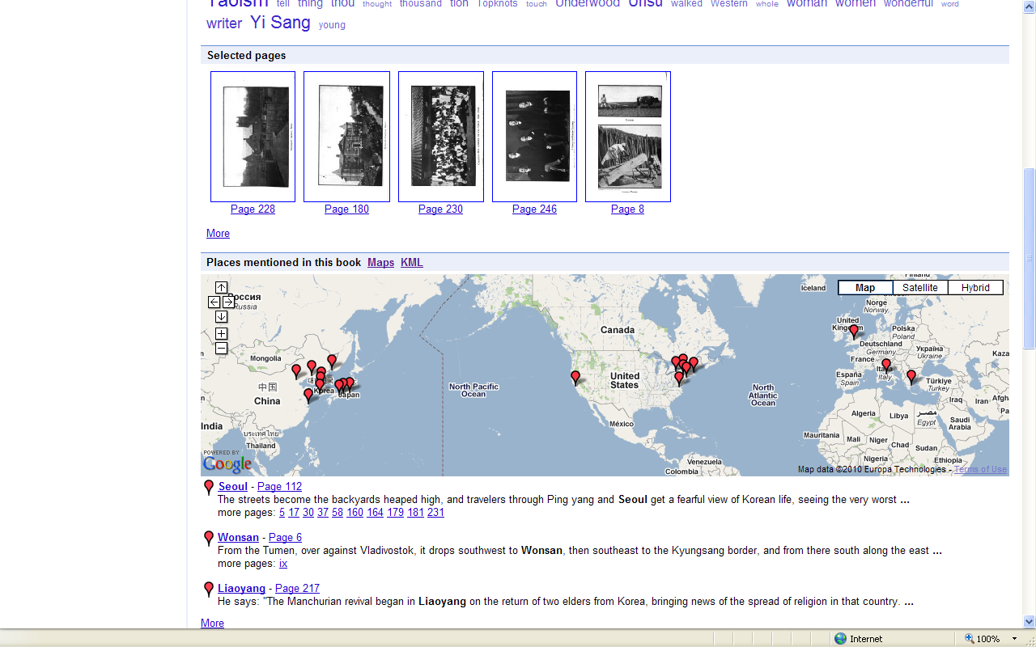
Features in Full view option
Selected Pages
Places mentioned in this book

Slide 20
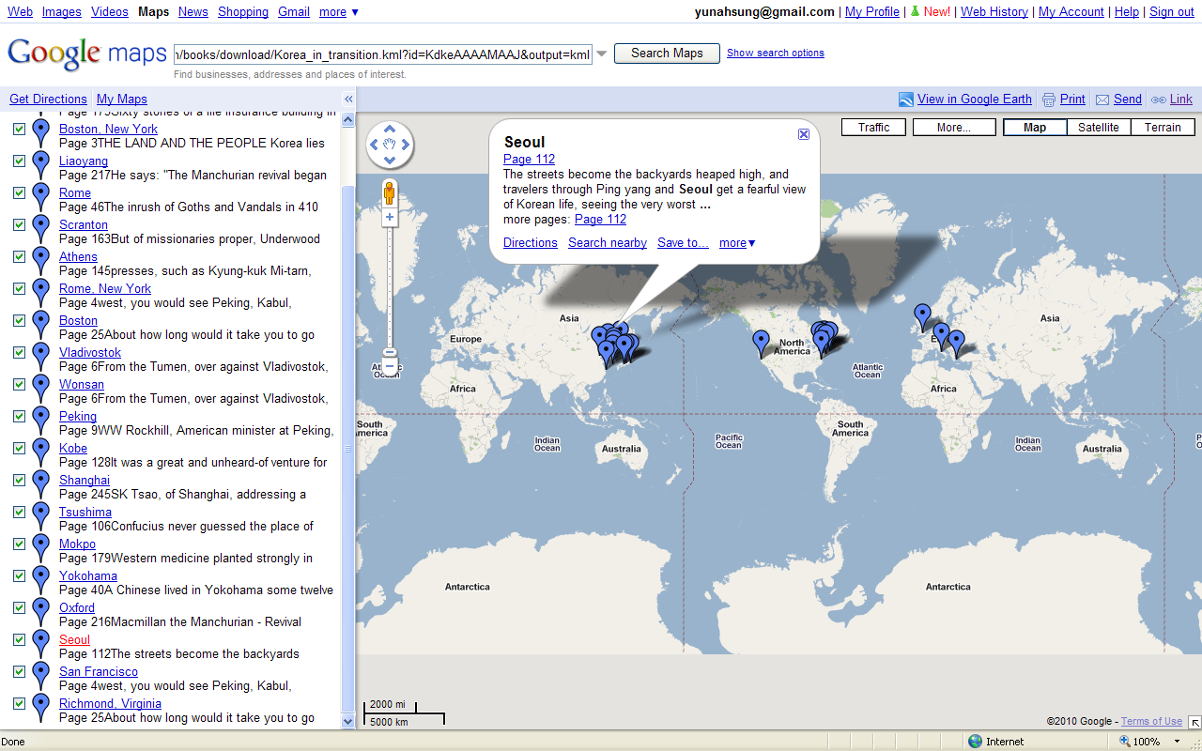
Features in Full view option
Places mentioned in this book

Slide 21
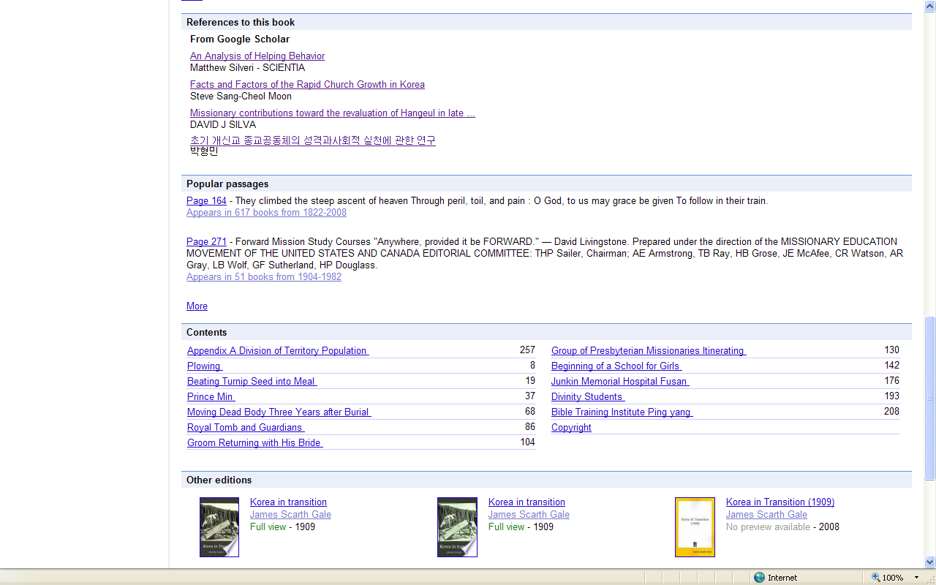
Features in Full view option
References to this book
Popular passages
Contents
Other editions

Slide 22
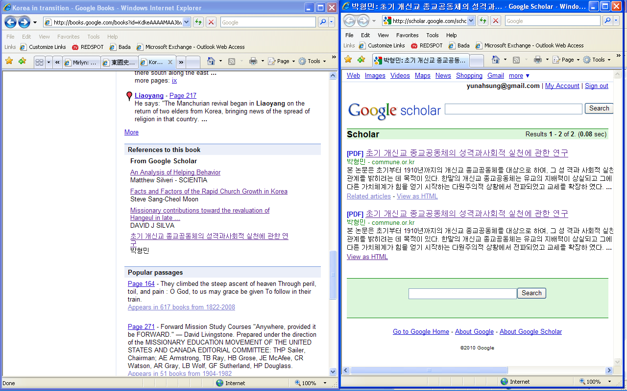
Features in Full view option
References to this book

Slide 23
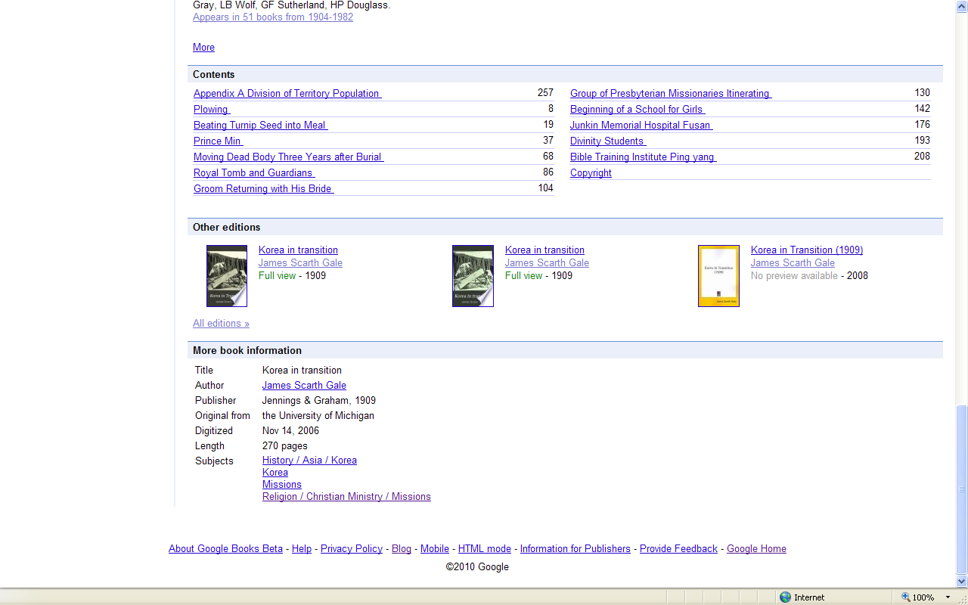
Features in Full view option
More book information
Title Korea in transition
Author James Scarth Gale
Publisher Jennings & Graham, 1909
Original from the University of Michigan Digitized Nov 14, 2006
Length 270 pages
Subjects History / Asia / Korea

Slide 24
Features in Full view option
Read this book
Read this book

Slide 25
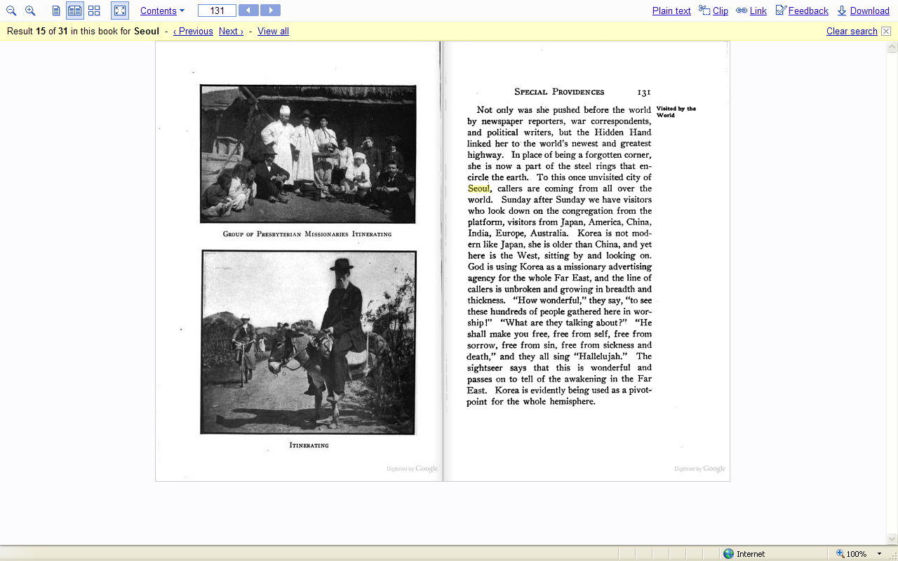
Features in Full view option
Read this book
Zoom out
Zoom in
One page
Two pages

Slide 26
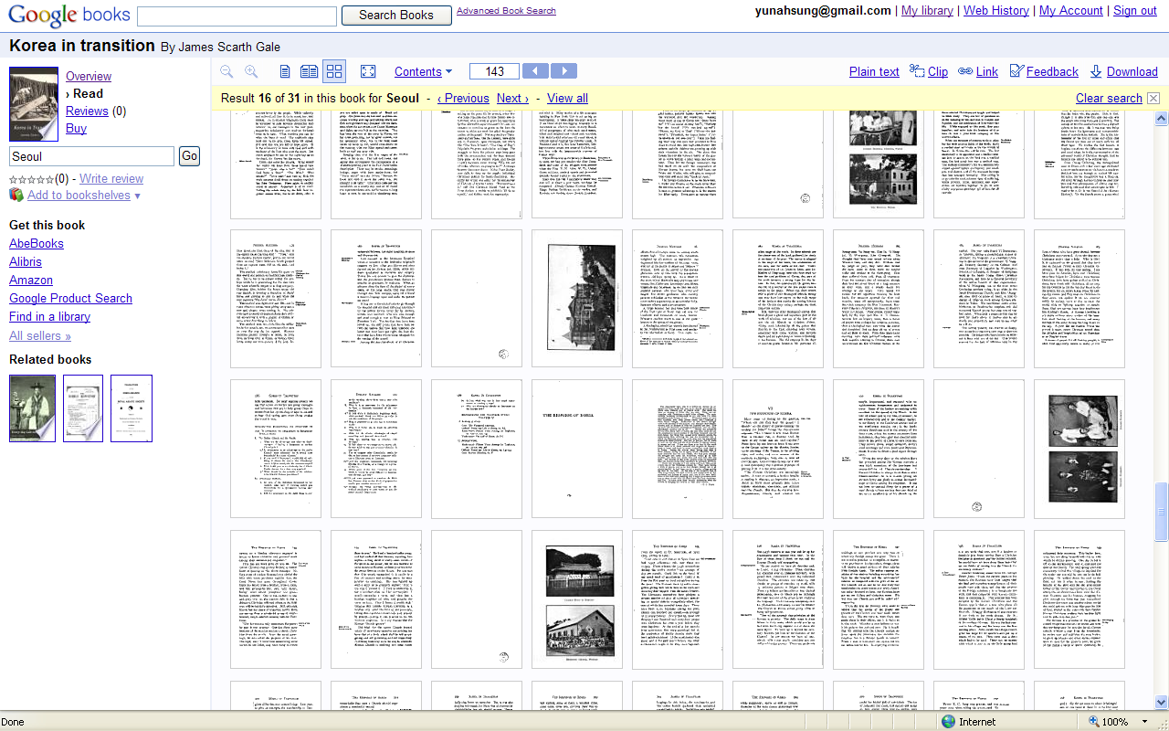
Features in Full view option
Read this book
Thumbnails

Slide 27
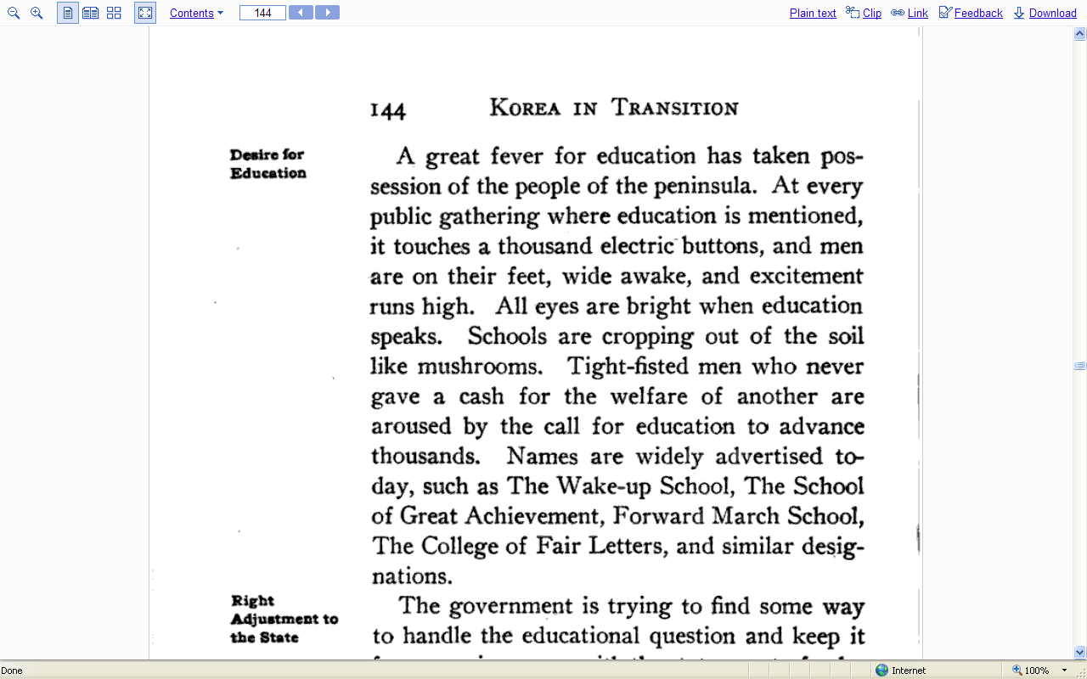
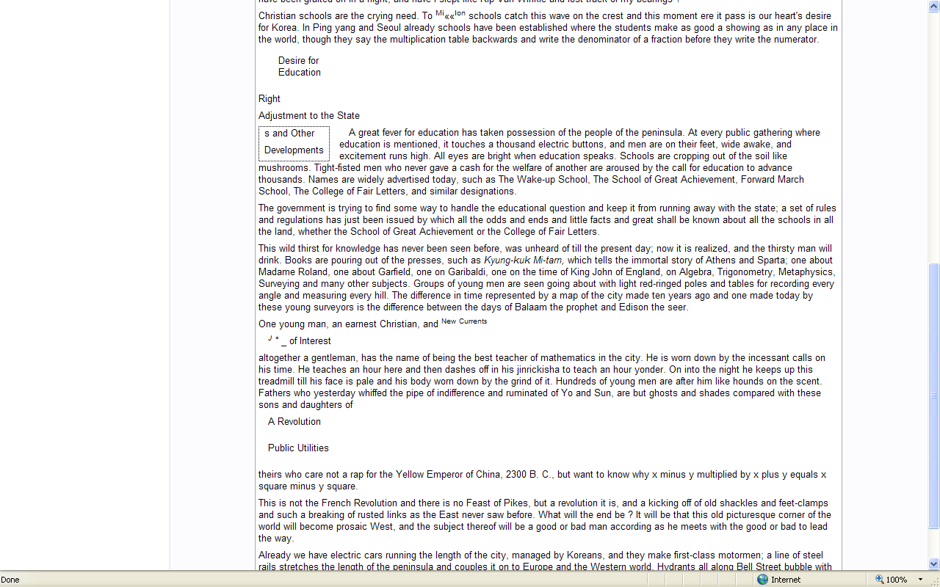
Features in Full view option
Read this book
Page images vs. Plain Text

Slide 28
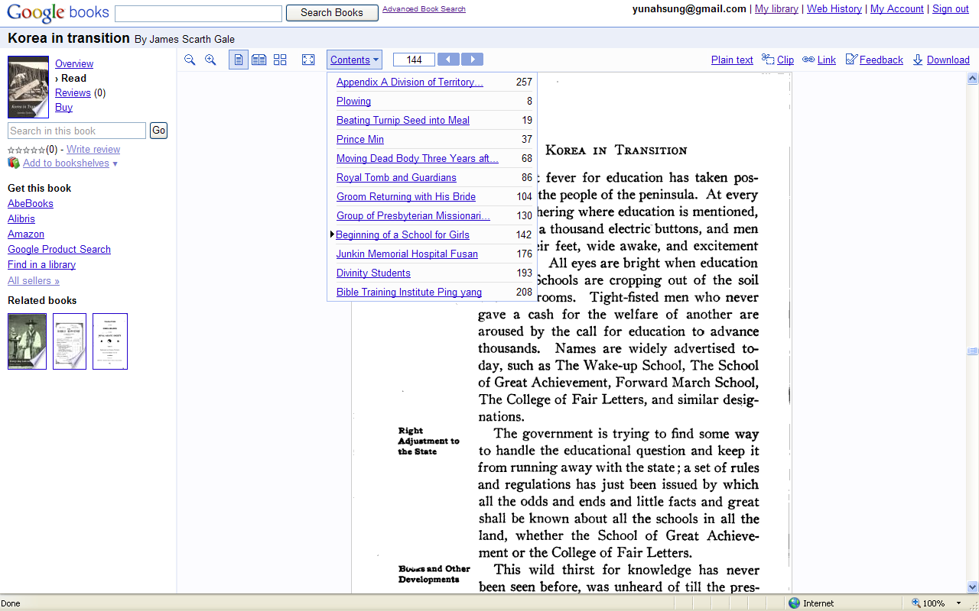
Features in Full view option
Read this book
Table of Contents
Get this book
Boo stores
Find in a library
All sellers

Slide 29
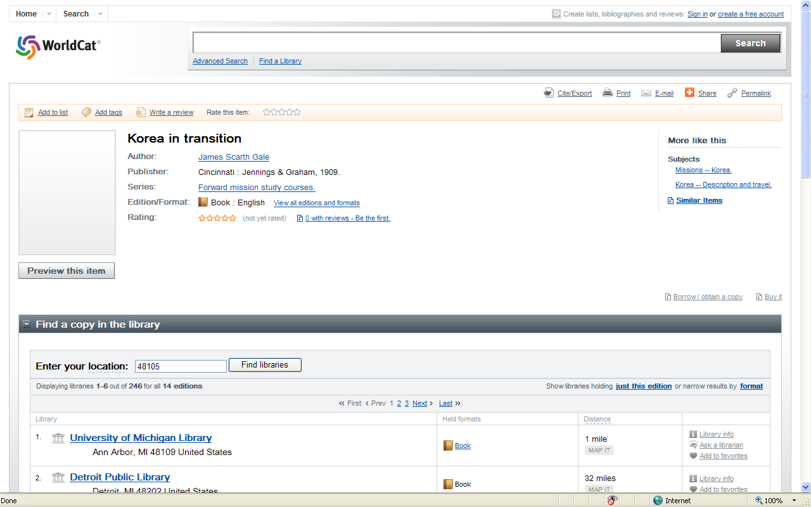
Features in Full view option
Find in a library

Slide 30
Features in Full view option
Search in this book

Slide 31
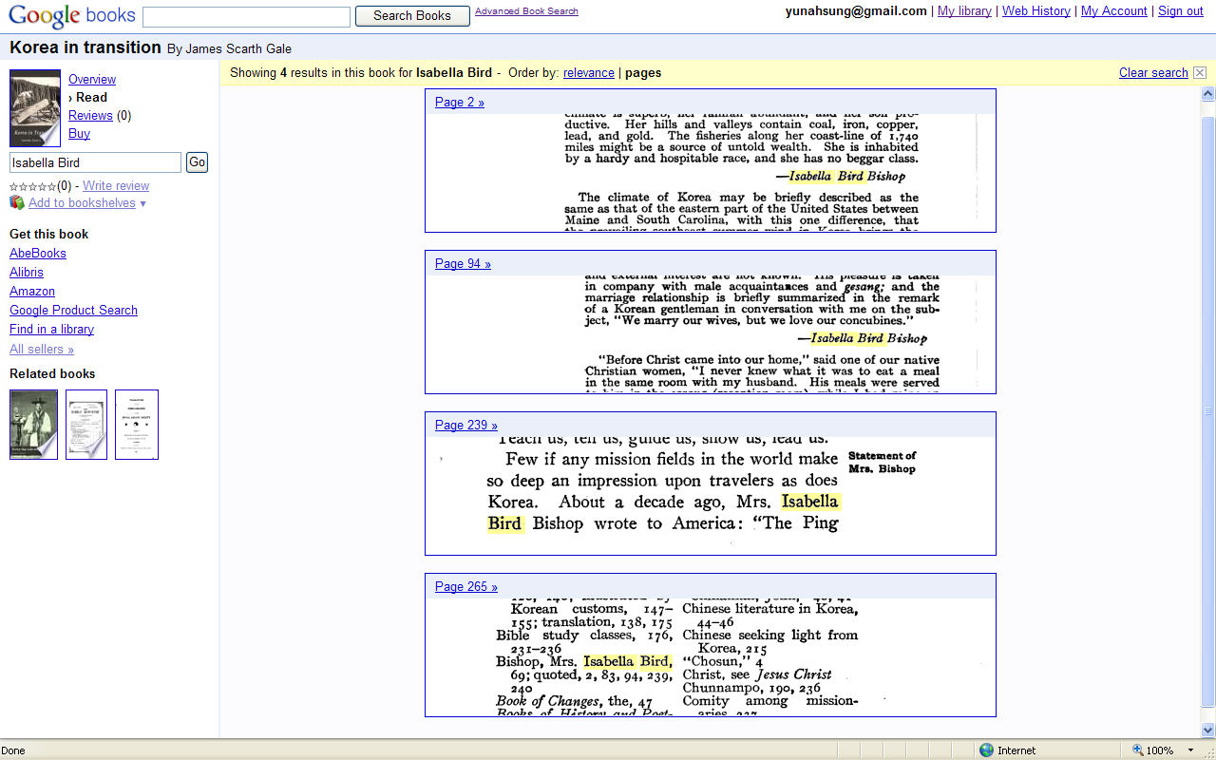
Features in Full view option
Search in this book
Search results page for “Isabella Bird”

Slide 32
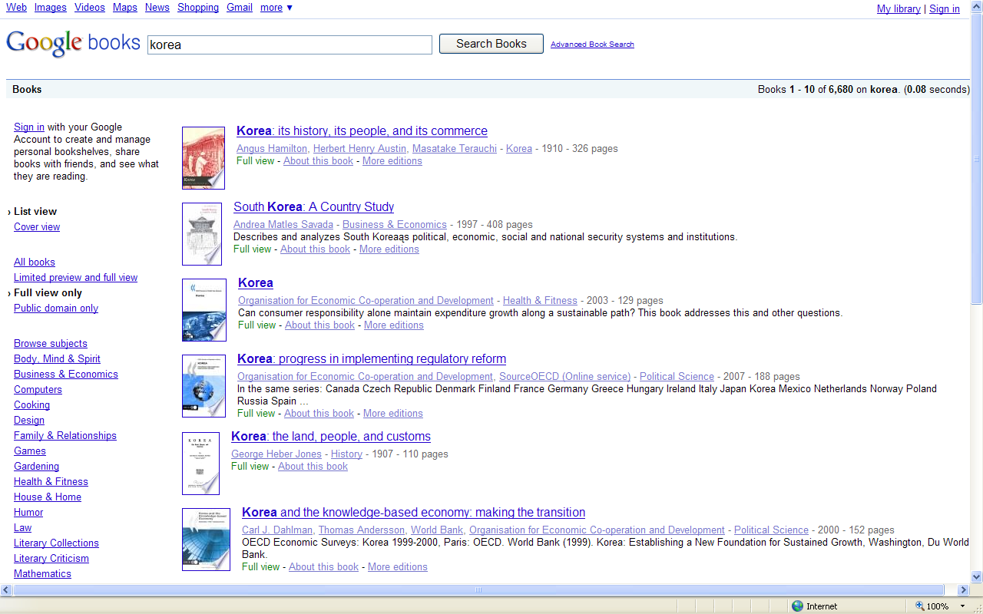
Public domain works on “Korea”

Slide 33
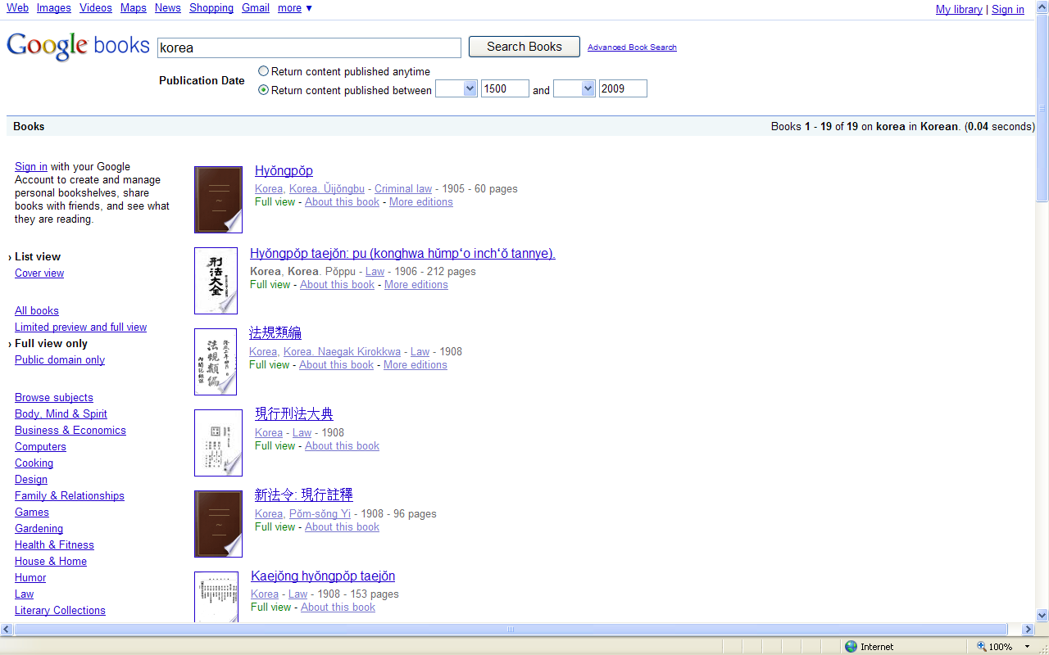
Public domain works on “Korea” in Korean

Slide 34
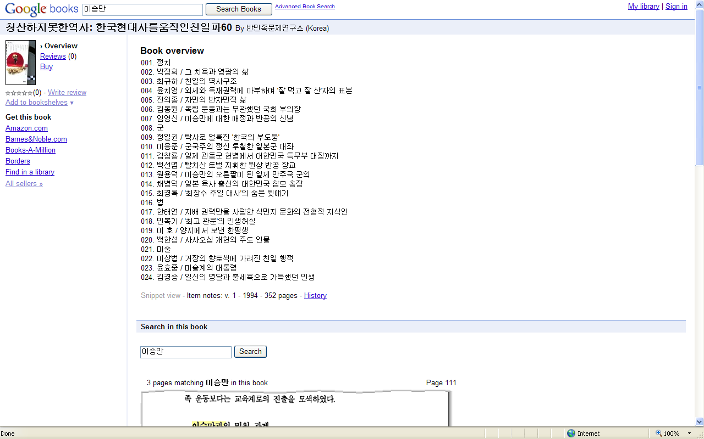
Features in Snippet view option
Books from Google Library Project
Book overview (Table of Contents)
Get this book
Find in a library

Slide 35
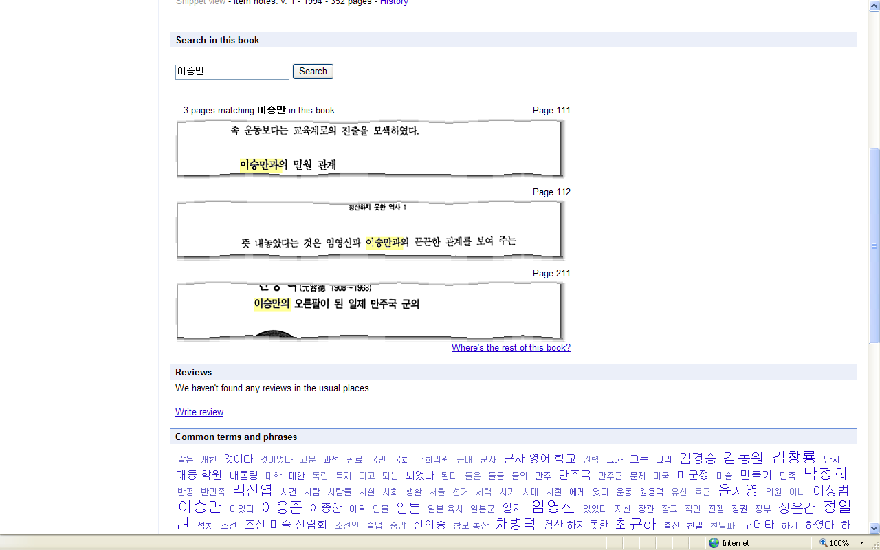
Features in Snippet view option
Search in this book

Slide 36
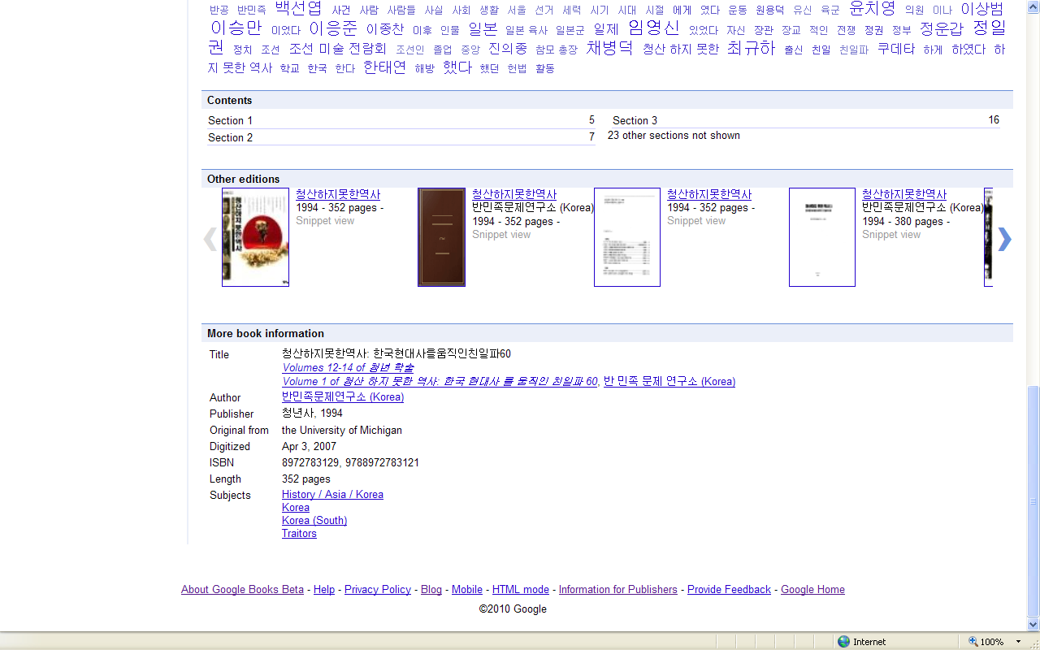
Features in Snippet view option
Common terms and phrases
Other editions
More book information
  Title
  Author
  Publisher
  Original from
  Digitized
  ISBN
  Length
  Subjects

Slide 37
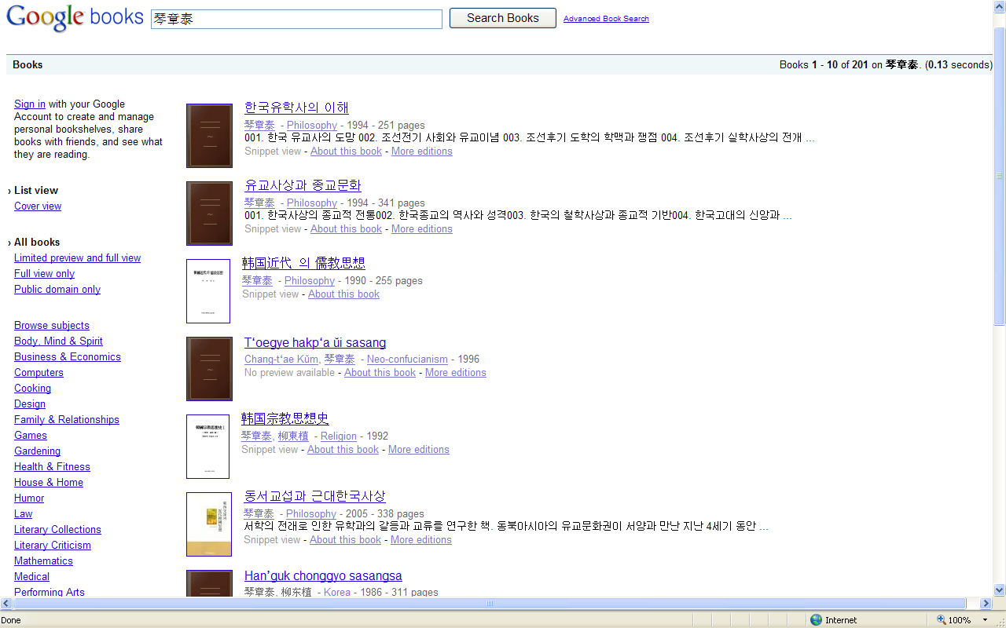
Features in Snippet view option ex) 금장태, 琴章泰
Digitized from the collection of
Univ. of Michigan
or
Univ. of California Library System

Slide 38
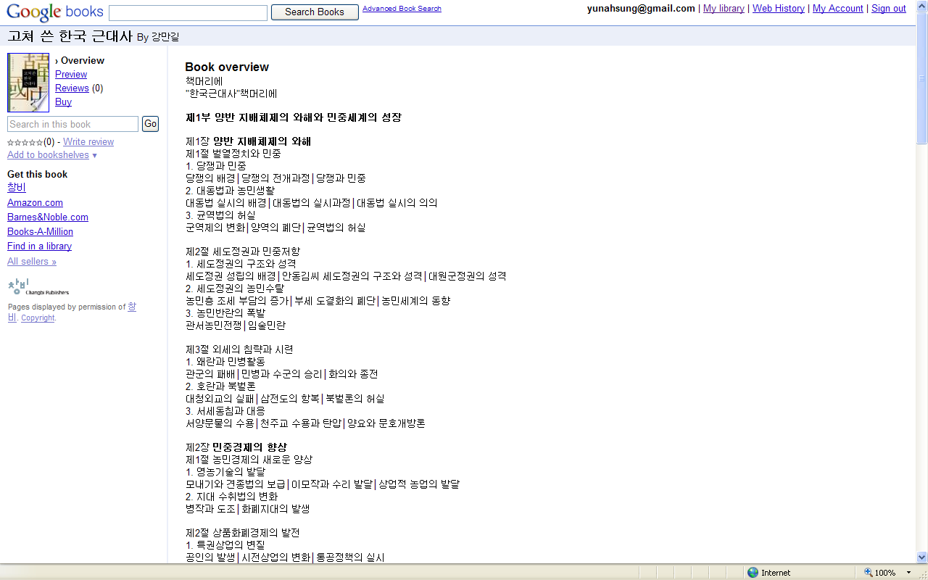
Features in Limited view option
Books from Google Partner Program
Book overview
(Table of contents)
ex) 고쳐 쓴 한국 근대사 by 강만길

Slide 39
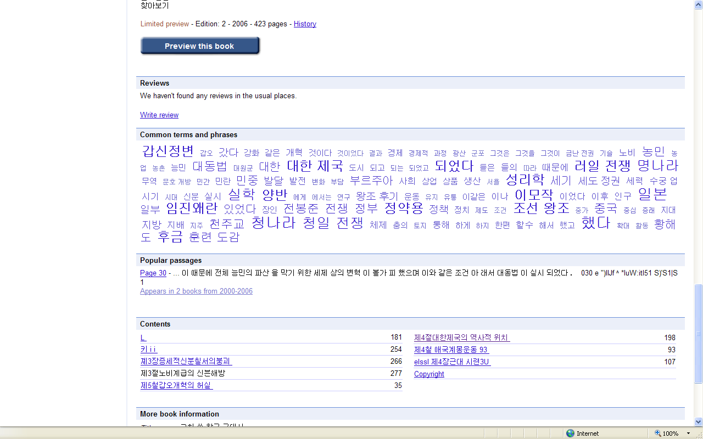
Features in Limited view option
Preview this book
Reviews
Common terms and phrases
Popular passages
Contents
More book information

Slide 40
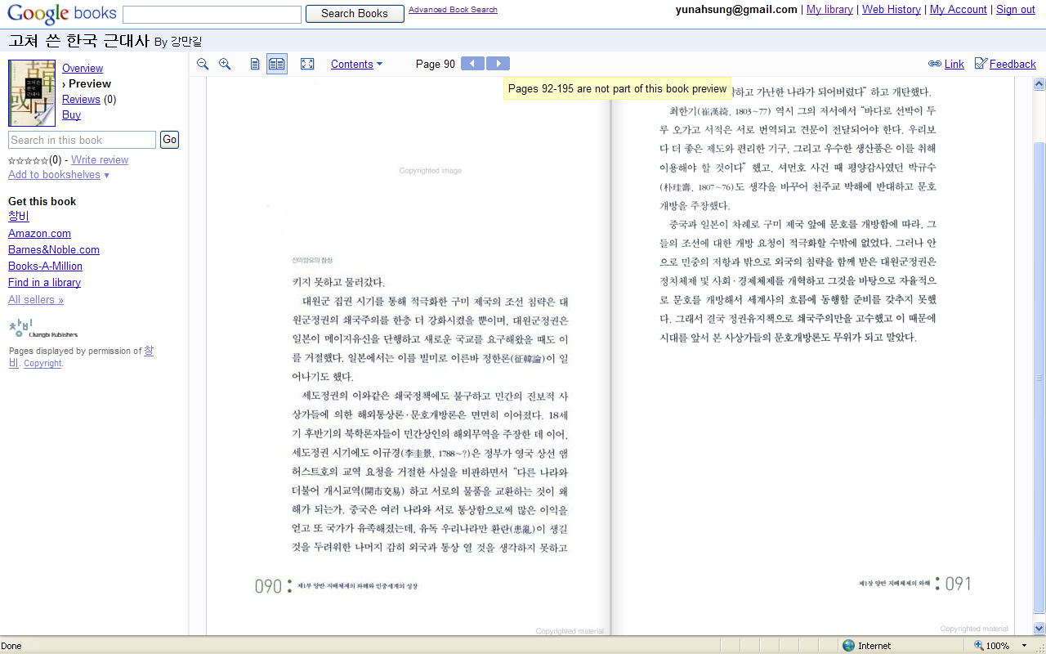
Features in Limited view option
Preview this book

Slide 41
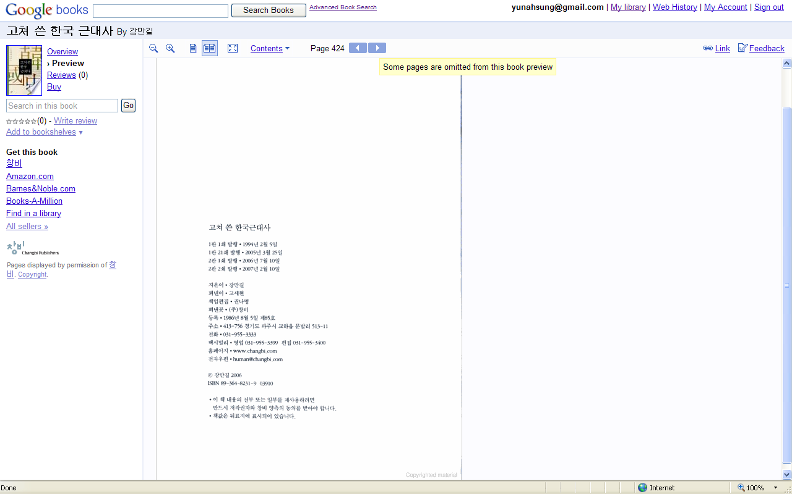
Features in Limited view option

Slide 42
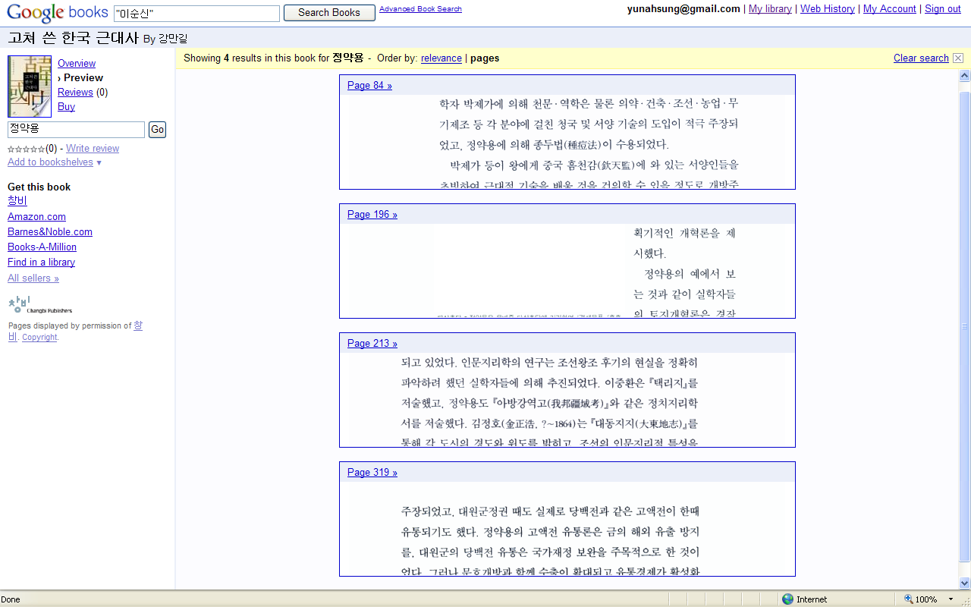
Features in Limited view option
Search in this book
Get this book
Find in a library
Google Ad

Slide 43
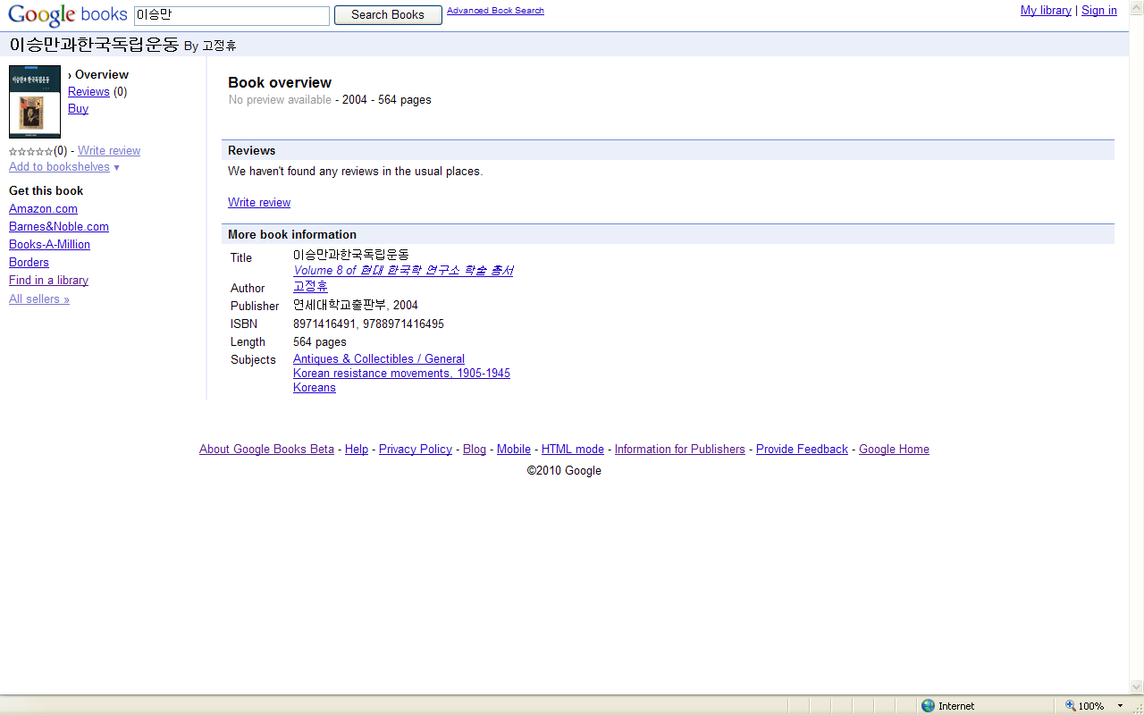
No preview available
Books not scanned by Google
Book overview
Reviews
More book information
  Title
  Author
  Publisher
  ISBN Length
  Subjects
Get this book
Find in a library

Slide 44
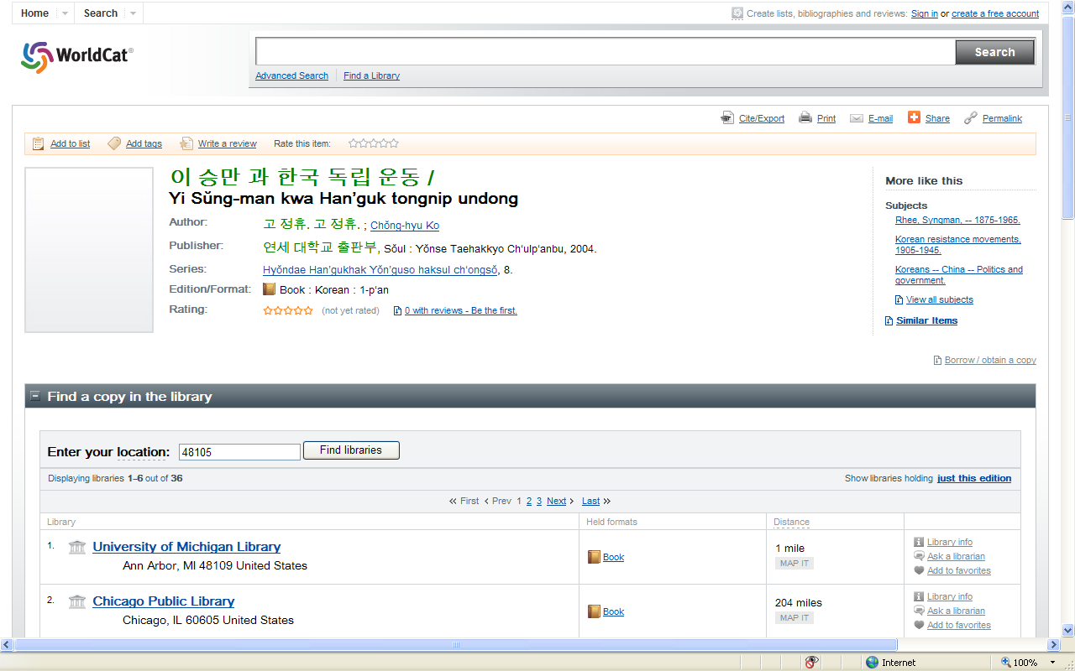
No preview available
Find in a library

Slide 45
Pending issues & Further improvement
Copyright
Optical Character Recognition (OCR)
Quality of Scanning
Too many search results
Long-term stability

Slide 46
Univ. of Michigan guidelines
Copyright
Place of publication | Publication date | Other condition | Copyright status
US | Any date | US Govt. Pub | Public Domain
US | 1923 or later | Not US Govt. Pub | In-Copyright
US | 1922 or earlier | Assuming not previously published outside US | Public Domain
Outside US | 1909 or later |  | In-Copyright
Outside US | 1908 or earlier | US IP address | Public Domain in US
Outside US | 1869-1908 | Non-US IP address | In-Copyright
Outside US | 1868 or earlier | Non-US IP address | Public Domain

Slide 47
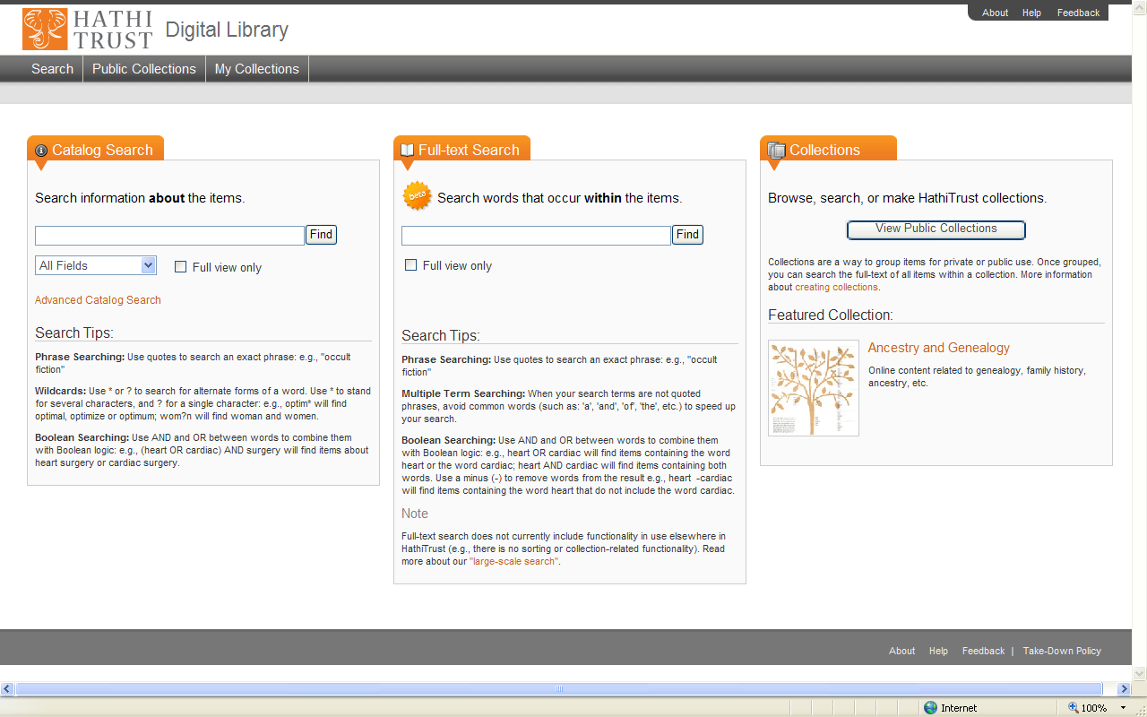
Hathi Trust Digital Library http://catalog.hathitrust.org/

Slide 48
Hathi Trust Digital Library
Collaboration of university libraries to establish a repository to archive and share digitized collections
CIC Libraries + 14 other Libraries
Digitized by Google + Digitized locally
Currently 5.5 million volumes digitized
15% of them in the public domain

Slide 49
Hathi Trust Digital Library
Univ. of Chicago | Columbia Univ.
Univ. of Illinois | Univ. of Illinois at Chicago
Indiana Univ. | Univ. of Virginia
Univ. of Iowa | California Digital Library
Univ. of Michigan | Univ. of California Berkeley
Michigan State Univ. | Univ. of California Davis
Univ. of Minnesota | Univ. of California Irvine
Northwestern Univ. | Univ. of California Los Angeles
Ohio State Univ. | Univ. of California Merced
Pennsylvania State Univ. | Univ. of California Riverside
Purdue Univ. | Univ. of California San Diego
Univ. of Wisconsin-Madison | Univ. of California San Francisco
 | Univ. of California Santa Barbara
 | Univ. of California Santa Cruz

Slide 50
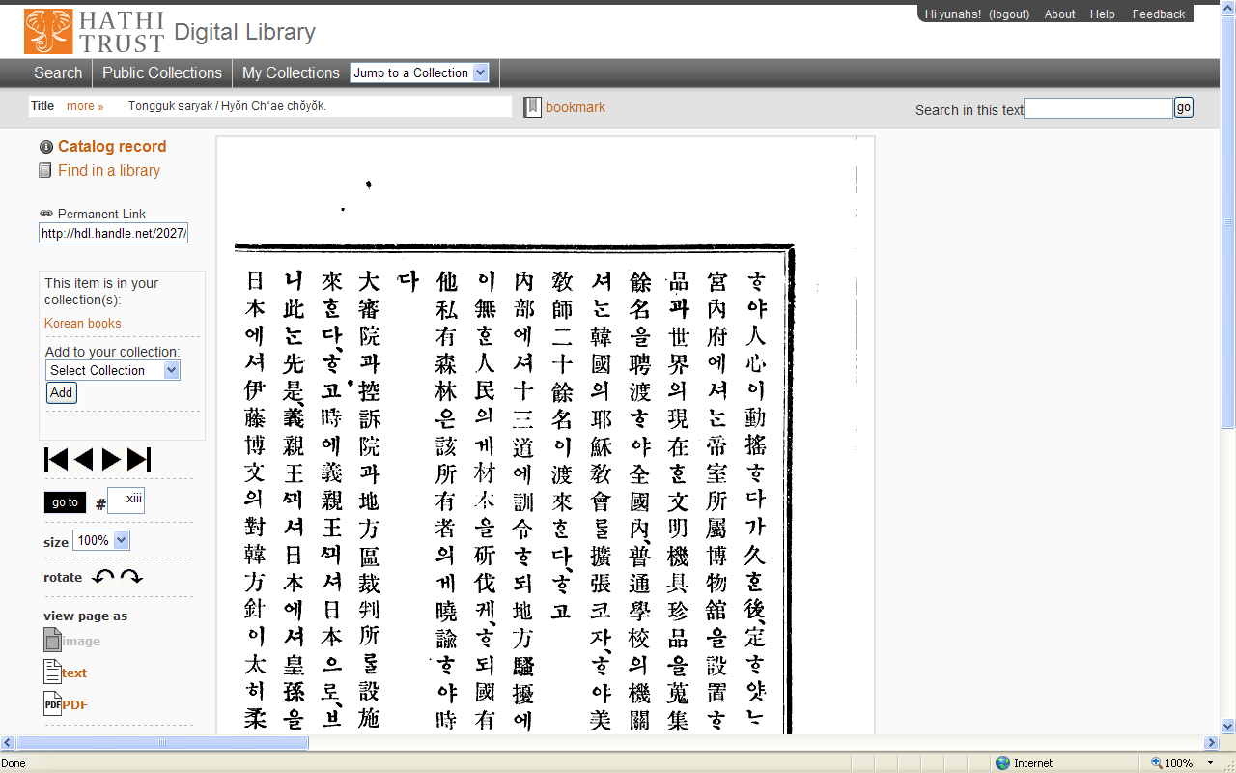
Hathi Trust Digital Library
東國史略
Tongguk saryak
玄采著譯
Hyŏn Ch’ae chŏyŏk
Kyŏngsŏng : Chungang Sŏgwan, [1908]

Slide 51
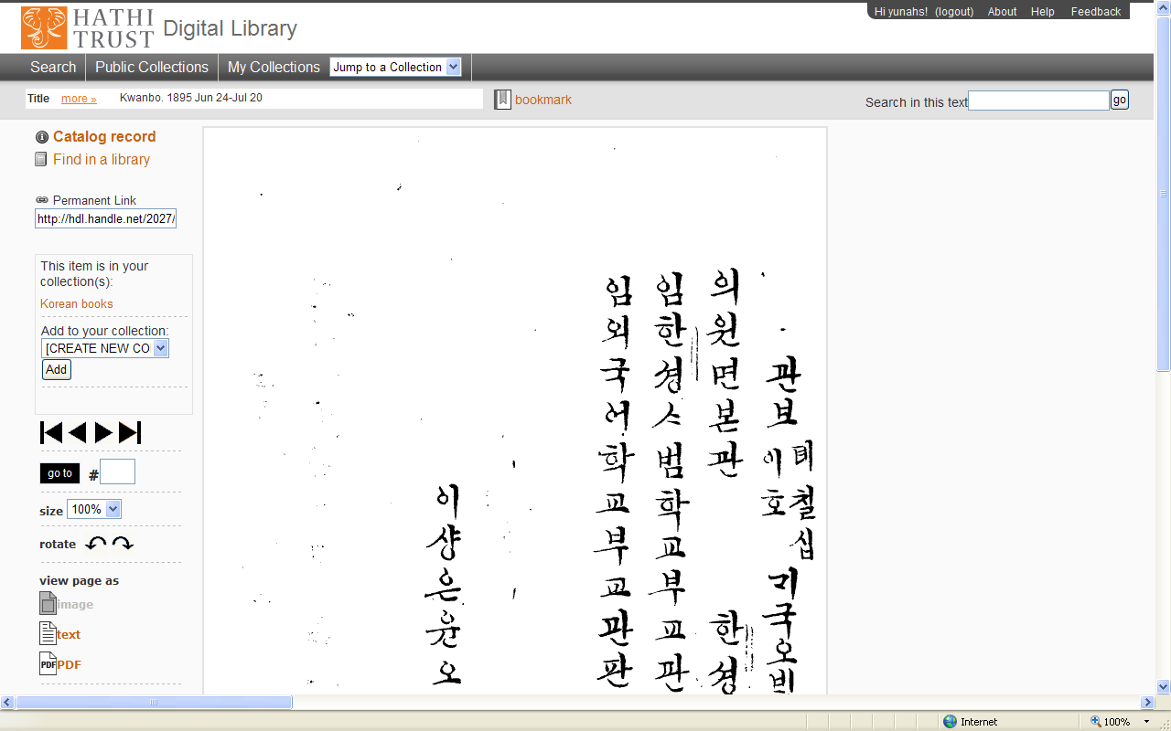
Hathi Trust Digital Library
官報
Kwanbo
内閣 記錄局 官報課
Naegak Kirokkuk Kwanbokwa
1894-

Slide 52
Advantages of Google Books
Full-text availability
Free from the limitations of time and location
Open to any users
Free of charge
Download available for public domain works
No need to know Korean Romanization rules

Slide 53
Advantages of Google Books
Browse books online
Simple steps for Book selection
Time saving
Convenience
Preview before getting a copy of the physical book

Slide 54
Advantages of Google Books
Multiple simultaneous accessibility
Increased accessibility to library collection
Easy access to high quality scholarly information
Preservation of original prints
No restriction on Circulation status
Low to No cost on digitization

Slide 55
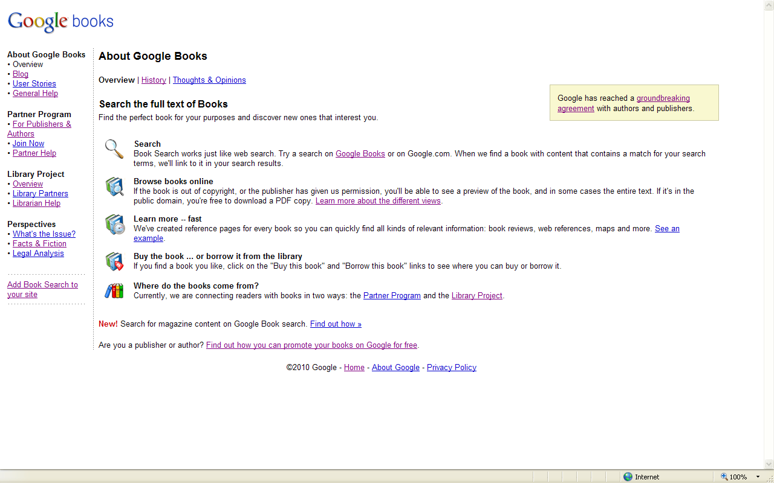
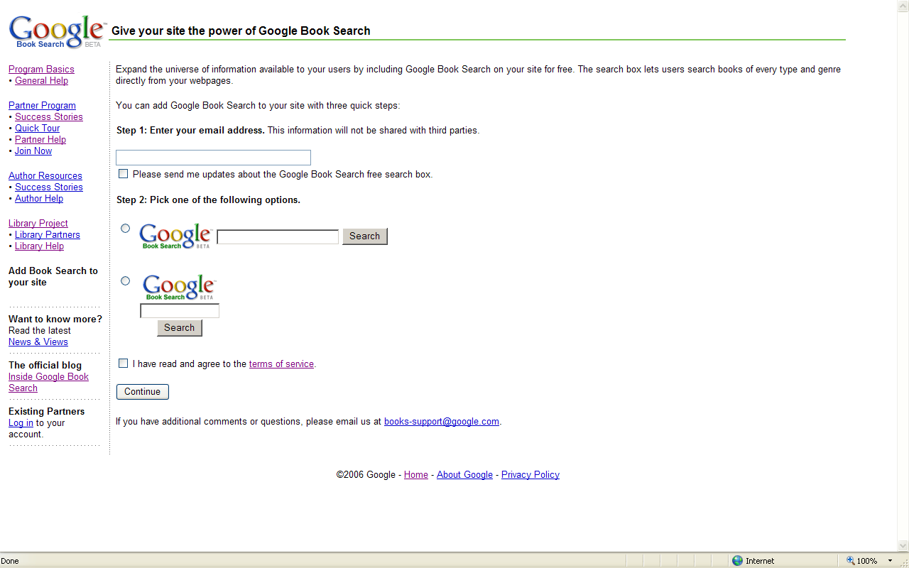
Add Book Search to your research guide
https://services.google.com/inquiry/books_email?hl=en

Slide 56
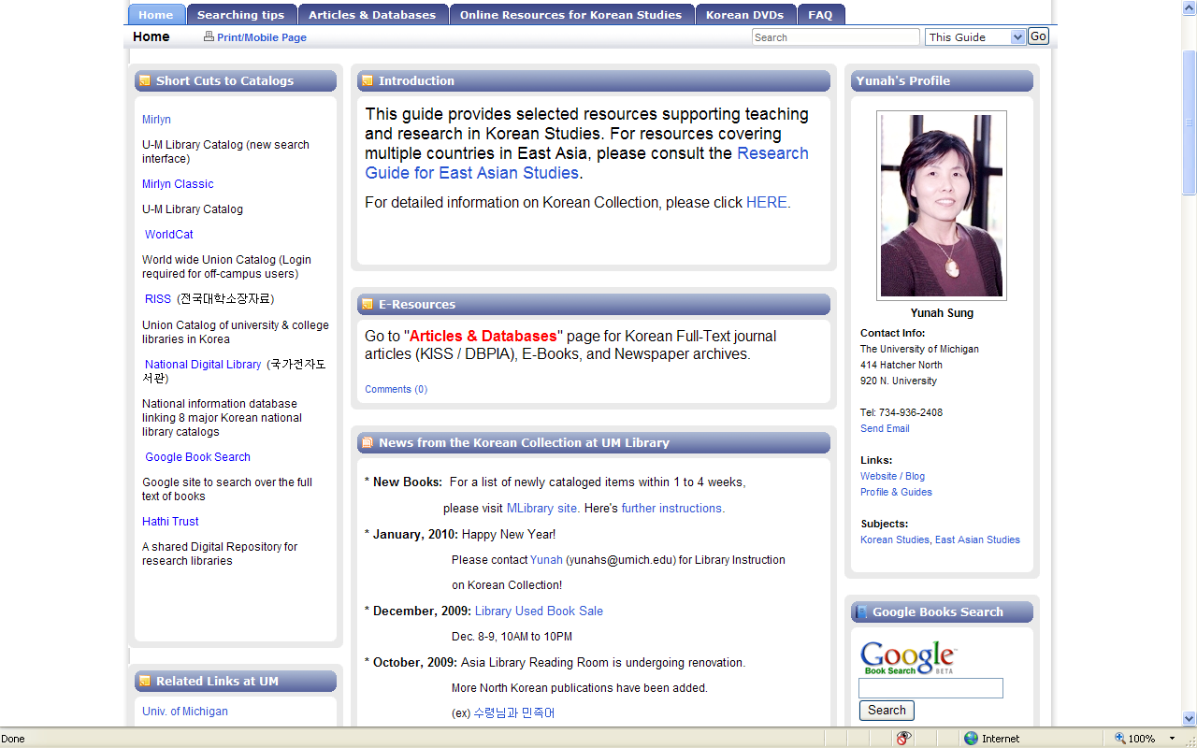
Thank you! http://guides.lib.umich.edu/koreanstudies

