Slide 1
Committee on Korean Materials 한국학 자료 위원회
March 26, 2015 4:10 – 5:10 pm
Chicago 8, Sheraton Hotel & Towers

Slide 2
Committee Members, 2014-2017
Miree Ku, Chair (Duke)
Jaeyong Chang (UC Berkeley)
Sanghun Cho (UCLA)
Mikyung Kang (Harvard)
Hyoungbae Lee (Princeton)
Jude Yang (Hawaii)

Slide 3
Committee Reports

Slide 4
The 4th Kyujanggak Workshop for Korean Studies Librarians from Overseas
제 4회 규장각 해외사서 워크숍
Date: August 19-21, 2014
Place: Kyujanggak Institute for Korean Studies, Seoul National University
Participants: 20 from 4 countries
Organizer: Kyujanggak Institute and CKM
Sponsor: Korea Foundation (KF) and Kyujanggak Institute
Lectures and Discussions on Korean Studies
Korean religious culture
History of Korean law
Korean traditional music
Research trends in modern Korean literature
Cultural significance of Hallyu
Kyujanggak Collection
The 7th Kyujanggak International Symposium for Korean Studies
August 21-22, 2014
East Asian Print Culture and Archives: Formation and Dissemination of Knowledge

Slide 5
The 7th Koreanology Librarian Workshop
제 7회 해외 한국학 사서 워크숍
Date: October 19-25, 2014
Place: National Library of Korea, Seoul
Participants: 19 from 6 countries
Organizer & Sponsor: National Library of Korea (NLK)
Lectures and Discussions on Korean Studies Librarianship

Slide 6
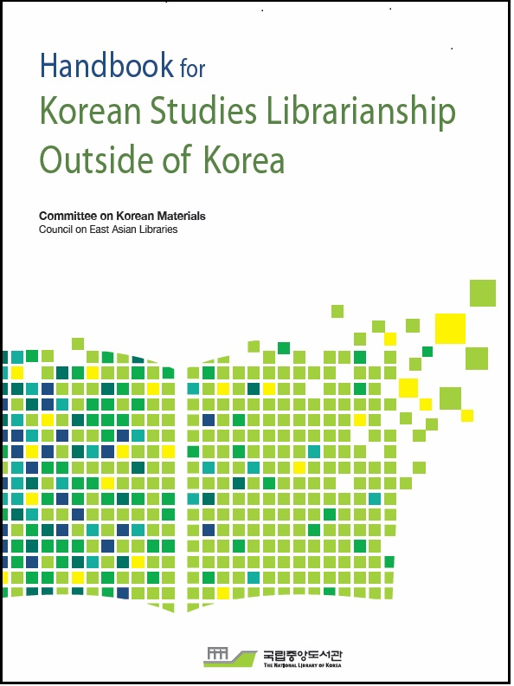
Publication of the Handbook for Korean Studies Librarianship Outside of Korea
Jointly published by
National Library of Korea (NLK)
Committee on Korean Materials (CKM)
Covers practical information on Korean Studies Librarianship
collection development methods and principles
acquisitions
cataloging
reference sources
approaches to information literacy and the liaison librarian role
in-depth bibliographies of free and fee-based electronic resources
issues related to information technology and library services
case studies of four Korean studies collections
characteristics of Korean Studies librarianship.
Print version: distributed by the NLK
Online version:
http://www.eastasianlib.org/ckm/koreanlibrarianship.html
http://www.nl.go.kr/inkslib/index.php?url=/data/view/845
Contributors
19 authors
2 editors: Philip Melzer and Nancy Sack

Slide 7
Collective Subscription of Korean Studies E-resources
2015 Korea Foundation’s Support Program
2014 e-resource support program annual report deadline: January 31, 2015
2015 application deadline: February 15, 2015
Notification: the end of March, 2015
Subcommittee on Korean Studies Resources
Hyoungbae Lee, Princeton University (Chair)
Mikyung Kang, Harvard University
Sanghun Cho, UCLA

Slide 8
Welcome!!!
Newcomers & Guests

