Slide 1
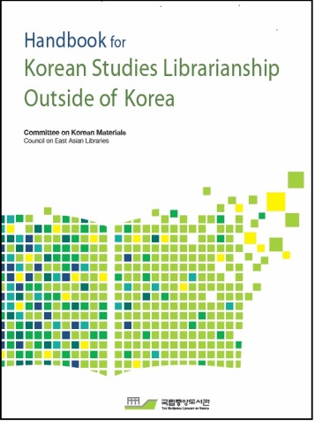
Panel Discussions
Handbook Editorial Board Members
Erica S. Chang, University of Hawaii at Manoa
Mikyung Kang, Harvard University
Yunah Sung, University of Michigan
Hyokyoung Yi, University of Washington
Hyoungbae Lee, Princeton University

Slide 2
Ch 2. Acquisitions and Collection Development
Collection Development (Hana Kim)
Producers and Distributors of Korean Language Materials (Jaeyong Chang)
Acquisitions: Approval Plan (Youngsim Leigh)
Acquisitions: Firm Orders (Mikyung Kang)
Gift and Exchange Program (Helen Kim, Yunah Sung)

Slide 3
Ch 3. Cataloging
Romanization (Erica Chang)
Textual Printed Monographs (Jee-Young Park)
Textual Printed Serials (Erica Chang)
Moving Image Materials (Erica Chang)
Sound Recordings (Eunseung Oh)
Scores (EunHee Nah)
Maps (Hee-Sook Shin)
Online Textual Resources (Erica Chang)
RDA Tools and Resources (Jee-Young Park)
Korean Cataloging Outsourcing (Eunseung Oh)
Subject Headings (Erica Chang)

Slide 4
Ch 4. Information Literacy, Faculty Liaison, Community Outreach and Reference Tools
Library Instruction/Information Literacy (Jude Yang)
Faculty Liaison and Community Outreach Activities (Hana Kim)
Ask a Korean Studies Librarian/Reference Services (Hyokyoung Yi)
Basic Reference Sources in Print Format (Kyungmi Chun)

Slide 5
Ch 5. Information Technology
Korean Fee-based Online Resources (Mikyung Kang)
Free Electronic Resources for Korean Studies (Hee-sook Shin)
English Databases for Korean Studies (Kyungmi Chun)
Technology and Library Services (Hyoungbae Lee)
Korean Studies Electronic Resources: Purchase and Subscription through Group Collaboration (Miree Ku)

Slide 6
Ch 6. Case Studies
Korean Collection at the University of Auckland Library (Kyu-won Hwang)
Korean Studies Collection at the University of Michigan (Yunah Sung)
Developing a Korean Studies Collection: the Case of the Monash University Library, Australia (Jung-Sim Kim)
Developing a Korean Studies Collection: the Case of Duke University (Miree Ku)

Slide 7
Ch 7. Characteristics of Korean Studies Librarianship
Essential Skills and Qualifications for Success (Joy Kim)
Opportunities, Priorities, and Facing Common Challenges (Joy Kim)

Slide 8
Comments on the handbook
Thank you, and the entire Committee on Korean Studies, for working so hard to prepare this manual. It will be enormously helpful, just as its predecessor was, especially to librarians like me who are responsible for Korean collections but have no expertise in that area. I am so grateful.
Notes:
Here are some of comments that we received regarding the handbook.

Slide 9
Comments on the handbook
The Committee on Korean Materials is doing such an outstanding job this year. The publication of this important resource has long been expected.

Slide 10
Comments on the handbook
Congratulations to the Committee on Korean Materials for the publication of the 2nd edition of this wonderful resource! I have had many occasions to refer to the previous edition, now sadly out-of-date. This new updated edition should serve an important role in guiding those involved with Korean Studies librarianship worldwide.

Slide 11
Comments on the handbook
As an "accidental" East Asian Languages and Cultures librarian, I can't thank you enough for publishing this guide. It will be invaluable as our Korean program grows.
Very useful and helpful to our work. I cannot wait to read it!

Slide 12
Comments on the handbook
This is a great contribution to the Profession and a fantastic guide to the library like ours, that does not have a Korean Studies librarian.
This is such an inclusive and helpful handbook for Korean Studies Librarianship.
This is a great tool, every library can use it locally.

Slide 13
Comments on the handbook
One of the things that always confuse simple minds if it comes to such library related publications is that librarians do have their own, very particular style guide/s on very particular areas (such as Romanization) while at the same time really doing some free-style fighting and dancing when it comes to listing bibliographic entries in their own articles (in footnotes or in the bibliography). This is a great example of that. Nicely confusing!
--From Korean Studies listserv--

Slide 14
Questions! Suggestions! Comments!

