Slide 1
Acquisitions: data loading
Mikyung Kang
Harvard-Yenching Library, Harvard University

Slide 2
What are Dataloads?
Orders:
Order Loader (MARC)
EDI Orders (EDI)
Invoices:
EDI Invoices (EDI)
XML Invoices (MARC)

Slide 3
Definitions
Order Loader (MARC files)
Nightly automated process that loads a bibliographic record and can create: holdings record, item record, and order
EDI Orders (EDI - Electronic Data Interchange files)
Electronic orders sent to the vendor through Aleph
XML Invoices (MARC files)
Electronic invoices created at Harvard with the Order Loader
EDI Invoices (EDI files)
Electronic invoices sent by the vendor

Slide 4
Records created by data loading
Bibliographic record
Holding record
Order record
Item record with machine-generated barcode#
Invoice record with line items

Slide 5
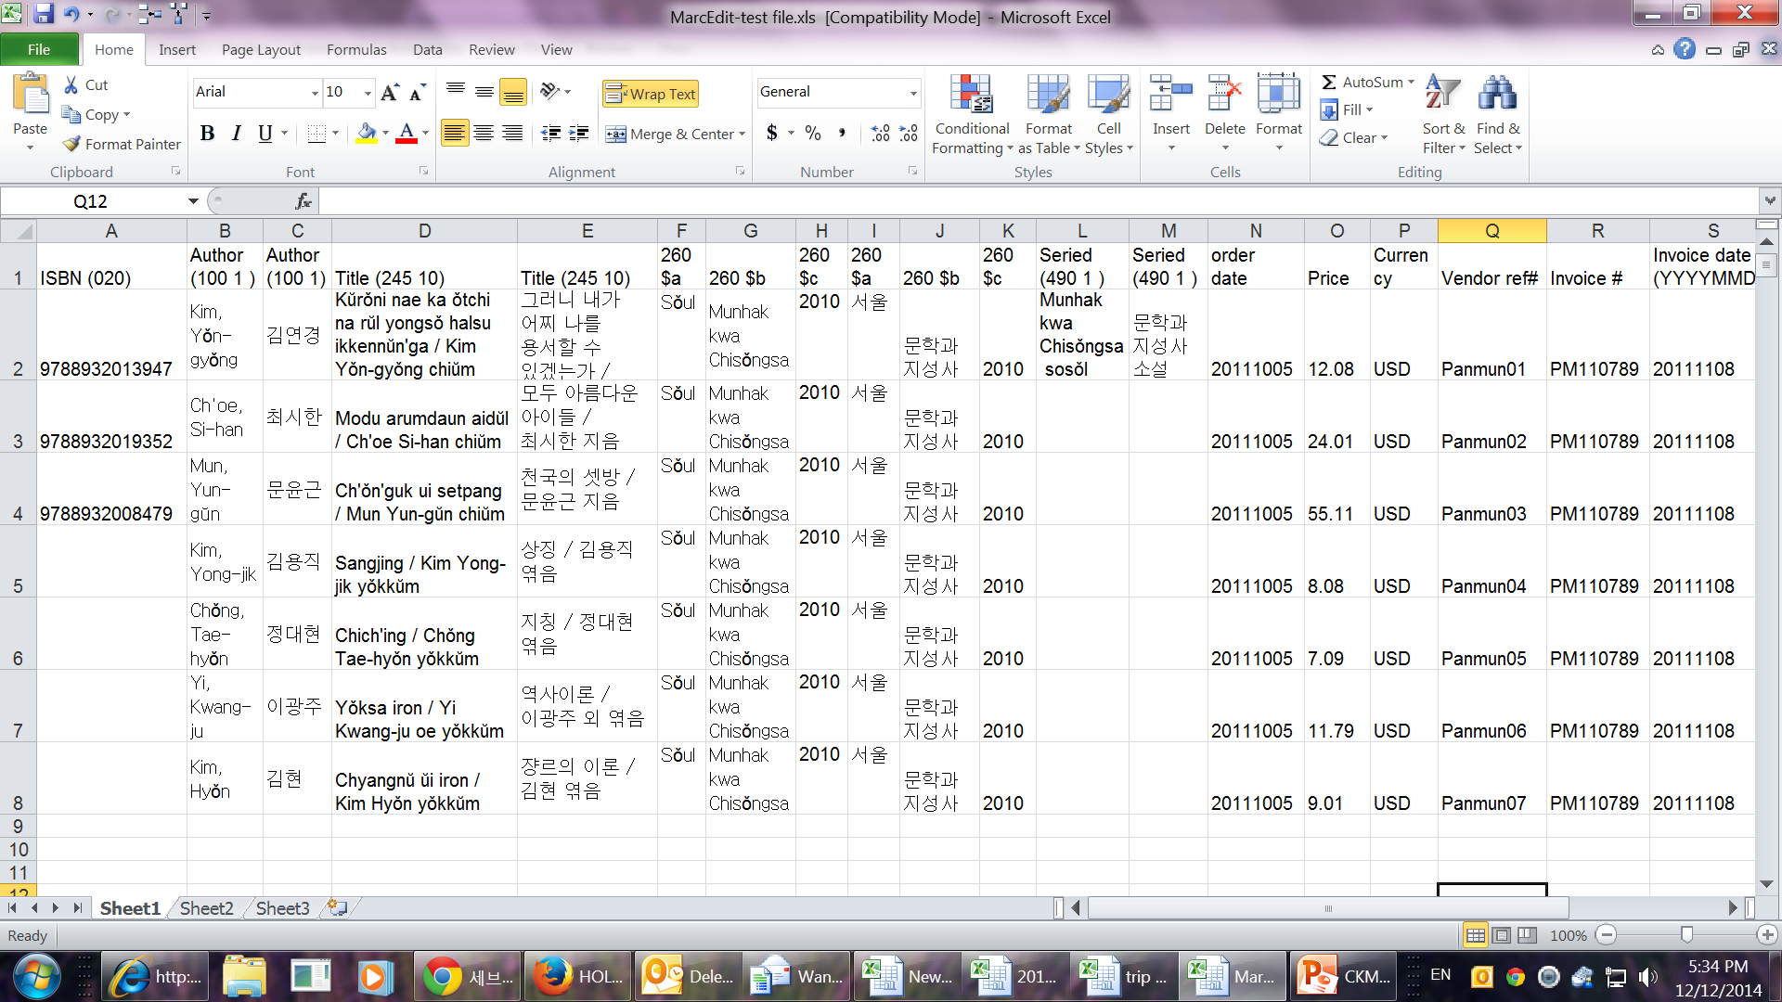
Excel Template for MarcEdit

Slide 6
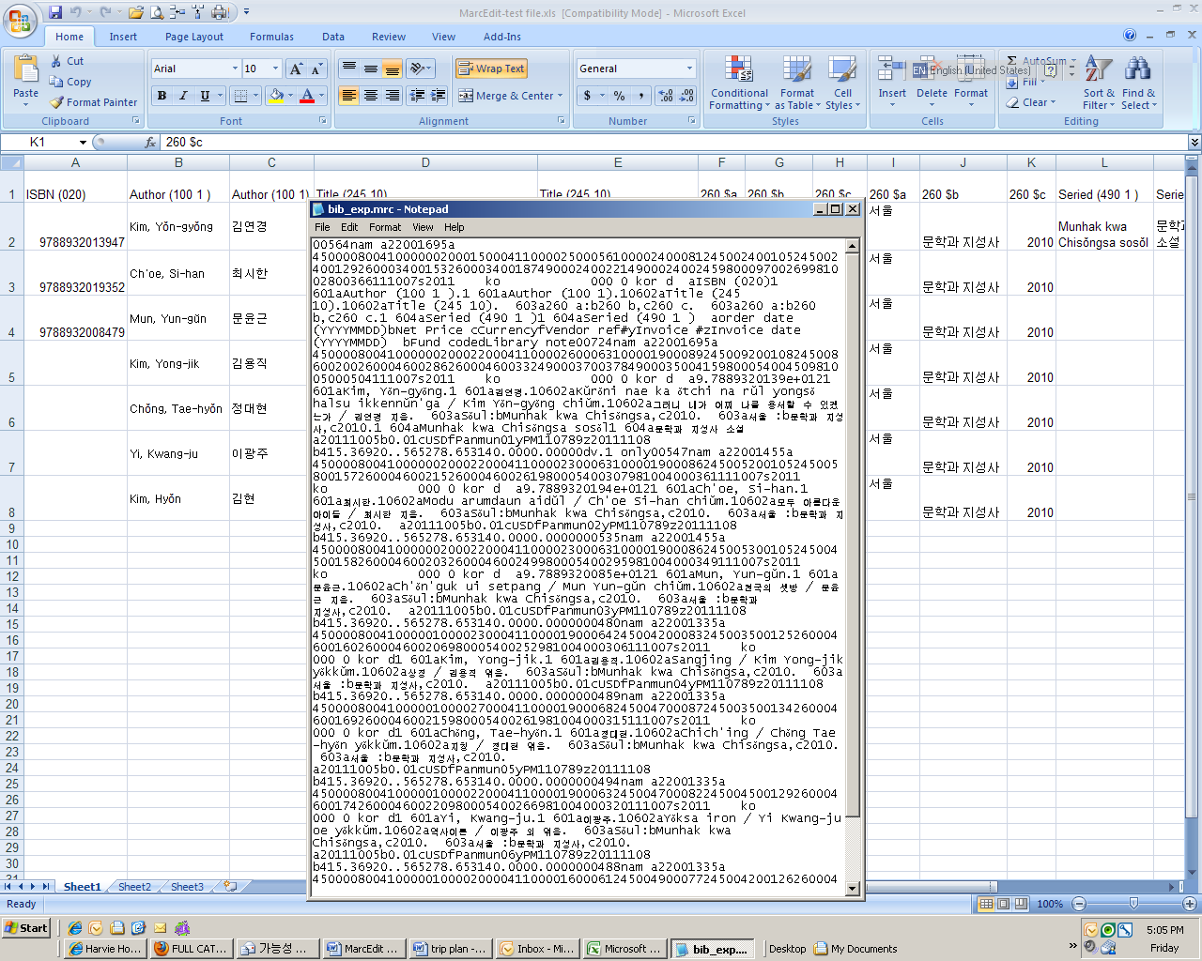
MARC file
converted
from Excel using
MarcEdit

Slide 7
Data mapping
Vendor record tag Aleph field
980 $a Order date (YYYYMMDD)
980 $b List price (optional)
980 $e Net price
980 $c Currency
980 $f Vendor reference number
980 $g Number of copies
981 $b Fund code (supplies year extension)
981 $d Library note

Slide 8
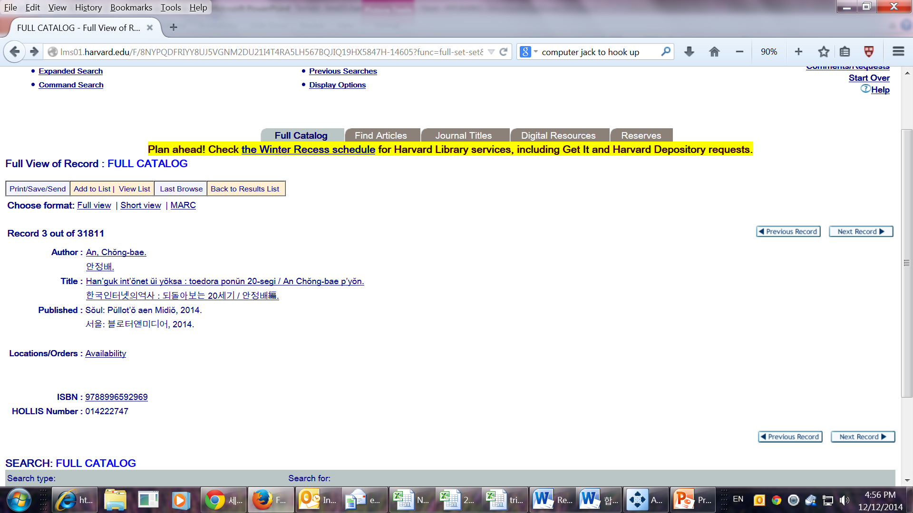
Order Record created
by Data Loading;
Display in OPAC

Slide 9
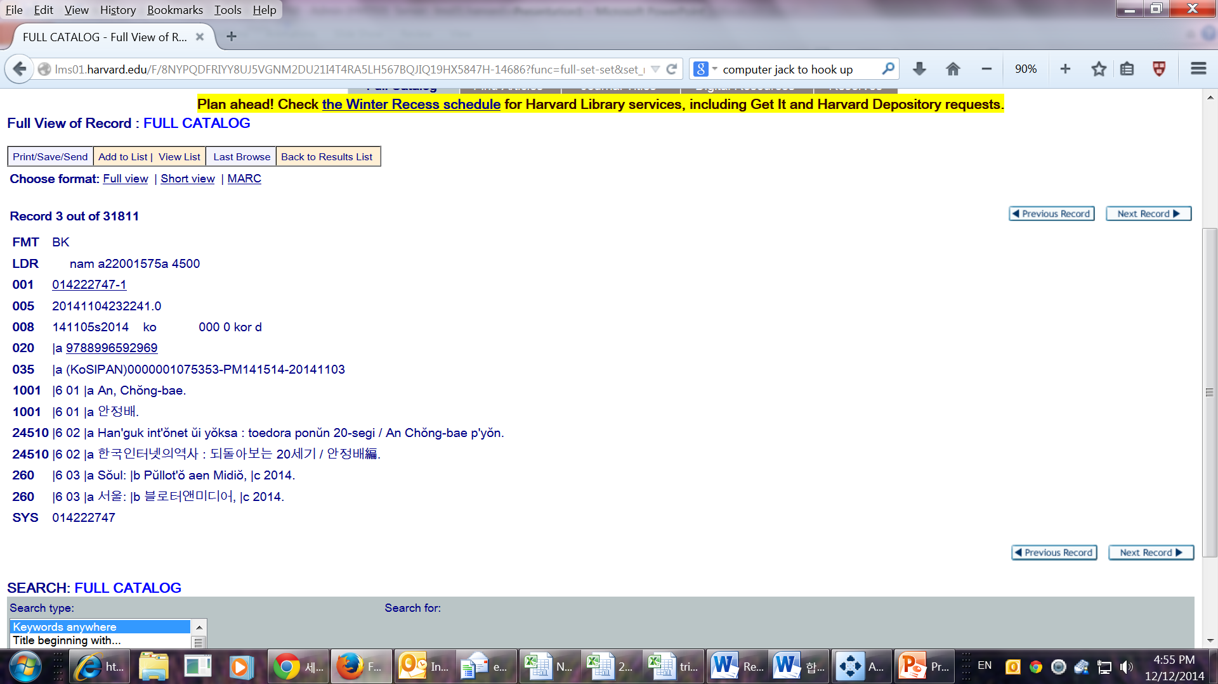
MARC Display

Slide 10
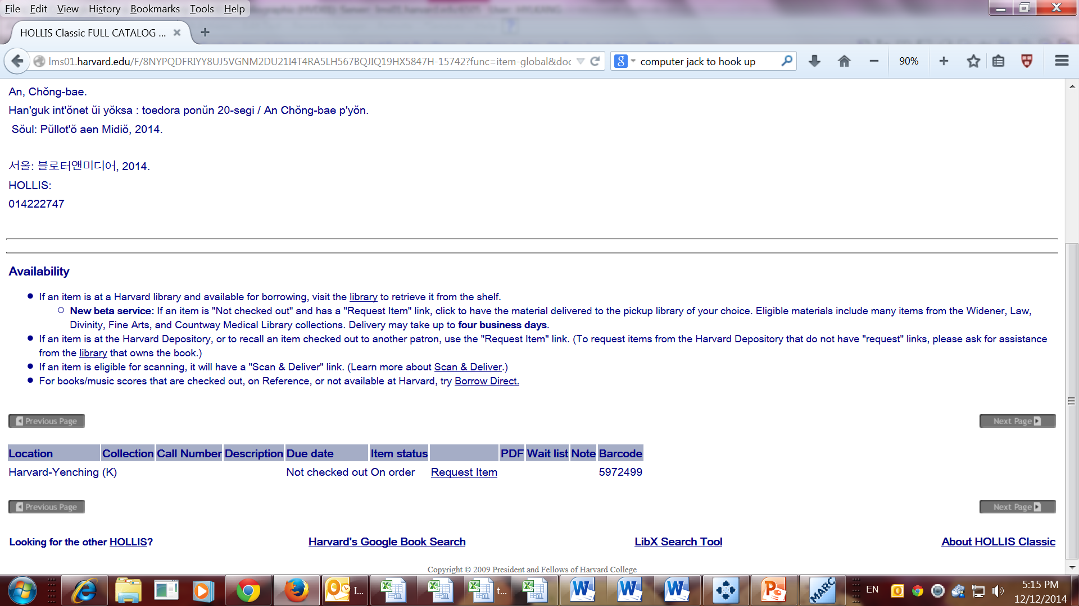
Item Status display in OPAC

Slide 11
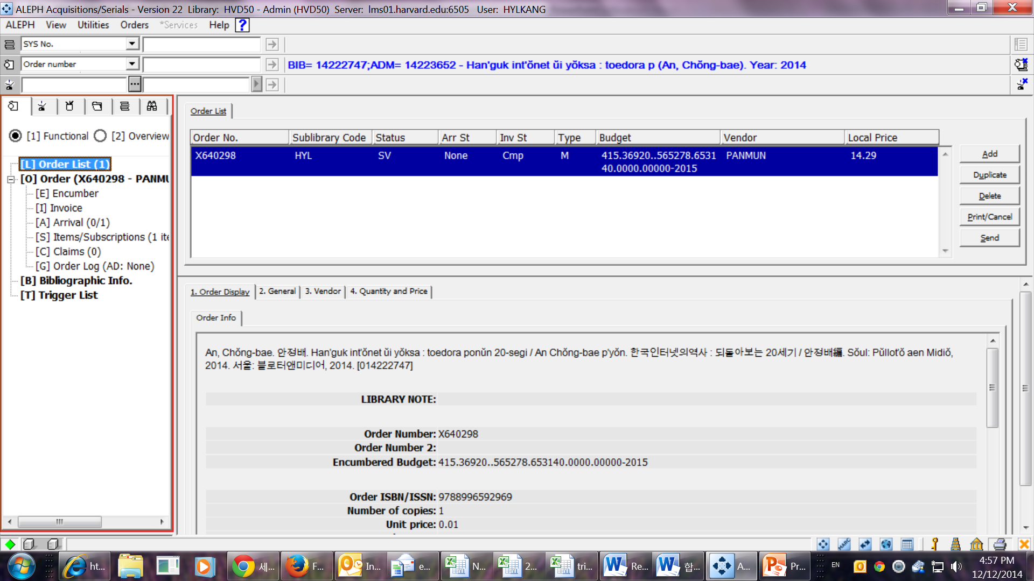
Order Record in Aleph

Slide 12
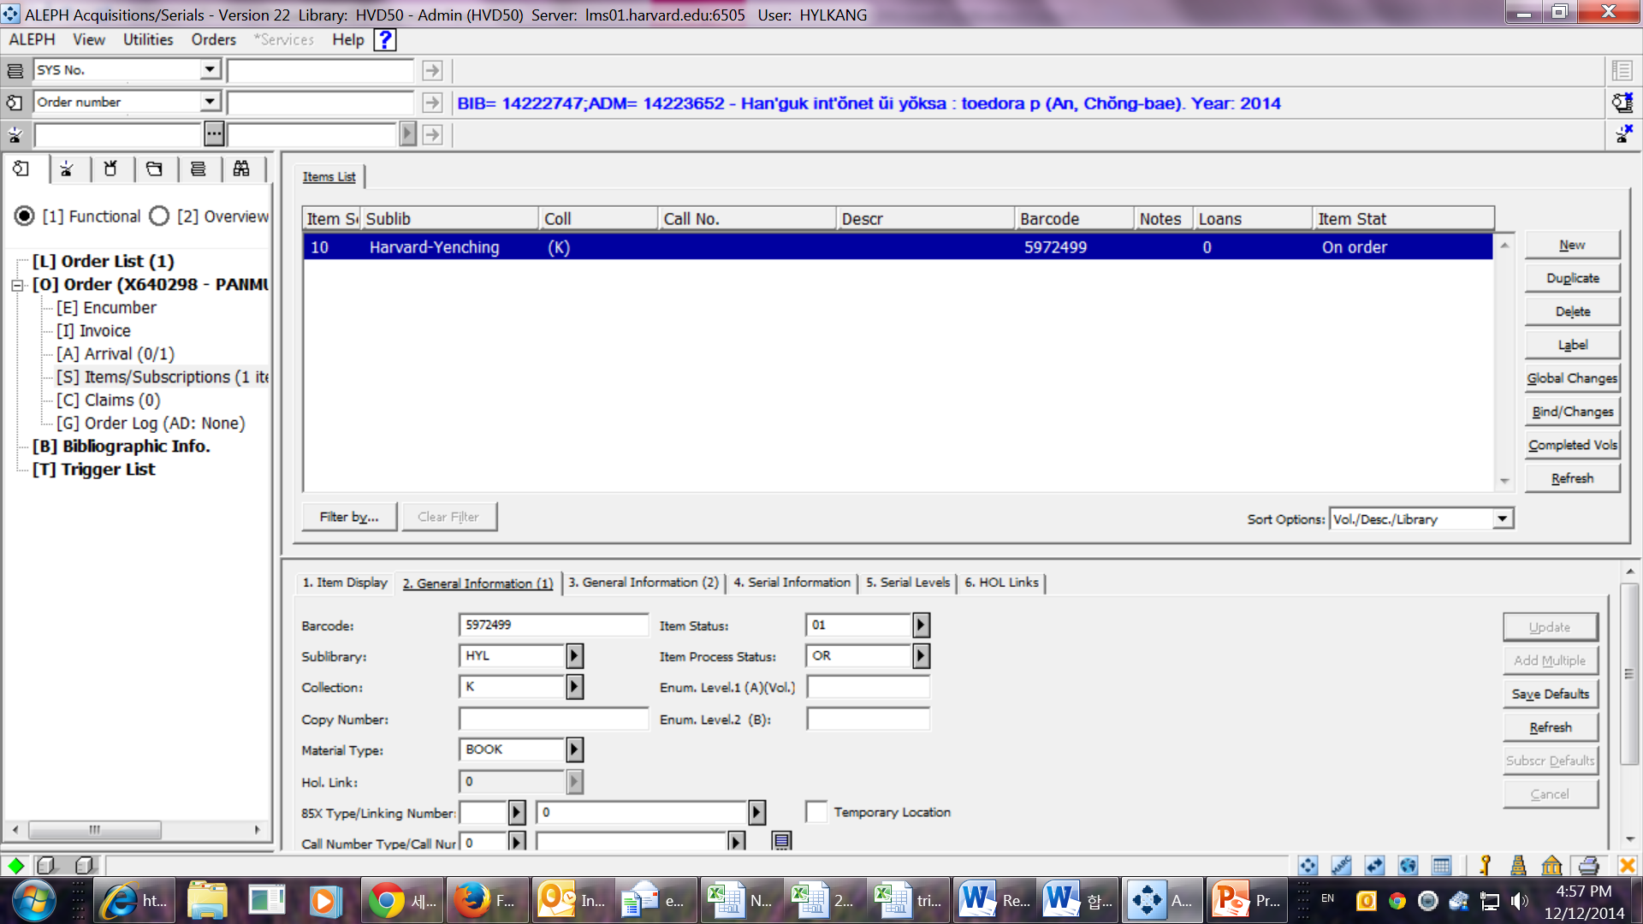
Item record in Aleph

Slide 13
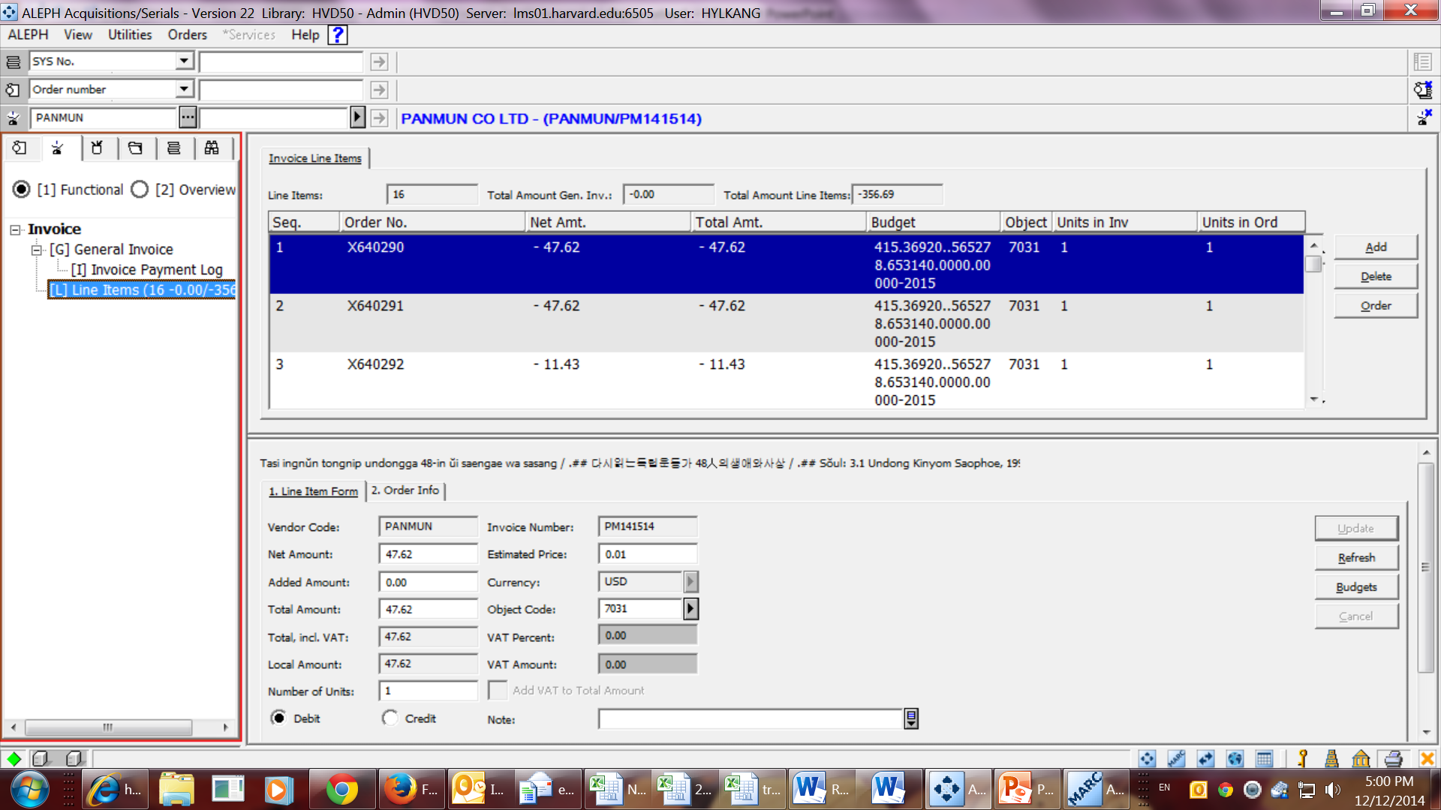
Invoice Record with
Line Items

Slide 14
UNA:+.? '
UNB+UNOC:3+3027180040000:14+0000000020946:14+141121:1021+096'
UNH+001282096+INVOIC:D:96A:UN:EAN008'
BGM+380+43013285+9'
DTM+137:20141121:102'
NAD+SU+3027180040000::14'
NAD+BY+0000000020946::14'
CUX+2:USD:4'
ALC+C++++FC:::SHIPPING'
MOA+8:74.68:USD:4'
RFF+BFN: '
LIN+1++9782708409774:EN'
IMD++010+:::Chatenet, M.'
IMD++050+:::Le prince, la princesse et leur logis. Manières'
IMD++050+:::d'habiter dans l'élite aristocratique européenne.'
IMD++109+:::Editions Picard'
IMD++110+:::Paris'
IMD++170+:::2014'
QTY+47:1'
MOA+146:69.79:USD:4'
MOA+66:69.79:USD:4'
MOA+203:69.79:USD:4'
PRI+AAB:69.79'
RFF+SLI:1204979'
EDI Invoice Sample
in text

Slide 15
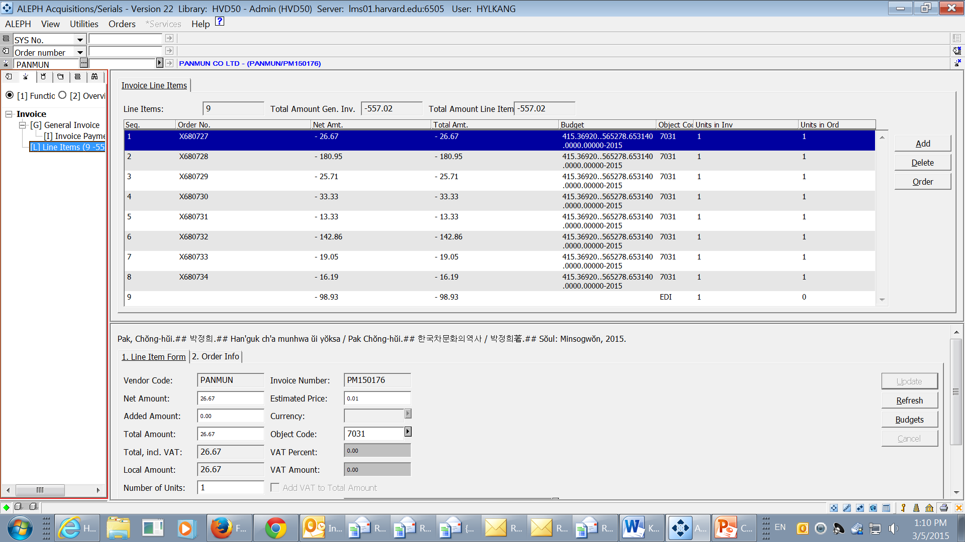
EDI Invoice in Aleph

