Slide 1


Slide 2


01 Introduction
Contents
02 Services
03 Added services
04 Process
05 Invoice and Exchange rate
06 Contact
07 The end

Slide 3

Eulyoo
01
Introduction
Introduction
Founded On December 1, 1945, Eulyoo Publishing Co., Ltd. has been a forerunner in modern publishing industry in Korea, particularly in the field of Korean studies.
Introduction of International Dept.
Since February 1955, Eulyoo Publishing Co., Ltd has been privileged to serve as the sole distributor of all publications.

Slide 4
Eulyoo
02
Services (part 1)
Services
Our specialties are in the field of social sciences and humanities with particular emphasis on Korean studies.
We also handle all kinds of publications published in Korea.
We usually send out selected lists to our clients.
We provide the following services ;
Selected and categorized New Book list(including Romanization of Korean language) on a bi-weekly basis by email, and also by mail.
Approval plan (including the library’s lists of preferred publishers)

Slide 5
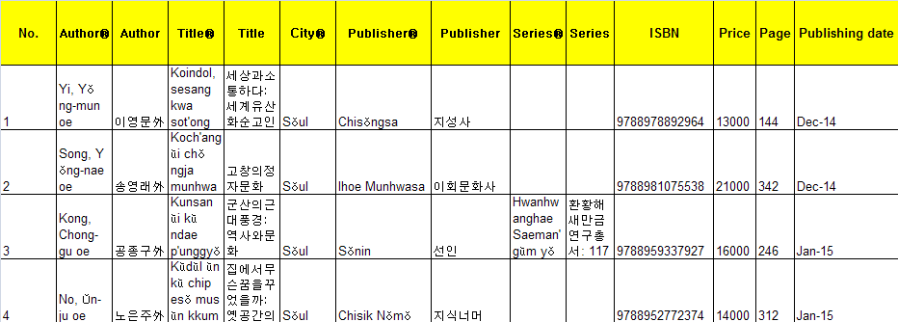
Eulyoo
02
Services (part 1)
Services
The New Book list provided in Excel form

Slide 6
Eulyoo
02
Services (part 2)
Services
We provide the following services ;
Duplicate checking
Handling Serial/Standing orders and government materials
Handling all types of materials such as Books, DVDs, CD-ROMs, Microform, Periodicals, Cartoons etc.
  Selected Korean arts list per month : Ceramics, Folk Paintings, Exhibition catalogue etc.
  Transparent Exchange rate
  Handling charge (20%)
  Method of payment : Wire transfer and Check

Slide 7




Eulyoo
03
Added Services
Added Services
  Selected Korean arts list per month : Ceramics, Folk Paintings, Exhibition catalogue etc.
  Types of materials such as Cartoons as well.
▲ Exhibition catalogue
▲ Korean popular cartoons

Slide 8



Eulyoo
03
Added Services
Added Services
  Selected Busan International Film Festival Award-winning movie lists and DVDs
▲ Busan International Film Festival catalogue
▲ Award-winning work in 2014, DVD ver.

Slide 9



Eulyoo
03
Added Services
Added Services
  Literary prize-winning works.
▲ 2014 a literary award-winning work
▲ 2015 literary award-winning works

Slide 10
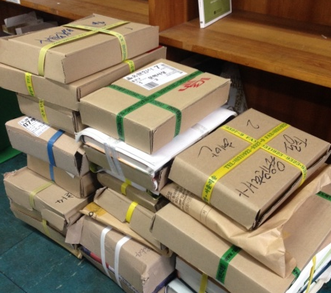
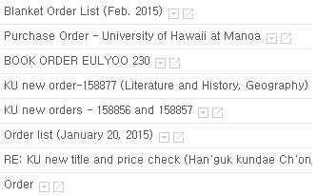
Eulyoo
04
Process
Process
Apply exchange rate transparently
1. Take an order via email
2. Order and Deliver
E-mail address
eulyoo@chol.com
eulyoo1@naver.com
Tel. 82-2-733-6934
Fax. 82-2-732-9154

Slide 11
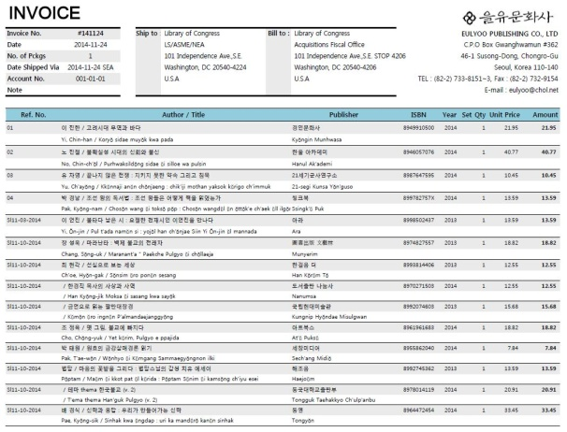
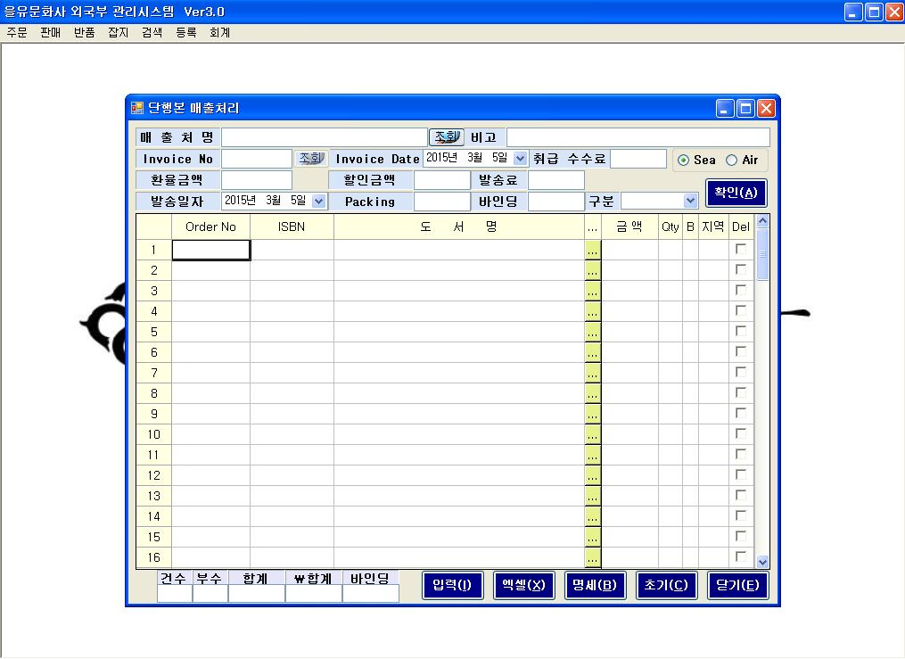
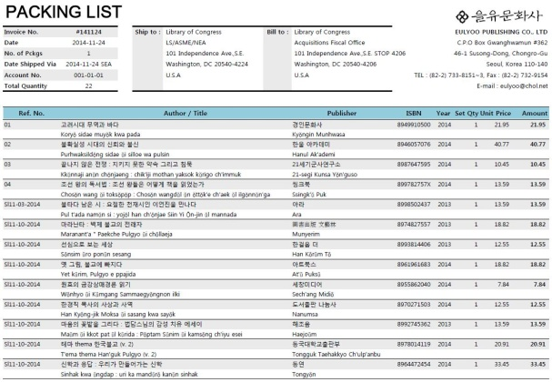
Eulyoo
04
Process
Process
Apply exchange rate transparently
4. Invoice and Packing list
3. Enter the information
▲ invoice
▲ Eulyoo’s system
▲ packing list

Slide 12



Eulyoo
04
Process
Process
Apply exchange rate transparently
5. Packing and Shipment (about 2-3 months)
Extra shipment services
Type | Period
Fedex | 5 to 7 days
EMS | Within 10days
Air | Within 2weeks

Slide 13
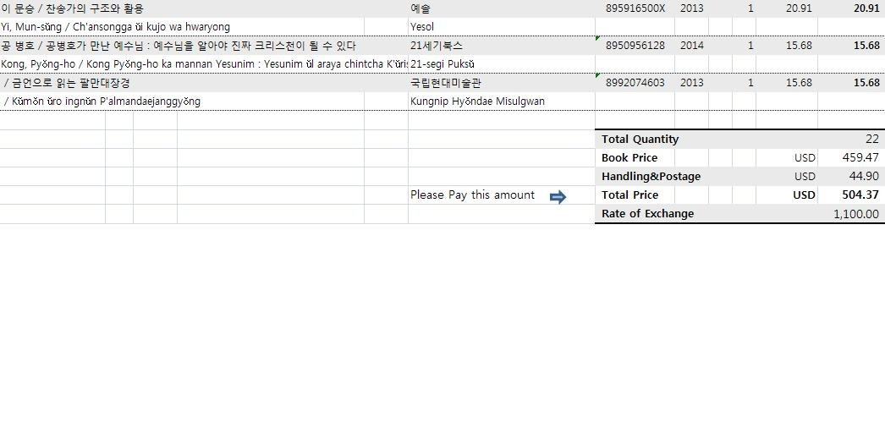
Eulyoo
05
Invoice
Outstanding Services
Apply exchange rate transparently
▲ At the bottom of the invoice
▲ Eulyoo’s system

Slide 14
Eulyoo
05
Invoice
Outstanding Services
Apply exchange rate transparently
▲ invoice
Q. How is the exchange rate applied?

Slide 15
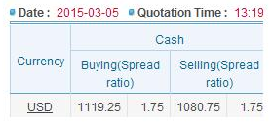
Eulyoo
How to apply the exchange rate?
05
Outstanding Services
Apply exchange rate transparently
1. Check exchange rate in real time
2. Apply exchange rate
…
1,000
1,050
1,100
Basic unit
…
▲ Basically, we apply exchange rate in 50 Korean won

Slide 16
Eulyoo
How to apply the exchange rate?
05
Outstanding Services
Apply exchange rate transparently
3. Round off to the nearest integer
$1 = ￦ 1,081
1,050 > 1,081 > (closer) > 1,100
▶ 1,081 is rounded off to 1,100
Case 1.

Slide 17
Eulyoo
How to apply the exchange rate?
05
Outstanding Services
Apply exchange rate transparently
3. Round off to the nearest integer
$1 = ￦ 1,121
1,100 > (closer) > 1,121 > 1,150
▶ 1,081 is rounded off to 1,100
Case 2.

Slide 18
Eulyoo
05
What is the advantage of the fluctuating exchange rate that we apply?
Outstanding Services
Stability

Slide 19
Eulyoo
06
Contact
Contact
If you want to know about our services in detail or you are interested in building a business relationship in the near future with us, We could schedule a meeting during CEAL meeting or you can contact us at the following number.
Manager
Name
Address
Contact number
Email address
Mi-jin, Jeong
Eulyoo publishing Co.,Ltd, Susong-dong, Chongro-gu, Seoul, Korea
82-2-733-8153
eulyoo@chol.com
Consulting
Name
Address
Contact number
Email address
Si-min, Seo
Eulyoo publishing Co.,Ltd, Susong-dong, Chongro-gu, Seoul, Korea
82-2-733-6934
eulyoo@chol.com
Sales
Name
Address
Contact number
Email address
Yoon-sun, Park
Eulyoo publishing Co.,Ltd, Susong-dong, Chongro-gu, Seoul, Korea
82-2-733-6934
Eulyoo@chol.com

Slide 20
Thank you

