Slide 1
Panmun Co., Ltd.
Korean e-Resource Supplying Agent
March 24, 2015
Forum on Korean Studies Resources
Ohio Hall, Sheraton Hotel & Towers, Chicago Illinois

Slide 2
Today’s Topic
Beyond the book vendor
e-Resources Agent
e-Journal & e-Book services
Notes:
It is good to see you again
This time I would like to present our e-resource service. Panmun is the book vender and supplies has been trying to extend our service

Slide 3
E-journal services
eArticle
New Nonmun

Slide 4
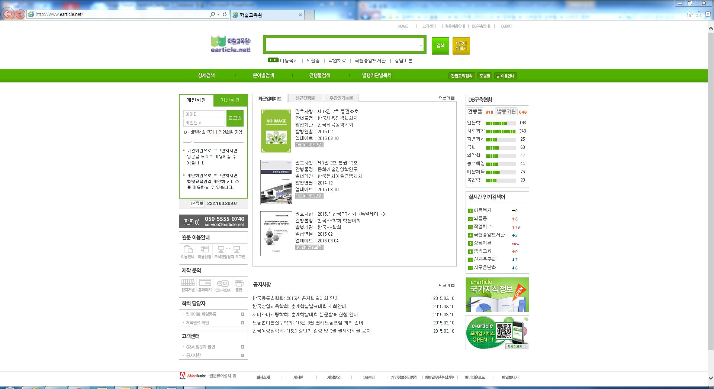
eArticle

Slide 5
eArticle
Publisher: Haksul Institute Co., Ltd.
URL: http://www.earticle.net
Type: academic e-journal
Subject: all subject
Data: 544 institutes, 807 journals
Features: 3rd major e-journal service, especial in humanity and
social science fields
Notes:
eArticle is an electric journal service for Korean studies. The publisher is Haksul Institute.

Slide 6
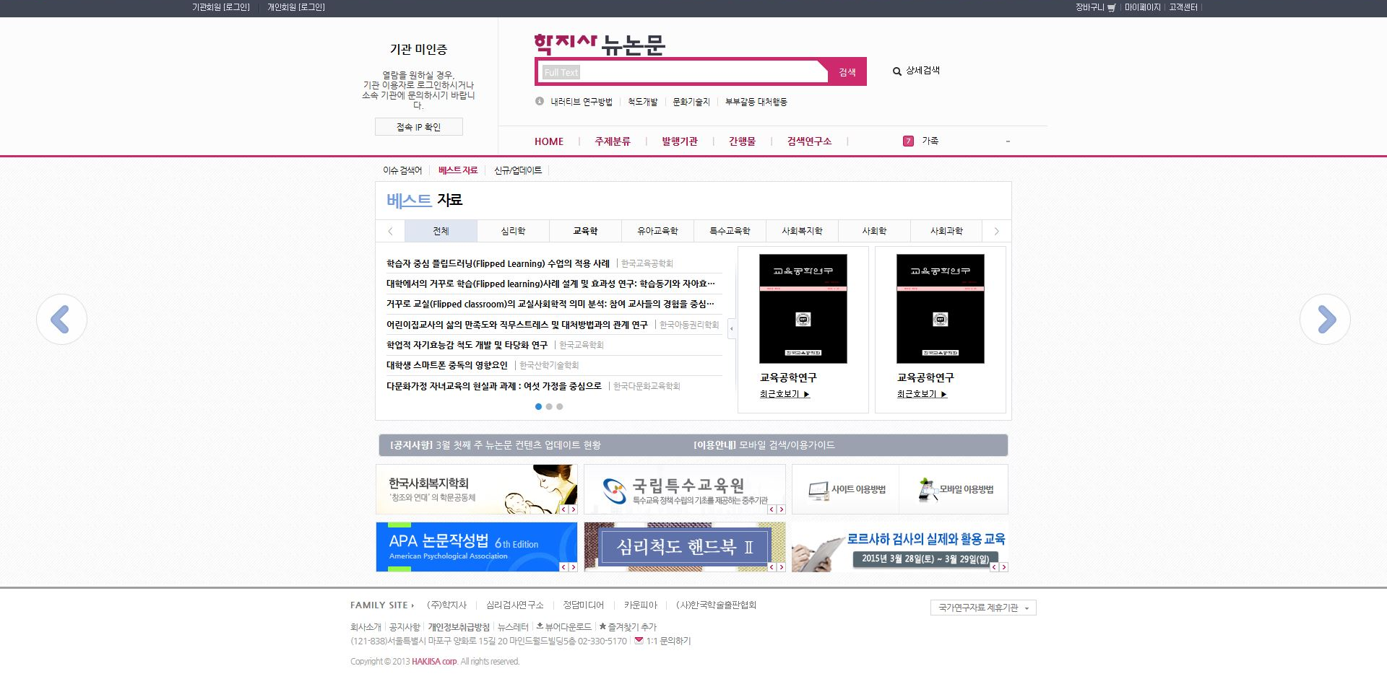
New Nonmun

Slide 7
New Nonmun
Publisher: Hakjisa Co., Ltd.
URL: http://www.newnonmun.com
Type: academic e-journal
Subject: all subject
Data: 204 journals
Features: Strength in pedagogy and psychology fields

Slide 8
E-book service
Official agent of Acadepia

Slide 9
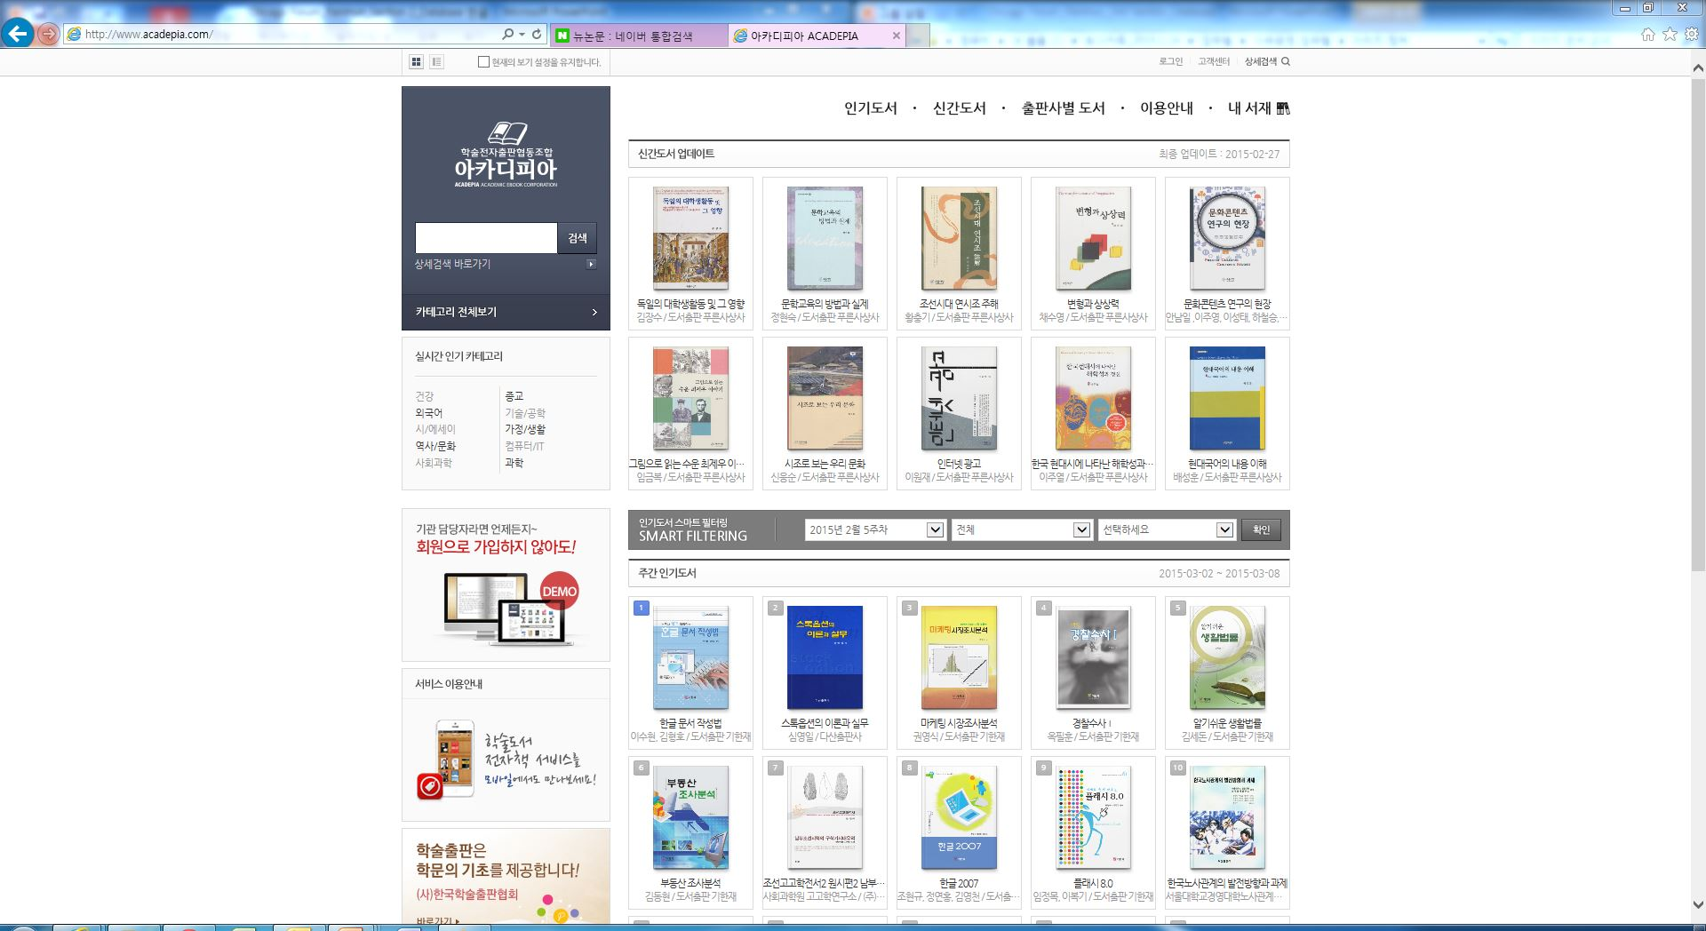
Acadepia

Slide 10
Acadepia
Publisher: Academic eBook Cooperation
URL: http://www.acadepia.com
Type: academic e-Book
Subject: all subject
Data: 48 publishers, 2,100 titles
Features: Korean 1st academic ebook service

Slide 11
Panmun Service Area
Paper publication: books, journals, news paper, periodicals, big sets
old books, etc.
e-Resource: e-books, e-journals, online-databases, etc.
Others: microfilm, DVDs, etc.
Library services: approval plan, data loading, etc.

Slide 12
Thank you very much!

