Slide 2
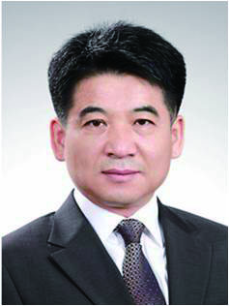
CEO
Jeong pyo Hong
Graduated from Incheon National University (Biology)
Completed the course of System Analysis in Korea Information Center
Graduated from Chung-Ang University Graduate school of Mass Communication (PublicationㆍMedia contents)
Studying in Kyunggi University (Library & Information Science)
Worked in Korea Computer Magazine as a reporter
Worked in Hancom as a editor
CEO of Global Contents Publishing Group Co., Ltd.
Korea publishing Cooperation association director
Korea scholarship e-book cooperation association director
Korea scholarship publishing association director

Slide 3
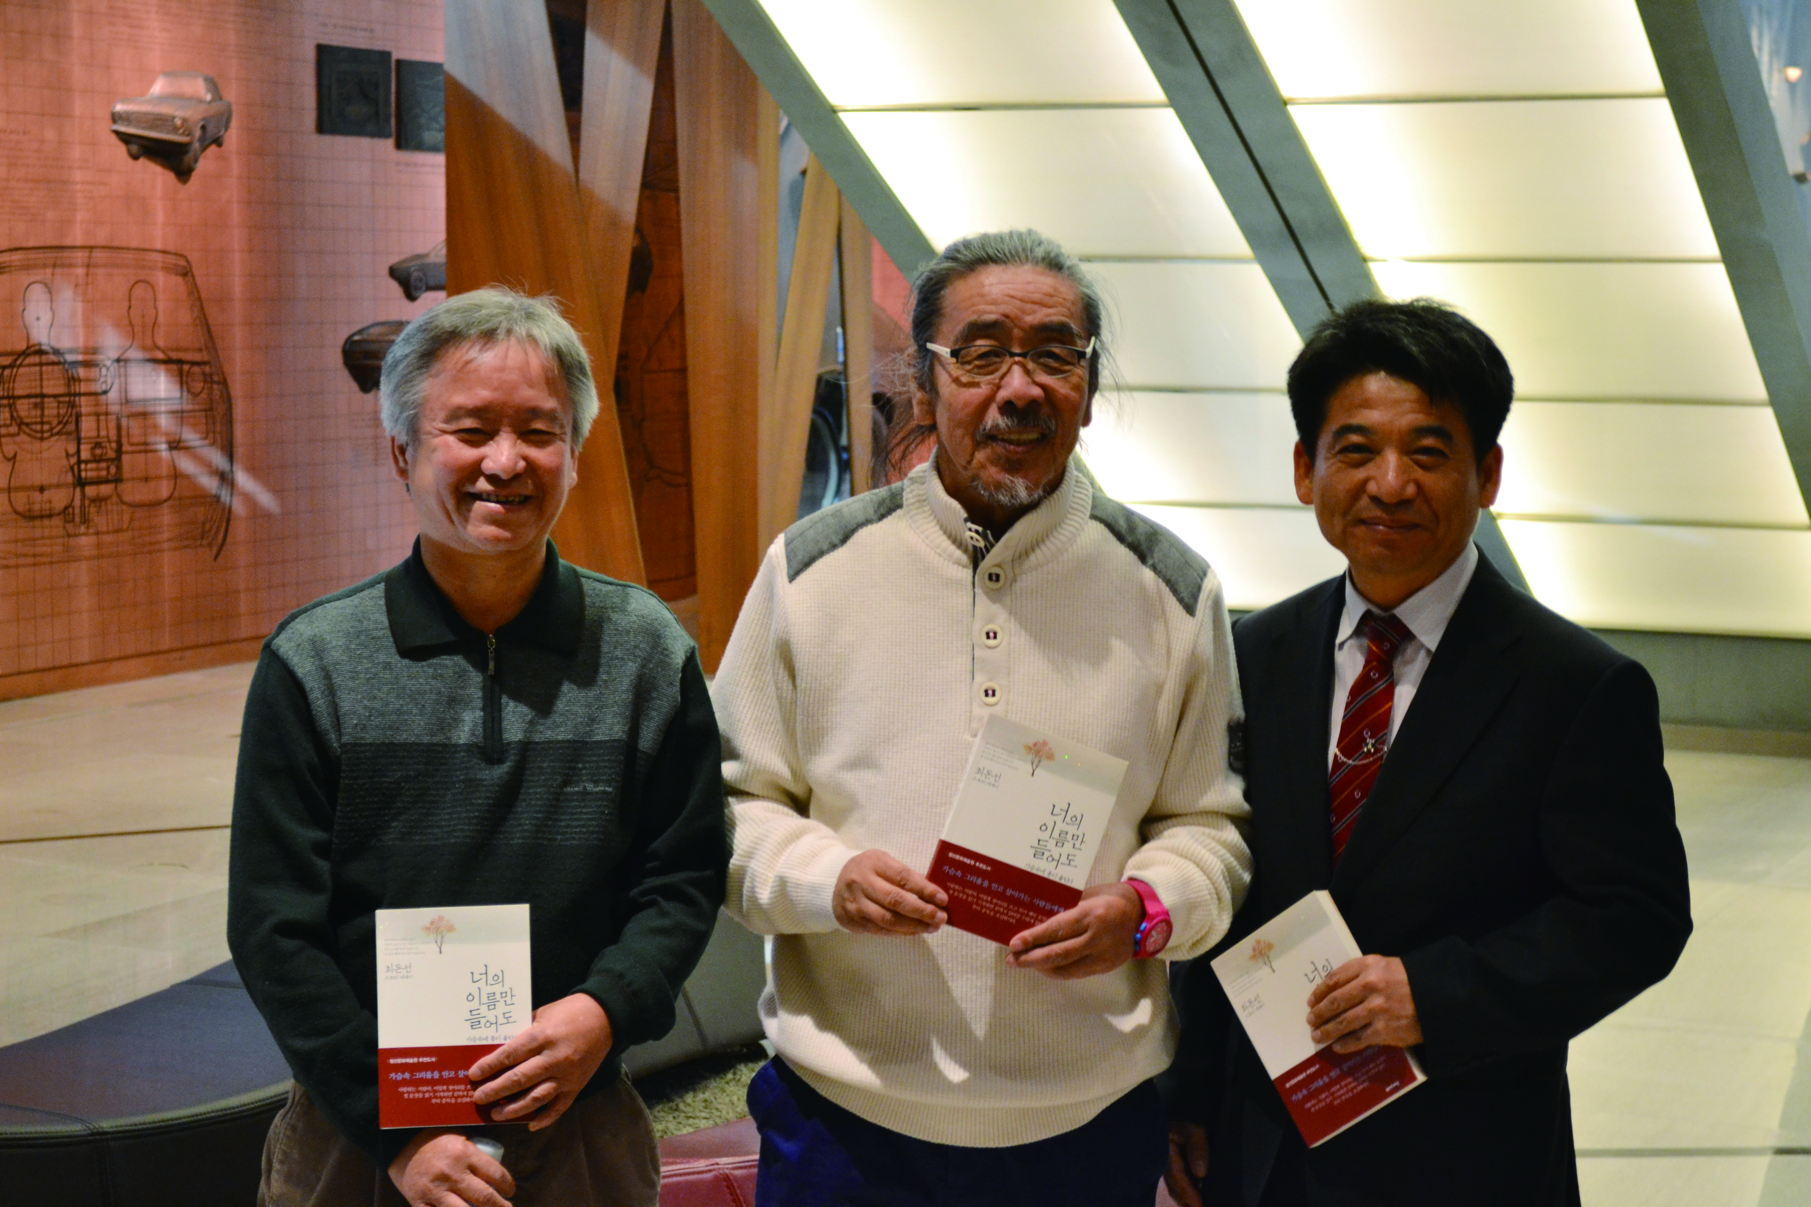
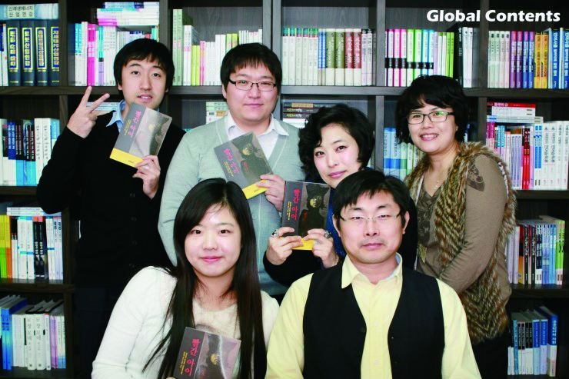
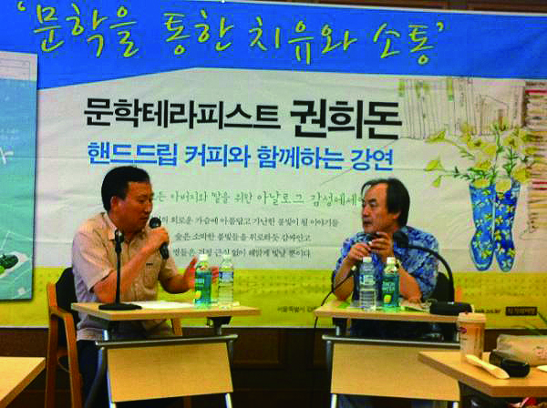
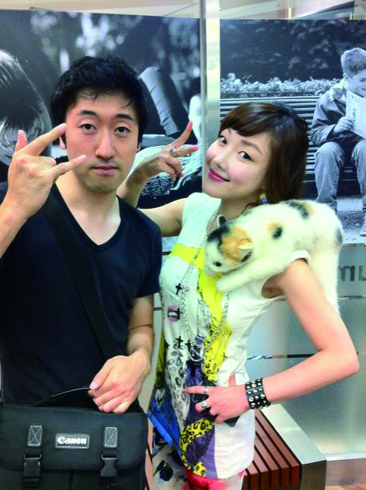
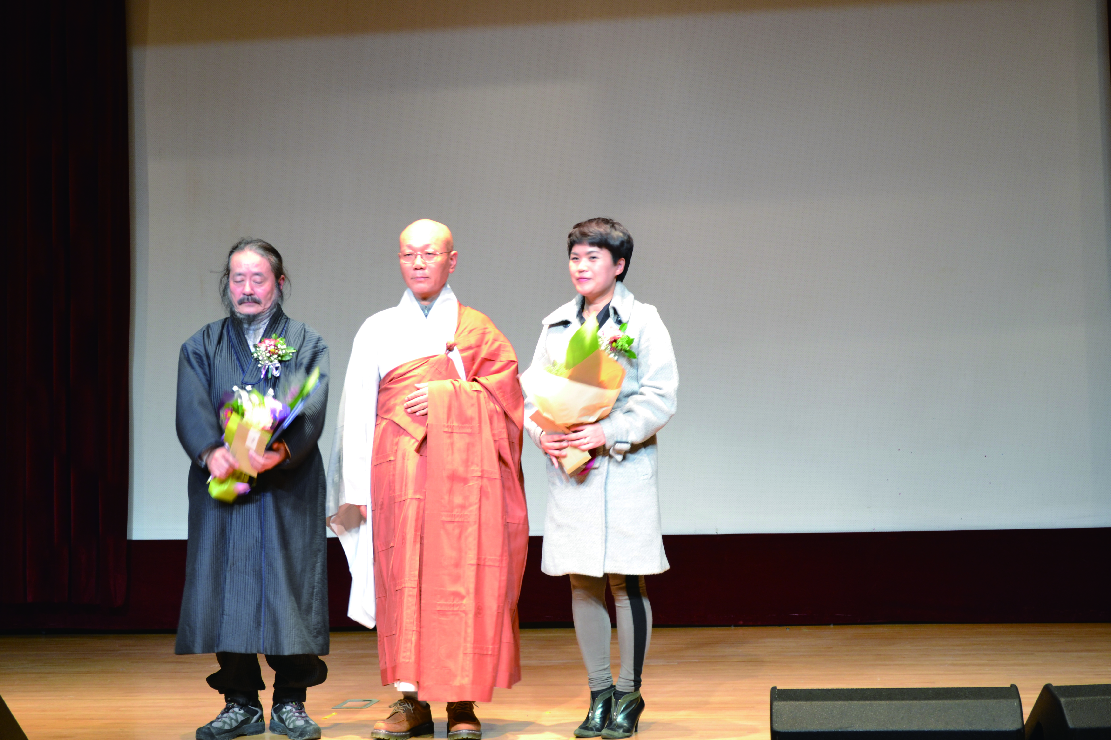
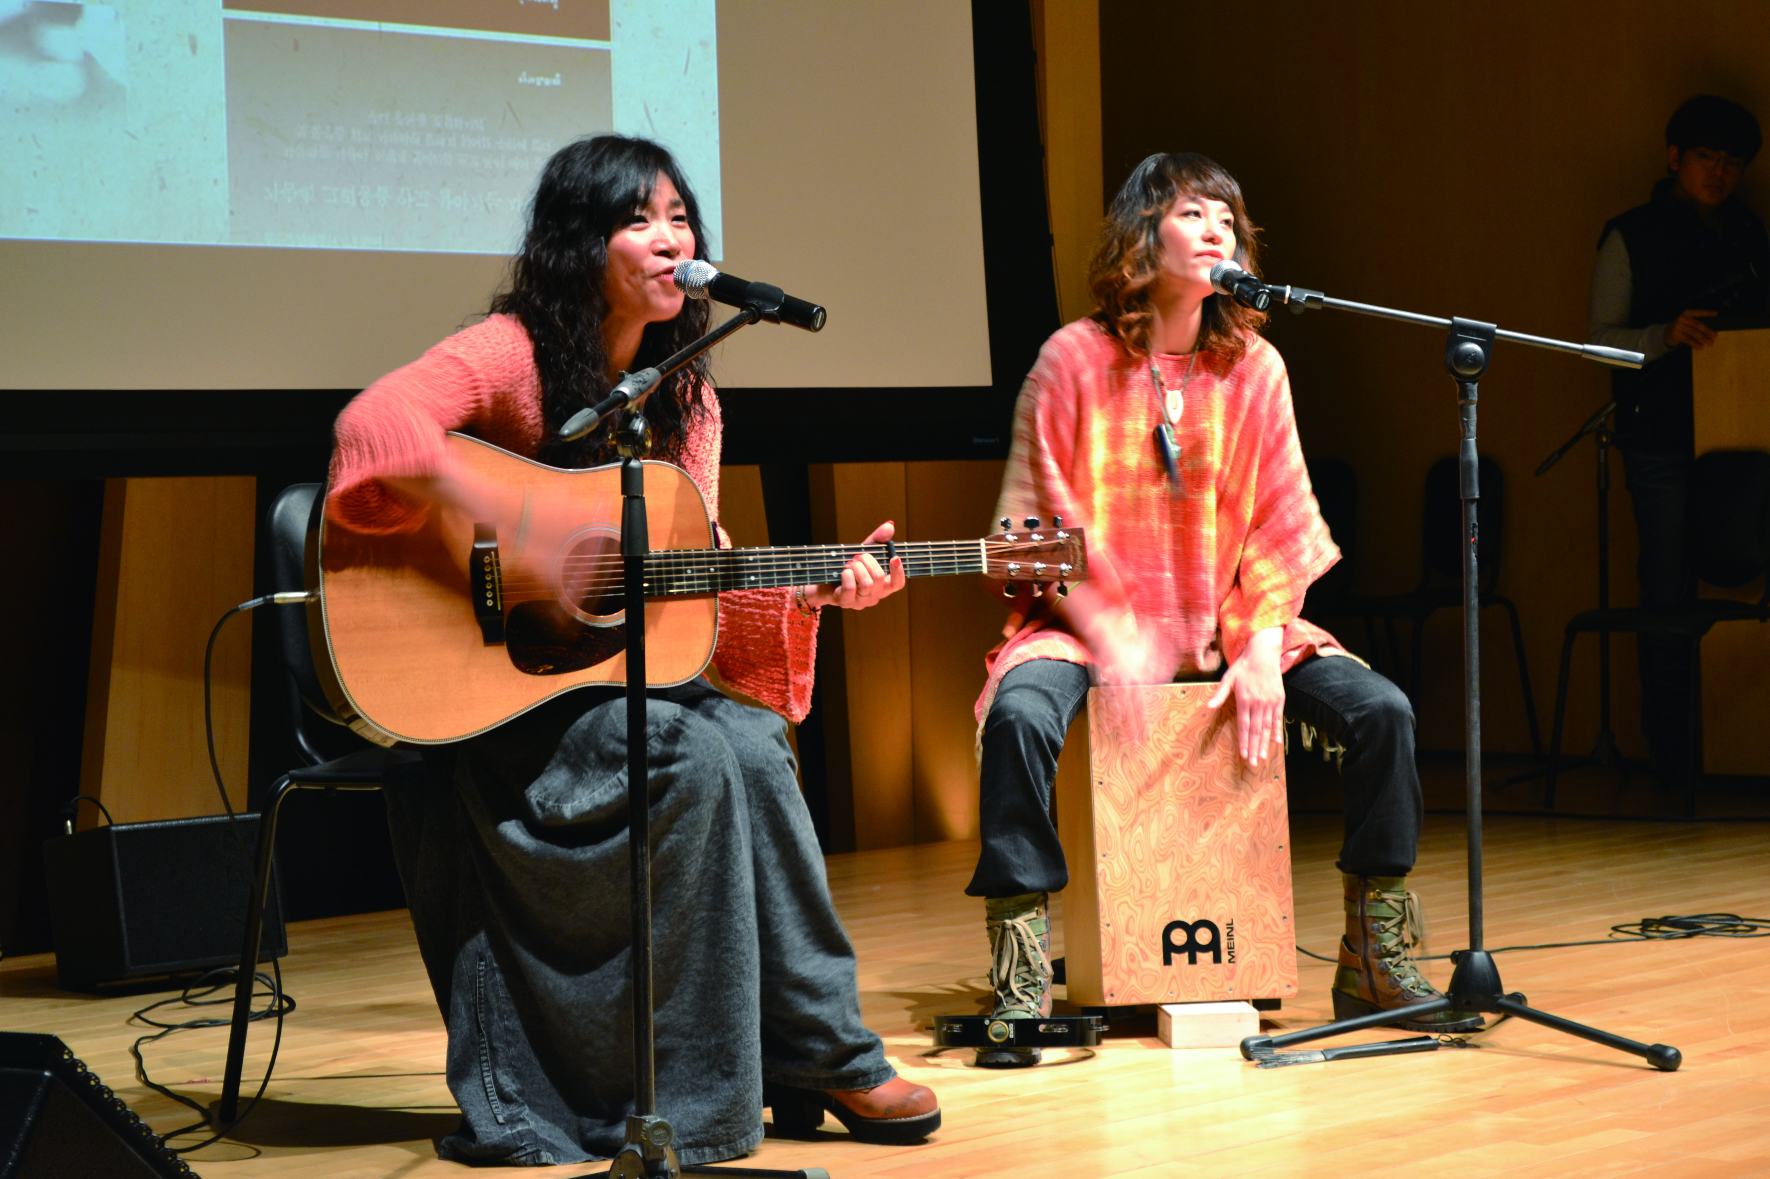
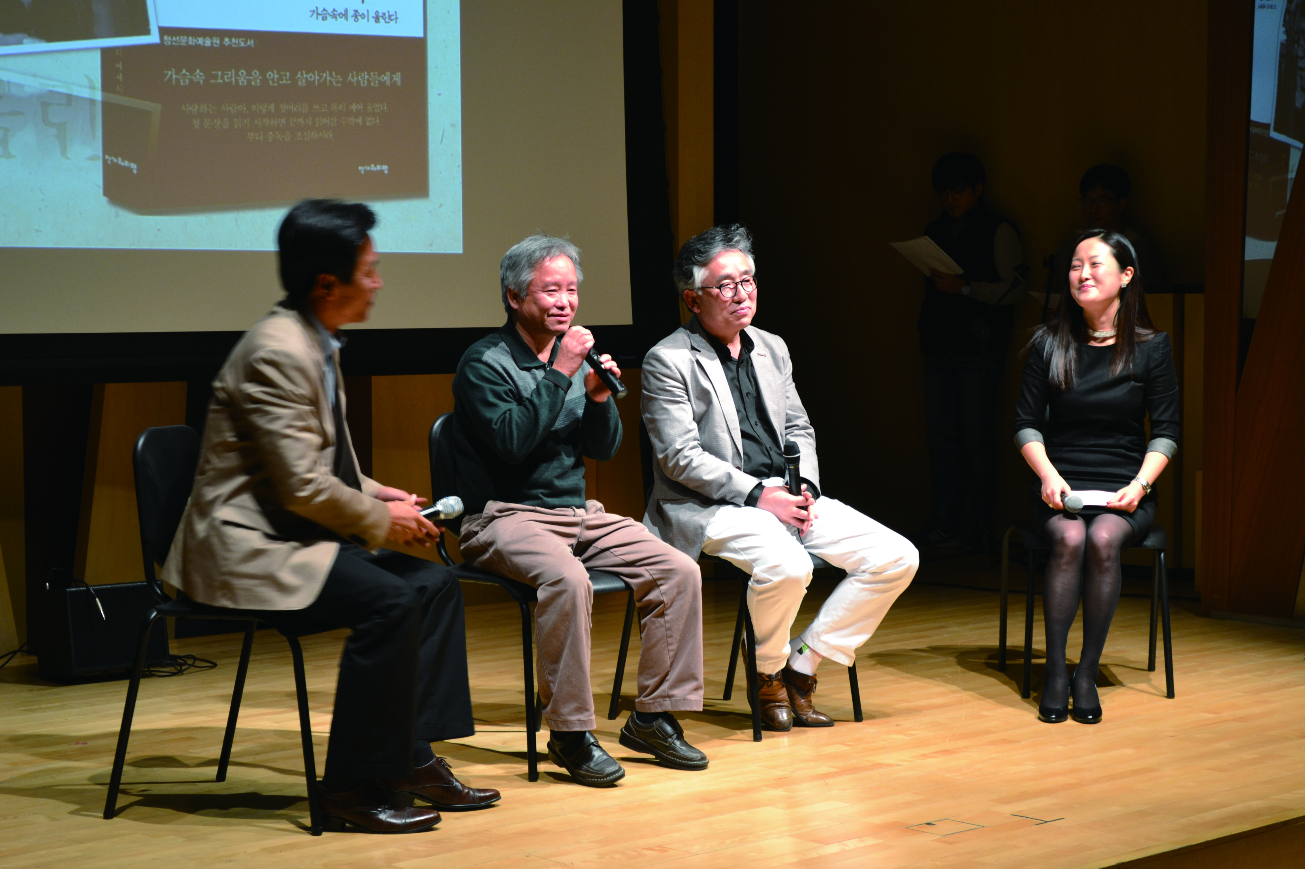
We contribute to the development of individual and nation by accumulating the knowledge and information based on the subject field of specialty publications
Global Contents Publishing Group is…
Vision
We try to contribute to the development of the individual and the
society by accumulating knowledge and information
based on the subject field of specific publications
Management Philosophy
Human-centered
Value of knowledge
Practice of share

Slide 4
on by accumulating the knowledge and information based on the subject field of specialty publications
Company Overview
Date of business launch
1st October 2001 Publishing management agency Comone Media Establishment
Corporation registration
24th October 2008 Global Contents Publishing Group Co., Ltd. Establishment
Field of business
Manufacture (publication)
Wholesale-retail trade(books, course material)
Public Library Delivery business
KORMARC Solution development
Own-Brand
Global Contents, KyungJin Publishing, Writer & Criticism
Comone Media, Serim publishing
Cowork-Brand
Korea Administration DB Center, Inha-University publishing department,
Edustandard Co,. Ltd.

Slide 5
on by accumulating the knowledge and information based on the subject field of specialty publications
Brands affiliated with Global Contents Publishing Group
Global Contents
- Humanities, History, Philosophy, Linguistics, Library & Information
KyungJin Publishing
- Korean Language and Literature, Korean Language Education
Writer & Criticism
- Literature, criticism, review, poetry, novel
Comone Media
- IT, Computer Engineering, Broadcasting communications
Serim Publishing
- Management of sightseeing, Leisure study, Leisure, health

Slide 6
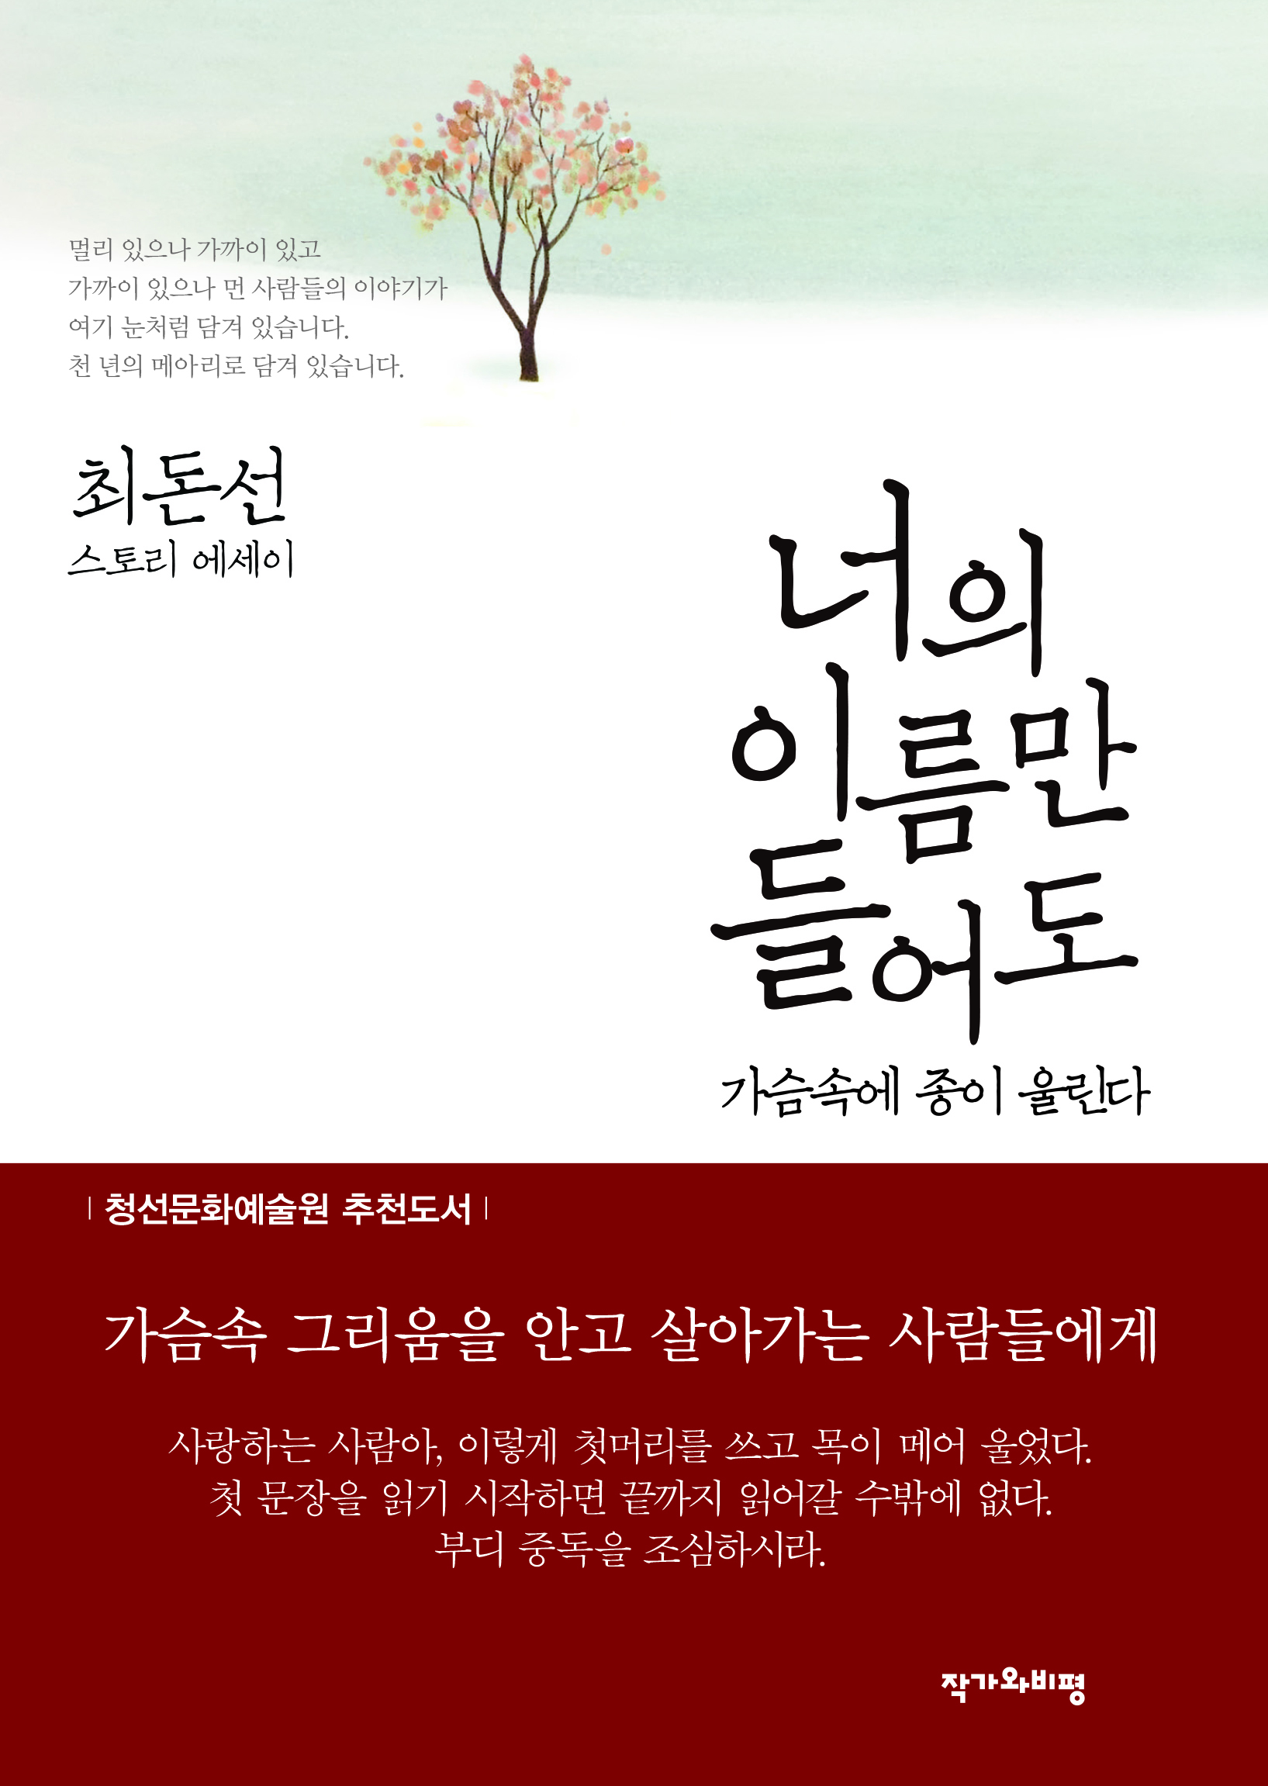
on by accumulating the knowledge and information based on the subject field of specialty publications
Awarded titles by Korea government (2014)
*A duck went out to sea 바다로 간 오리
Munhak Nanum
*The bell of my heart is rung when I hear your name.
너의 이름만 들어도 가슴에 종이 울린다.
Munhak Nanum
The Rise and Fall of the Monster
괴물흥망사
Munhak Nanum

Slide 7
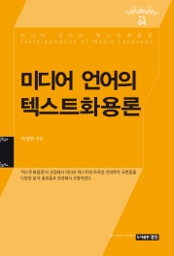
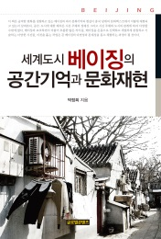
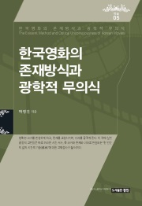
Awarded titles by Korea government (2013)
on by accumulating the knowledge and information based on the subject field of specialty publications
Text pragmatics of media language
Ministry of Culture, Sports and Tourism
Spatial memory and Cultural representation of International City Beijing
Ministry of Culture, Sports and Tourism
Love poetry, meet on tour
Ministry of Culture, Sports and Tourism
Existing method and Optical unconscious of Korean movies
The National Academy of Sciences
Ask the way of the Choseon missions to Japan about today
Munhak Nanum

Slide 8
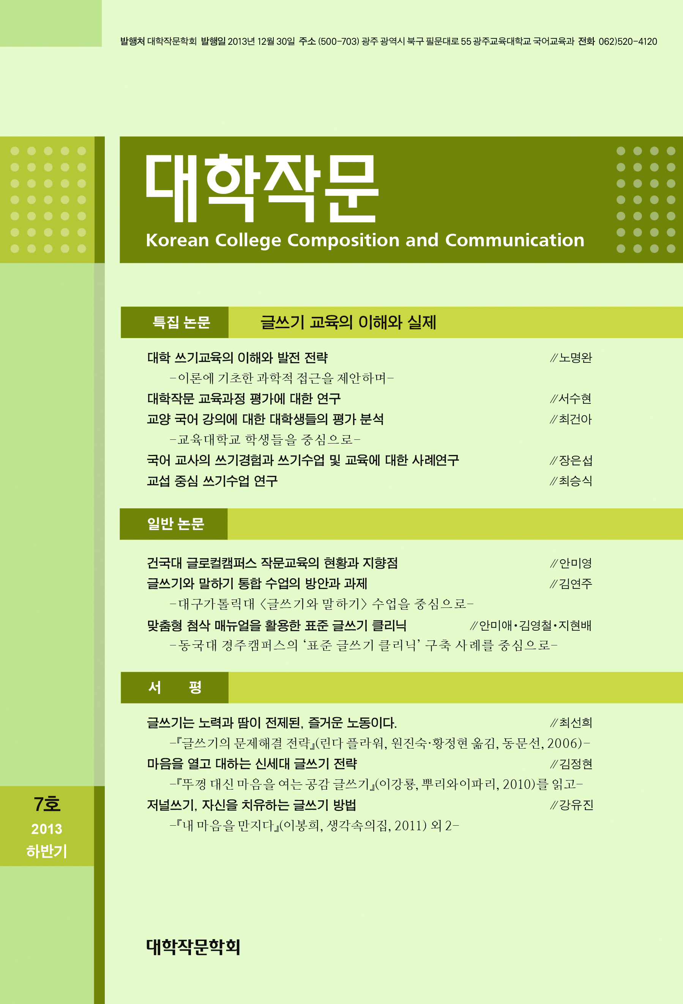
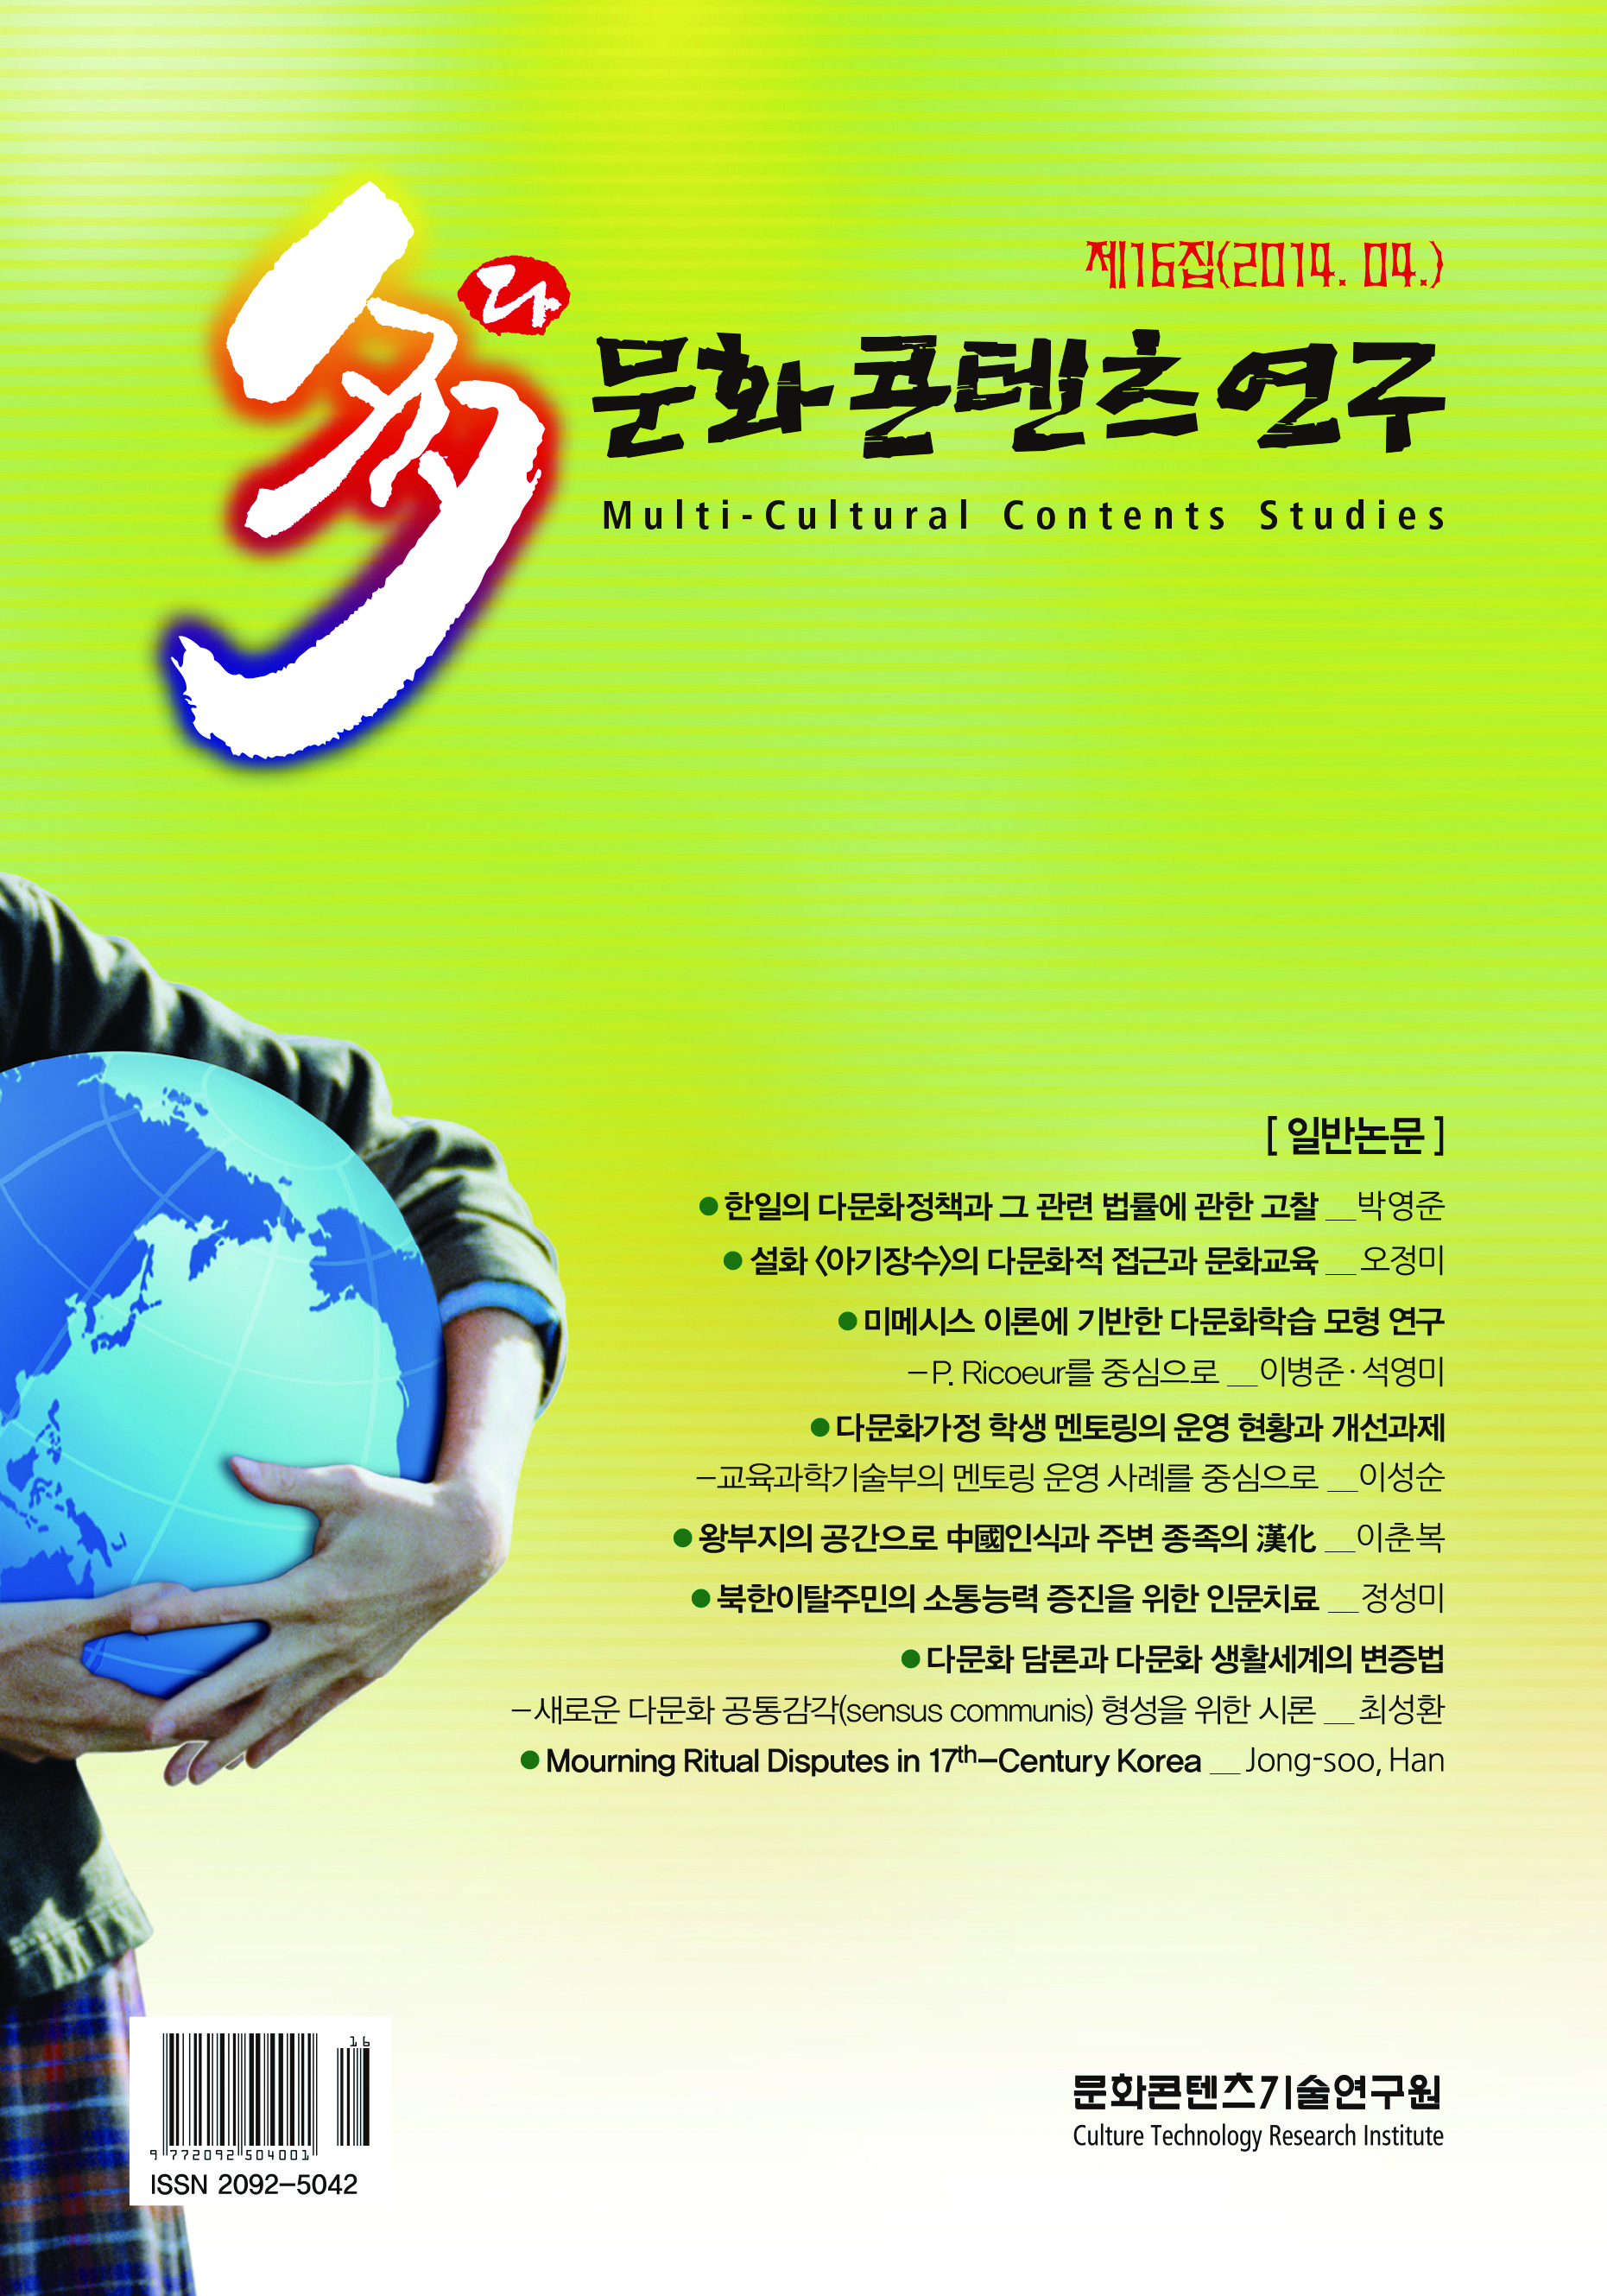
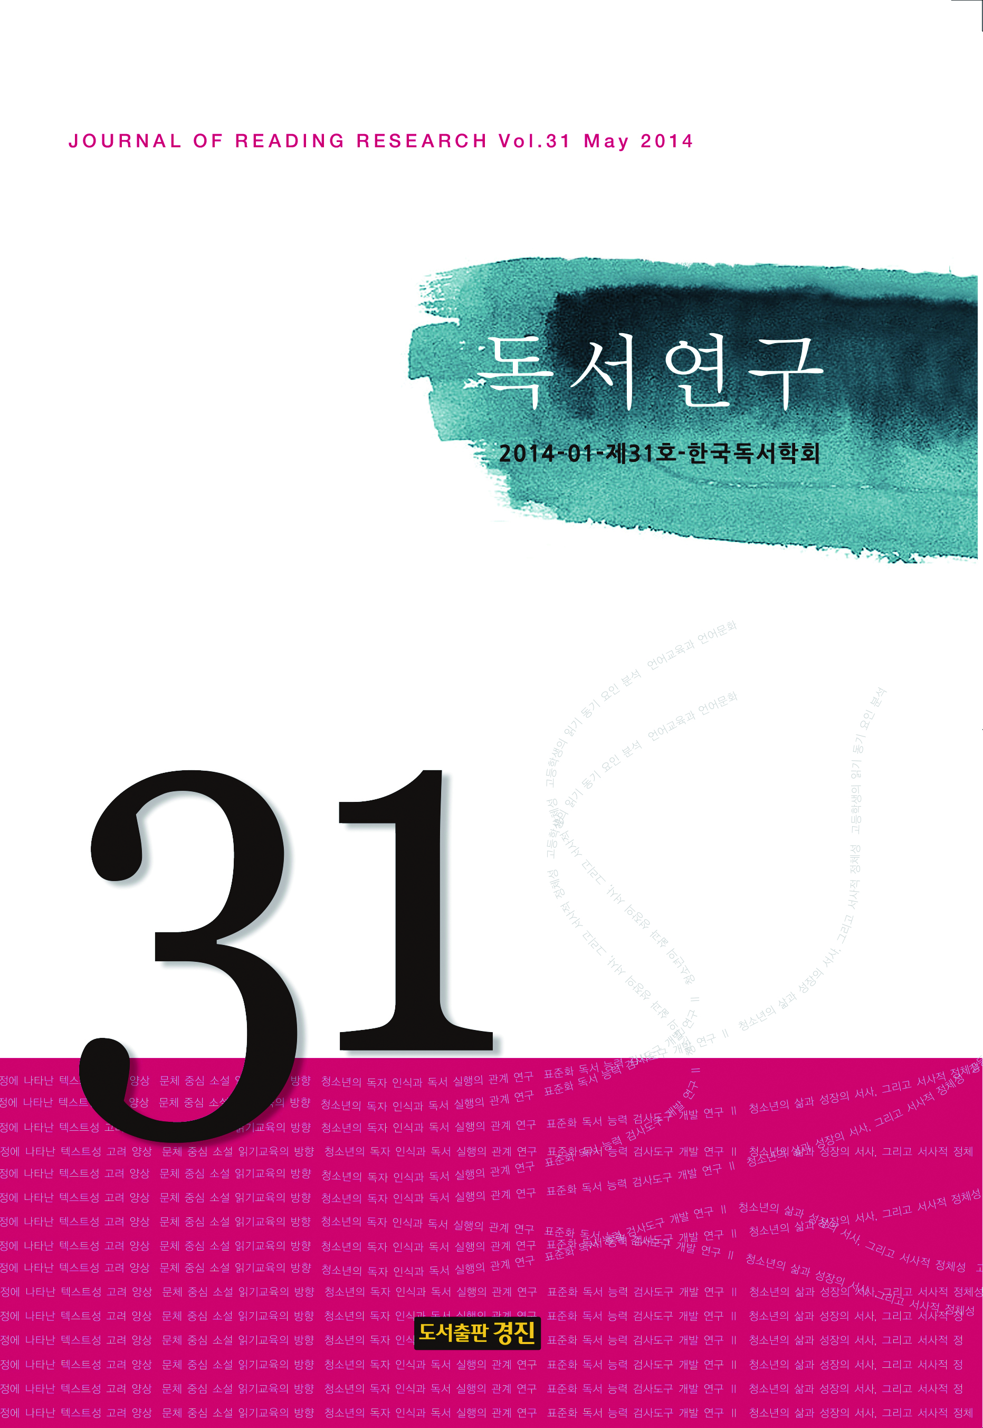
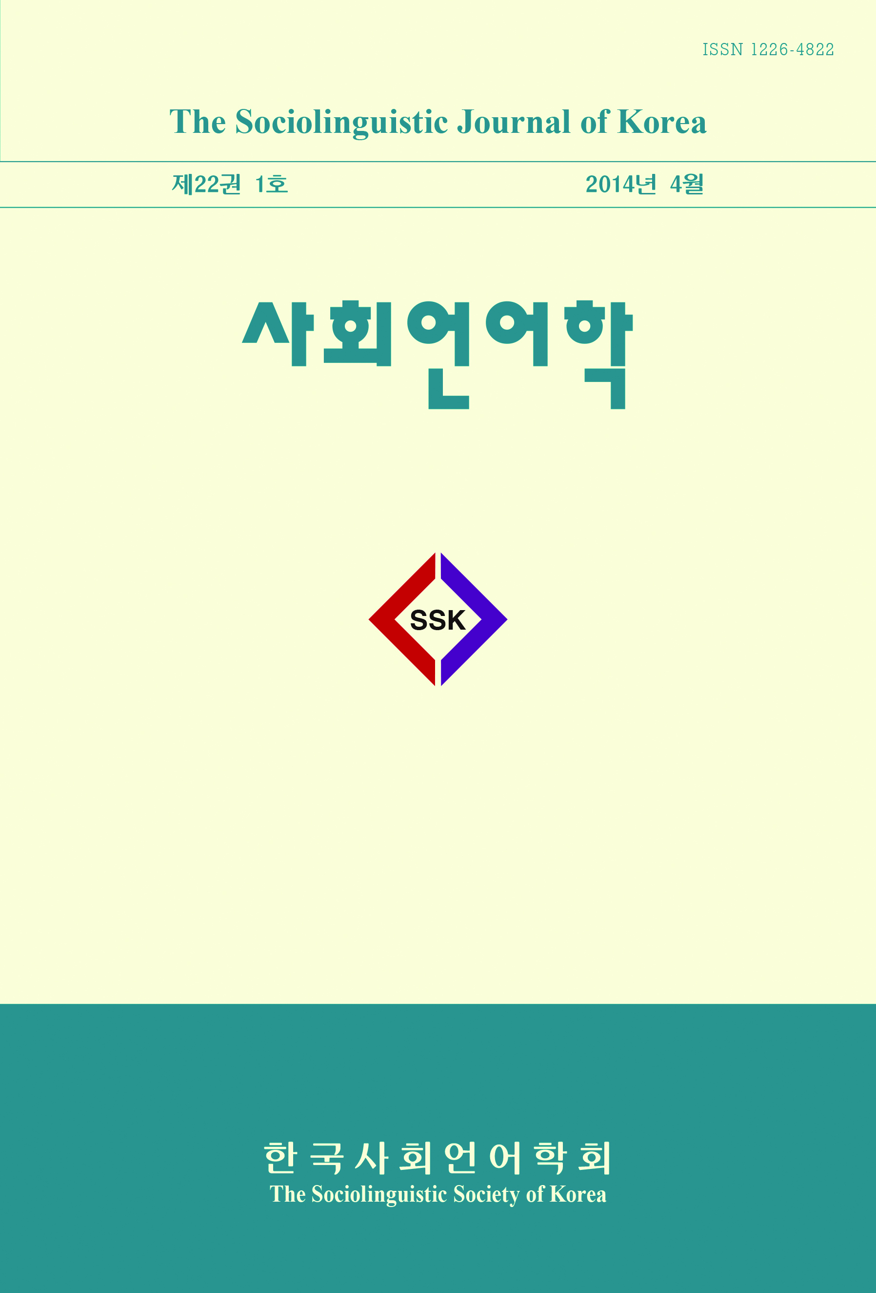
on by accumulating the knowledge and information based on the subject field of specialty publications
Academic journal
Multicultural study
College composition
Korean Studies
Reading Research
Sociolinguistics
The Writer and critic
System and economy

Slide 9
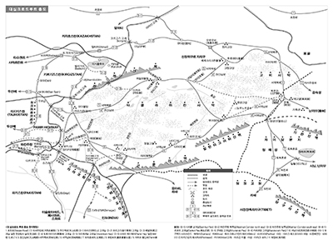
on by accumulating the knowledge and information based on the subject field of specialty publications
References 1
Silk Road Classic Travel Notes

Slide 10
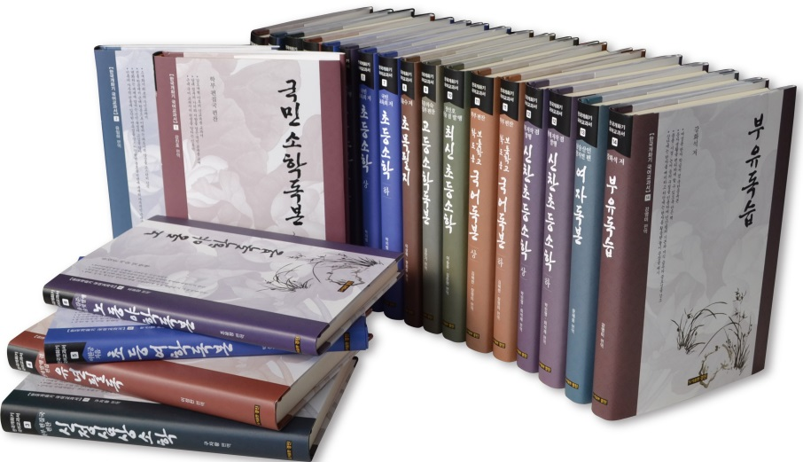
on by accumulating the knowledge and information based on the subject field of specialty publications
References 2
Sourcebooks of premodern textbooks of Korean
Compilations of premodern Korean textbooks with the original and the translation in modern language.

Slide 11
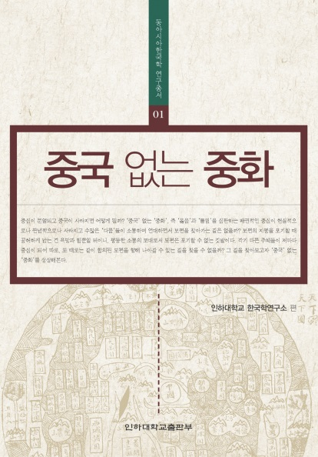
on by accumulating the knowledge and information based on the subject field of specialty publications
References 3
East Asia Korea research Series

Slide 12
on by accumulating the knowledge and information based on the subject field of specialty publications
References 4
Ocean University of China East Asia research Series

Slide 13
on by accumulating the knowledge and information based on the subject field of specialty publications
Sales record with Korean public libraries
2013 Book sales and MARC performance
Dogok information Library (contract price \15,790,000-contract complete)
Jongno Public Library (contract price \14,788,000-contract complete)
Sootaek Elementary School Library (contract price \2,389,000-contract complete)
2014 Book sales and MARC performance
Dobong Public Library (contract price \21,730,000-An annual contract complete)
Seodaemun Public Library (contract price \13,894,000-An annual contract complete)
Cheonggye Public Library (contract price \155,681,930-contract complete)
Godeok Lifelong Learning Center (contract price \24,797,000-An annual contract complete)
Dongjak Public Library (contract price \37,347,000-An annual contract complete)
Songpa Public Library (contract price \45,000,000-An annual contract complete)

Slide 14
on by accumulating the knowledge and information based on the subject field of specialty publications
In Global Contents Publishing Group
1. Excellent editing force who has in-depth experience
2. Experienced contents designer
3. Diverse production experiences : Magazines, catalogs, books,
public institution source book, etc.
We will always do our best!!

Slide 15
Thank you!!

