Slide 1
The CEAL committee on Korean Materials (CKM) 2016 Annual Meeting
Korean Government Information and Statisitcs
03/31/2016
JUNGWON YANG

Slide 2

Who I am
Jungwon Yang ( yangjw@umich.edu)
International Government Information and Public Policy Librarian
Univeristy of Michigan

Slide 3
Targeted Clients
Faculty members, researchers, and students, who cannot use Korean version materials.
Who need access reliable Korean government information in general
Who want access statistics related to Korea

Slide 4
Korean Government Information
Reliability
Accessibility

Slide 5

Reliability
Information Overflow
Difficult to find reliable resources
Use International Governmental Organization Resources
Such as
United Nations
OECD
World Bank
IMF
Image source: http://www.applicanttrackingsystem.co/blog/todays-is-the-world-of-information-overflow/

Slide 6
OECD iLibrary
Aka. Organisation for Economic Co-operation and Development
Originally Economic organization
Good resource for economic data of developed countries and some developing countries
  e.g. China, India, Brazil, and Indonesia
  Publication : Open to public
  Statistics : Subscription
  Theme : Agriculture, Economic, Education, Employment, Governance, Energy, Transportation etc.

Slide 7
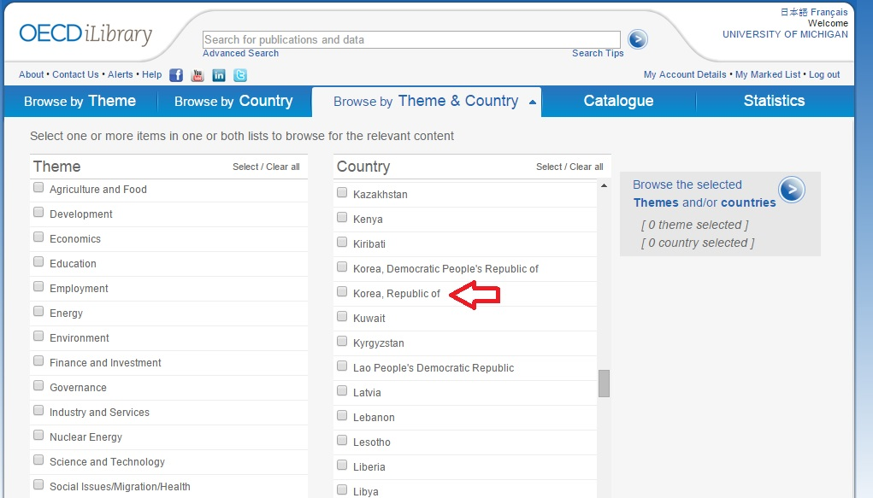
Check your library catalog first
If it is not available from your library, use following URL http://www.oecd-ilibrary.org/
Use Theme & Country to find government report

Slide 8
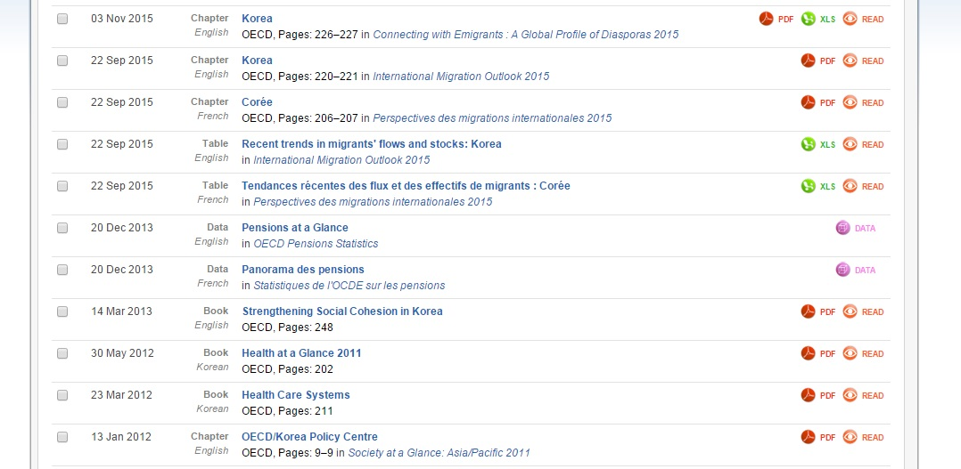
Social issue/Migration/Health AND Korea
Excel file in a report
Read vs. PDF
Dataset

Slide 9
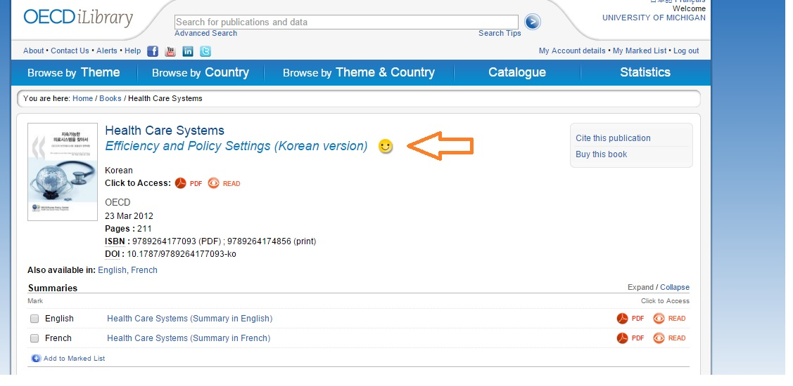
Availability

Slide 10
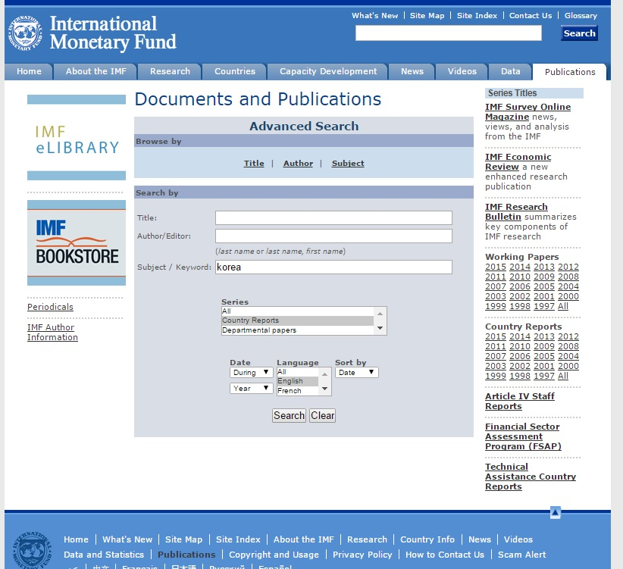
IMF working paper
Focused on Economic issues
International Monetary Fund
Country report in full text ( 1997- present)
Type “IMF working paper “ in google search
https://www.imf.org/external/publications/pubindadv.htm

Slide 11
Statistics
Reliability
Availability

Slide 12
Statistics
Strategy 1: Data from International governmental organization
-OECD iLibrary : subscription only
-IMF eLibrary Data : open to public , macroeconomic data , 1950-
-World Bank’s World Development Indicators (WDI): open to public , social issue/welfare/poverty data , 1960-
-United Nations Commodity Trade Statistics (COMTRADE):
open to public, results are limited to 50,000 records, comprehensive trade data
Research Guide : Finding Statistics international section (Univeristy of Michigan)

Slide 13
Strategy 2: use Korean government data
Korean Statistical Information Services (KOSIS)
  Population
  Income/wage
  Employment
  Finance
  Welfare
  Education
  Environment
GIS,Map and Statistics:Korea Library Guide (Univeristy of Michigan)

Slide 14
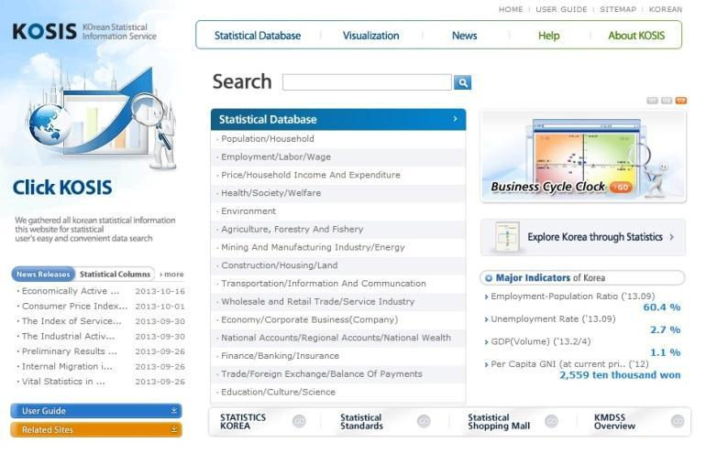
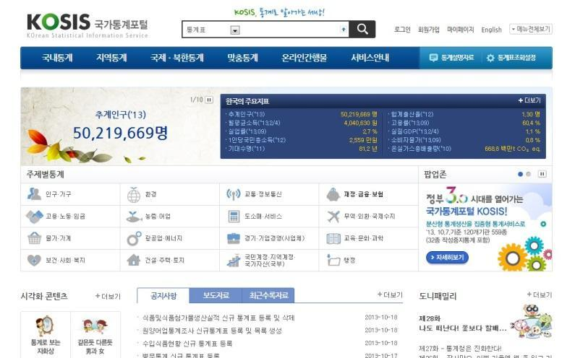
Korean Statistical Information Services (KOSIS)
  English version vs. Korean version
  Coverage : e.g. population 1970 vs. 1925
  Annual vs. Yearly, Quarterly, Monthly

Slide 15
Survey Data
Polling the Nation: Public Opinion , subscription only
Asian Barometer :
  Longitudinal data
  Public opinion on issues such as political values, democracy, and governance
ICPSR
  Korean General Social Survey (-2012)
  Presidential Election Panel Study
  KOSSDA ( Korea Social Science data Archive)
  Public Opinion Data Archive

Slide 16
Obstacles
Be aware of language barrier
Technical Problems : Internet Explorer only. Active X

Slide 17
Recommendations
Collaboration, collaboration, and collaboration !
For government information: collaborate with international document librarian, and political science librarian in your library
For statistics and geospatial data: collaborate with data librarian in your library
Use listserv of CKS.

Slide 18
What I did not cover today
Geospatial data in Korea
Actual data retrieval process from International statistical databases
How to find subnational statistics from KOSIS

Slide 19
Thank you!
Questions ?

