Slide 1
Strengthening the Chinese
Electronic Resources Supply Chain
with Standards and Best Practices
Bie-hwa Chen Ma
Chinese Language Electronic Resources Cataloging Librarian
Shared Cataloging Program Unit
Systemwide Collections Services
UC San Diego Libraries
bcma@ucsd.edu
March 14, 2012

Slide 2
Outline
Chinese E-resources Access and Cataloging Issues
Current Standards & Best Practices
OpenURL and DOI
KBART
PIE-J
Unaddressed Issues and Future Developments
How You Can Help

Slide 3
Long-standing Chinese E-resources Cataloging & Access Issues
Vendor-provided metadata
Content presentation and identification
URL and link resolution
Others
Word division of Pinyin
OCLC records
Character formats (traditional vs. simplified)…
Notes:
Vendor-provided metadata
Inaccurate (citation issues resulted from hidden title changes), inconsistent, incomprehensive, title list distribution, …
Content Presentation and Identification
Missing (title pages, etc.), blurry images, mistranslated during digitization, hidden titles, renumbering, …
URL and Link Resolution
Permanent URL provision and change alert
Link resolution providers’ inexperience in managing Chinese language resources
No/weak relationship between K-B providers and content providers
Availability of title-level links
Others
Word Division of Pinyin, OCLC records, character formats (traditional vs. simplified)…

Slide 4
Feasible Collective Resolutions
Source of problems
All responsible parties in
the supply chain
Key to win-win
solutions:
Collaboration
Feasible solutions
OpenURL, KBART, and PIE-J
Authors
A & I
Services, OPAC,
Search engines
Content providers/
Aggregators
Platform
providers
Link
resolvers
Libraries
Publishers
Roles in E-resources Supply Chain

Slide 5
Current Standards
&
Best Practices
Notes:
In the following session, current standards and best practices will be introduced with examples of good or bad practices explaining how these standards and practices can help.

Slide 6
Linking Technology
Static URL
Source Target
Persistent URL (PURL)
Source HTTP Redirect Target
BibPURL: http://bibpurl.oclc.org/web/42677 http://ej.nict.gov.tw/JTR
Digital Object Identifier Persistent Link (DOI System URL + DOI)
http://dx.doi.org/10.1007/978-1-4614-1296-0
http://www.springerlink.com/content/m4nk15/#section=957676&page=1
Open URL
Source Link Resolver
Static Link (e.g., http://www.wanfangdata.com/wf/~kjqk/hljda/index.html)
PURL
Current URL
User Accessible Target(s)
(Appropriate Copy/Copies of the resource)
(Citation)
Source link/ outbound link/ Source OpenURL
(Query)
Target link(s)/ inbound links
Target OpenURL
(output)
Knowledge Base (K-B)

Slide 7
OpenURL Standard, Benefits, Linking Practices
OpenURL Framework for Context-Sensitive Services Standard
Source OpenURL link examples
Version 0.1: http://openurl.cdlib.org/?sid=SCP:SCP&genre=article&__char_set=utf8&title=黑龙江档案
Version1.0: http://resolver.example.edu/cgi?url_ver=Z39.88-2004&rft_val_fmt=info:ofi/fmt:kev:mtx:book&rft.isbn=0836218310&rft.btitle=The+Far+Side+Gallery+3
OpenURL benefits
Appropriate copies
Reduce linking failures
Lower link maintenance cost
Interoperability for data exchange
Linking practices for Chinese resources
Mostly incompliant with DOI or OpenURL
Bad quality metadata in K-B

Slide 8
KBART recommended best practices
Why KBART
Knowledge Bases And Related Tools (KBART) Working Group
Launched by UKSG and NISO in 2008
Goal: to improve the supply of data to link resolvers and knowledge bases
“Phase I Recommended Practice” published in 2010
Phase I Recommendation (Focused on journals)
Exchange method and frequency
Data format
Fields labels and order
Specifics for certain fields

Slide 9
KBART Recommendation
Exchange Method and Frequency
Method: Website or FTP
Frequency: Monthly if applicable
KBART addresses the Chinese E-resources metadata exchange issues
Mostly by request only
Irregularly and infrequently
Only half of the journal packages in K-B

Slide 10
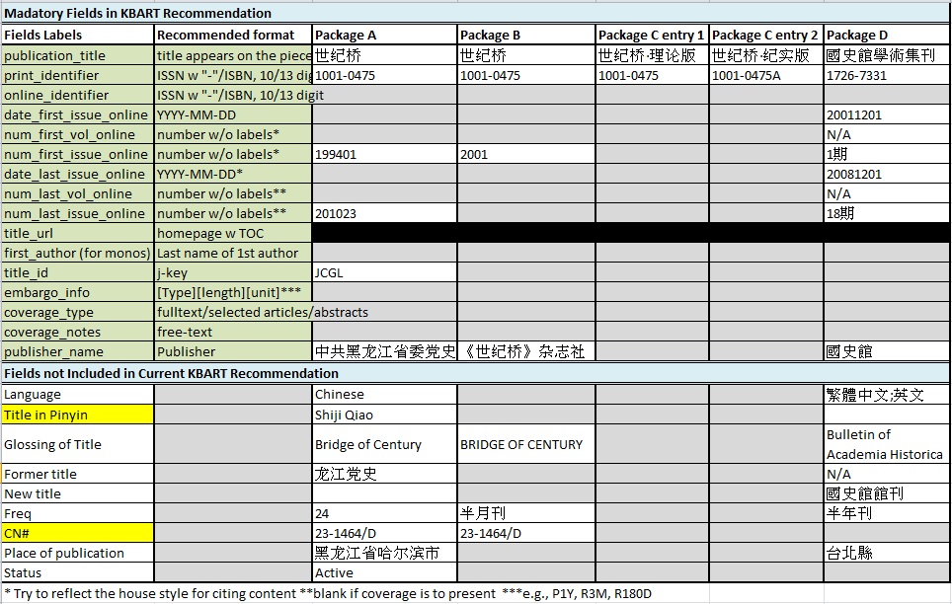
Provider-Supplied Metadata
Vs. KBART Mandatory Fields & Data Format:
Various data formats
Inaccurate ISSN
Missing important metadata for KB & cataloging needs
(Cells in gray)
Non-Roman specific fields to be added?
No separate entry for old/new title

Slide 11
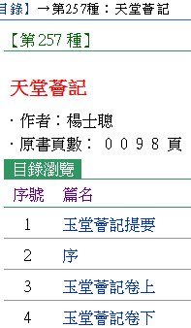
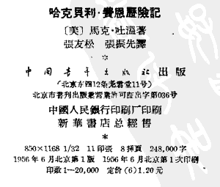
KBART Recommendation can help eliminate these practices!
Title on website
Date in the MARC record, 1960
Date on the image of colophon, 1956
Title in the digitized resource

Slide 12
Presentation and Identification of E-Journals (PIE-J)
Best Practices
Presentation and Identification of E-Journals (PIE-J) Working Group: formed by NISO in 2010
Goal: to develop a recommended practice on the presentation and identification of e-journals
Best Practices: to be published in 2012
Best Practices highlights
Retention of original title and citation information
Display of correct ISSN, title histories, & publication information
Creation of a presentation for easy access to all content
Digitization consideration

Slide 13
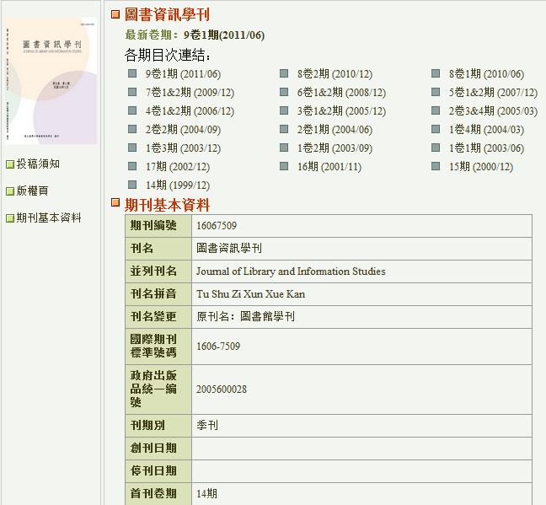
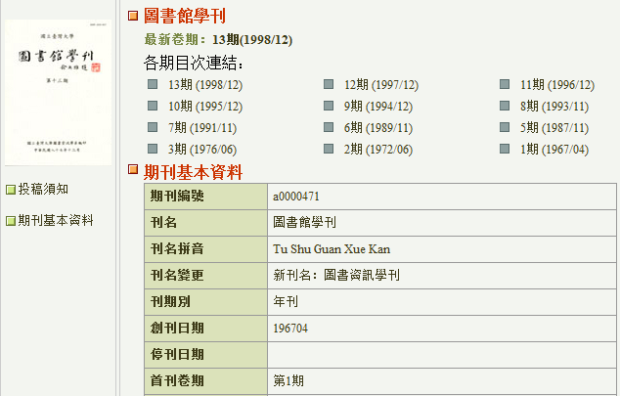
PIE-J Best Practices – Title Change A Good Example
All content from the former title is presented in a separate website under the title and the identifying citation information it was originally published.
Later title
Former title

Slide 14
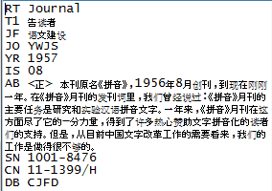
PIE-J Best Practices – Citation Output
“Ensure that all outputs by the publisher of provider (e.g., Table of Contents alerts, exporting or e-mailing citations of articles) use the journal title and other identifying citation information under which the content was originally published.”
The above practices can eliminate the citation problems below.
No ISSN 拼音 [Pin yin] 1956-1957
0511-4764 文字改革 [Wen zi gai ge] 1957-1985
1001-8476 语文建设 [Yu wen jian she] 1986-
RefWorks output for the 2nd article
Saved search results from different titles presented and listed under latest title
Renumbered by the provider.
Cited under the latest title

Slide 15
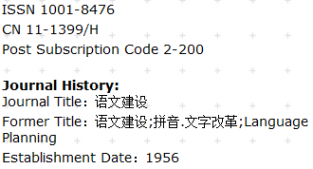
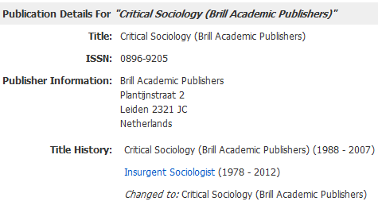
PIE-J Best Practices – Journal History & ISSN
“Provide a journal title history. Include the full journal title, publication date range, and ISSN for the current title”
Best example among Chinese journal packages
Good example of best practice

Slide 16
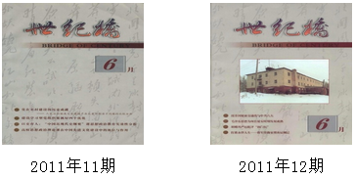
PIE-J – Keep identifying information consistent across all versions
“Retain content once it is published, whether digitized from the print or born digital. Do not remove, rename, or renumber content. ”
Bad practices that could have been eliminated.
Package A:
Package B:

Slide 17
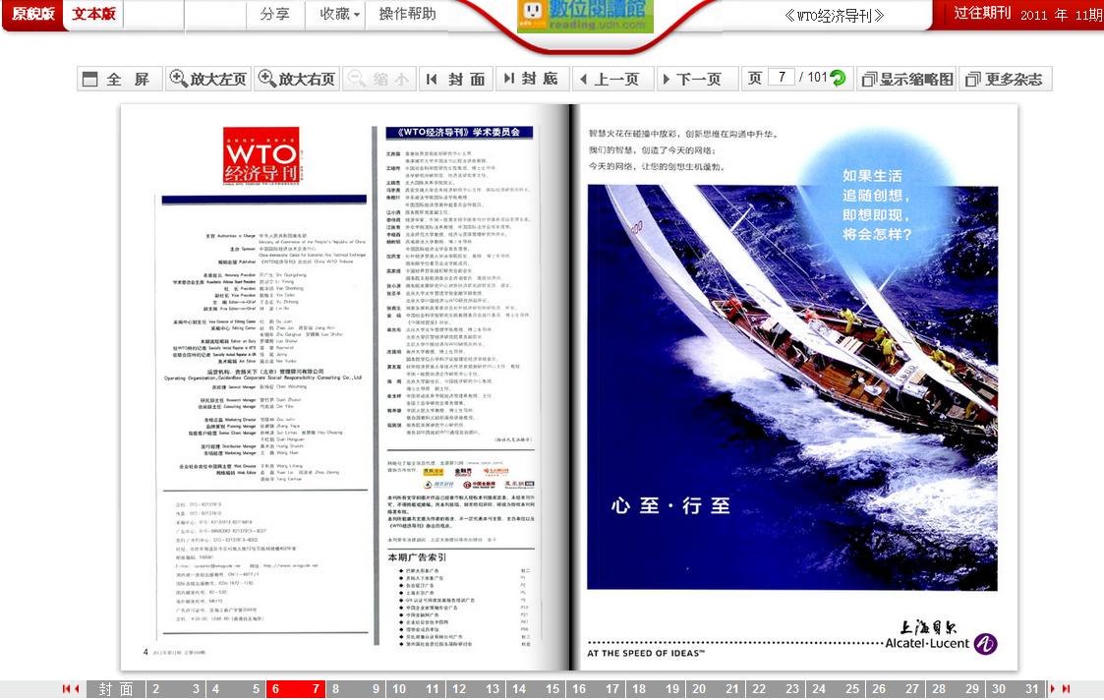
PIE-J Best Practices – Digitize from Cover to Cover
“Digitize the entire original volume or issue, front and back covers, and all internal pages, including blank or nearly blank pages, and advertisements ”
The only one and best example from DragonSource

Slide 18
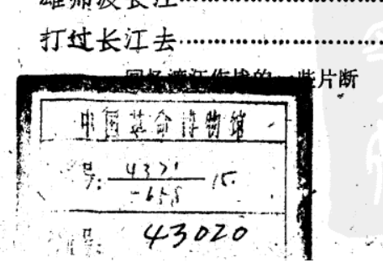
Unaddressed Issues/Future Developments
Pinyin word division discrepancy
中国史研究动态
Vendor Zhongguo Shi Yanjiu Dongtai
SFX zhong guo shi yan jiu dong tai
ISSN Zhongguoshi yanjiu dongtai
OCLC Zhongguo shi yan jiu dong tai
Chinese E-books presentation
Missing content
Resolution requirement
Underway
KBART phase II
IOTA
Data covered by labels from a library

Slide 19
How you can help
Work with the standards & best practices in mind
Catalogers: Create records with accurate and most complete metadata
Acquisitions: Connect content and K-B providers
Bibliographers: Incorporate them into contracts wherever possible
Content providers/Publishers/K-B team/A & I Services/Search engine providers: Endorse standards and practices as they are to your benefits!
For everyone:
Report metadata errors
Promotion and adoption of standards and best practices
Pass information and provide education if necessary
Recognize providers/publishers who adopt them
e.g., KBART logo:
Use them as communication tools among relevant parties

Slide 20
How you can help (cont.)
Participate in the public review of the best practices
Get Involved with future developments
Input your ideas on forming a CJK working group
Sponsors
Members
Charge
Identify CJK-specific issues
Recommend CJK-specific best practices
Work as a liaison between CEAL and related working groups
…
Your continued support!

Slide 21
Recommended Readings
Glasser, S. (2012). Broken links and failed access : how KBART, IOTA, and PIE-J can help. Library resources & technical services, 56(1), 14-23.
OpenURL Framework for Context-Sensitive Services http://www.niso.org/apps/group_public/download.php/6640/The%20OpenURL%20Framework%20for%20Context-Sensitive%20Services.pdf
DOI http://www.doi.org/, http://www.crossref.org/
Knowledge bases and related tools : a recommended practice of the National Information Standards Organization (NISO) and UKSG http://www.uksg.org/sites/uksg.org/files/KBART_Phase_I_Recommended_Practice.pdf
KBART: endorsement http://www.niso.org/workrooms/kbart/endorsement/
Presentation and Identification of E-Journals (PIE-J)
http://www.niso.org/workrooms/piej
http://www.slideshare.net/twissbrooks/best-practices-for-presentation-of-e-journals-part-1
http://www.slideshare.net/twissbrooks/best-practices-for-presentation-of-e-journals-part-2
IOTA: Improving OpenURLs Through Analytics
http://www.niso.org/workrooms/openurlquality/

Slide 22
Q & A
Bie-hwa Ma
bcma@ucsd.edu

