Slide 1
On RDA Implementation 2013 CEAL Annual Meeting 3:30-4:45 PM , Thursday, March 21, 2013 Manchester Ballroom A, Manchester Grand Hyatt, San Diego Complimentary Refreshment Provided by OCLC. Thanks!!
The CEAL Committee on Technical Processing & OCLC CJK Users Group
Joint Program

Slide 2
Committee on Technical Services (CTP) Membership (2011-2014)
Dongyun Ni
Librarian, Original Cataloging Collection Services
University of Hawaii at Manoa
Yue Shu
Chinese Librarian
Smithsonian Institution Libraries
Jai-hsya Tsao
Head, East Asian Technical Services East Asian Collection University of Chicago Library
EunHee Nah (2011-2012)
Korean Cataloger
Harvard Yenching
Library Harvard University
Shi Deng (Chair)
Head, CJK Acquisition/Cataloging Unit
Metadata Services Department
UC San Diego Libraries
Erica Soonyoung Chang
Librarian, Korean Language Specialist
Original Cataloging Collection Services University of Hawaii at Manoa
Yoko Kudo
Metadata and Media Cataloging Librarian Metadata and Technical Services
University of California, Riverside
Mieko Mazza
Japanese Technical Services Librarian
East Asia Library
Stanford University

Slide 3
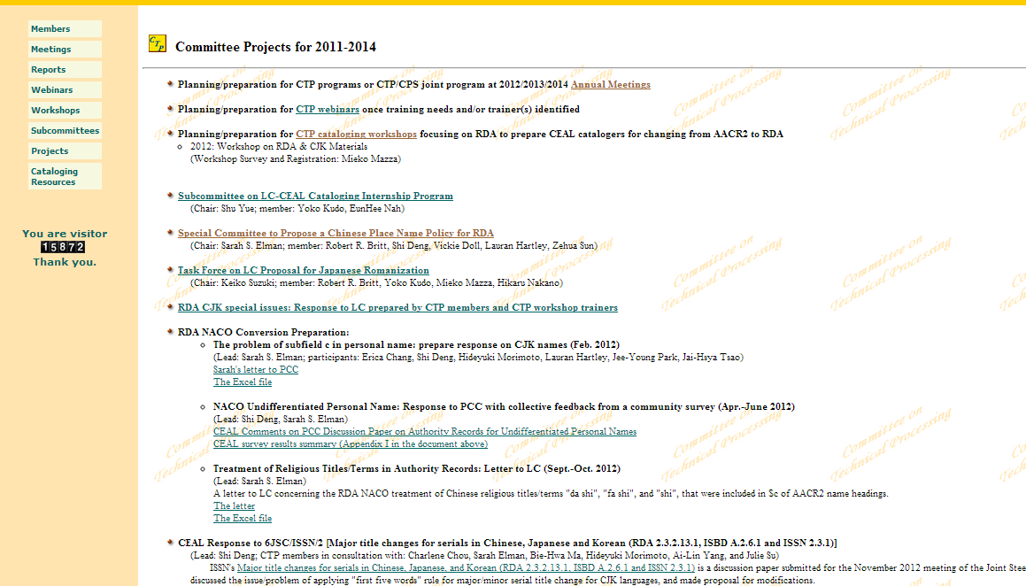
CTP Activities on Project Page http://www.eastasianlib.org/ctp/projects/project11_14.htm

Slide 4
OCLC CJK Users Group Membership (2012-2014)
Charlene Chou (Chair)
Chinese Cataloger
C.V. Star East Asian Library
Columbia University
Shuyong Jiang (Vice Chair/Chair Elect)
Chinese Studies Librarian/Cataloging Coordinator
University of Illinois
Keiko Suzuki (Member at Large)
Catalog Librarian
East Asia Library
Yale University
Xiuying Zou (Member at Large)
Public Services Librarian
University of Pittsburgh
Jade Atwill (Chinese Officer)
Asian Studies Librarian
Penn State University
Hikaru Nakano (Japanese Officer)
East Asian Cataloger
University of Florida
Erica Chang (Korean Officer)
Librarian, Korean Language Specialist
Original Cataloging Collection Services University of Hawaii at Manoa
Sharon Domier (Past Chair)
East Asian Studies Librarian
University of Massachusetts, Amherst
http://eastasianlib.org/oclccjk/oclccjk/Welcome.html

Slide 5
On RDA Implementation
Program introduction
LC Updates (Thompson Yee, LC)
PCC Updates
Updates (Linda Barnhart, UCSD)
Q&A (Becky Culbertson, UCSD)
OCLC Updates (Cynthia Whitacre, OCLC)
CJK NACO Project (Sarah S Elman, Columbia)
Q&A session

