Slide 1
RDA Implementation:
Current Status & Known Issues
The CTP Subcommittee on RDA, 2013-2015
March 27th, 2014

Slide 2
Agenda
Part one: RDA Survey Report
Part two: Known Issues
  Analyzing impact on resources discovery
  Strategies of solutions
Questions & Comments

Slide 3
Part One
RDA Survey Report

Slide 4
RDA Survey Form
Five questions only
  Goals:
    Know the current status of RDA implementation, as CEAL CTP provided two RDA workshops in 2012 & 2013
    Get more inputs to help prioritize the known issues, esp. including the comments from public services
92 Responses received worldwide
  Day 1: received 51 responses from most libraries implemented RDA already
  A worldwide survey: the last response coming from South Africa

Slide 5
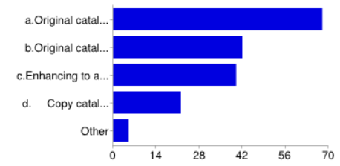
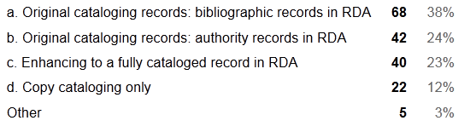
Part One--Implementation status--1. Has your institution implemented RDA yet? If yes, have you contributed the following kinds of records?

Slide 6
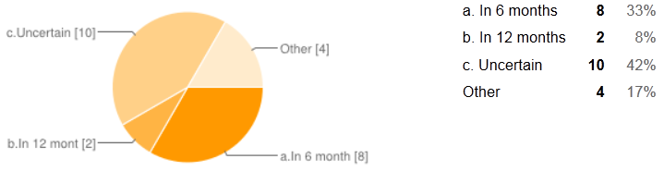
2. If you have not implemented RDA yet, when will your institution plan to do?

Slide 7
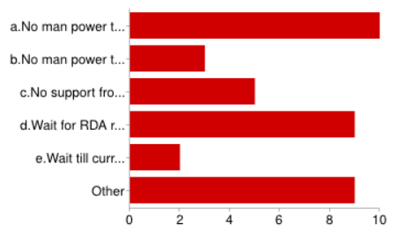
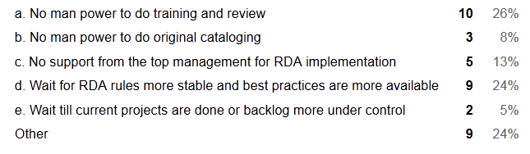
3. If you have not implemented RDA yet, what are major obstacles?

Slide 8
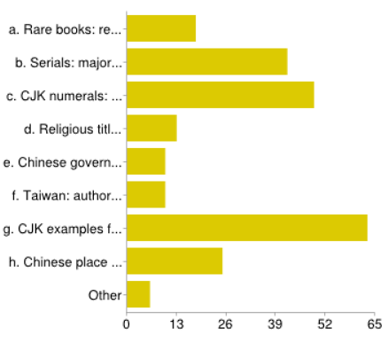
Part Two--Prioritization of the known issues--4. If you have implemented RDA or are aware of RDA rules, how would you prioritize the following issues for the CTP Subcommittee on RDA to work on:

Slide 9
Top five of popular votes
CJK examples for each format (like DCEAM for AACR2)
CJK numerals (follow-up with LC responses, e.g. Arabic numbers vs. Romanized forms)
Serials: major & minor changes; CEG updates
Chinese place name (guidelines/policy on implementation of RDA 16.2.2.12 Alternative)
Rare books (e.g. relationship designators such as Chinese rare books guidelines and Pre-Meiji rare books guideline (collaboration with CJM)

Slide 10
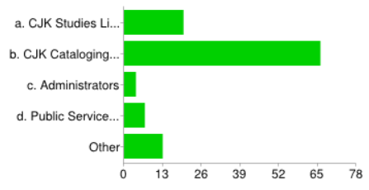
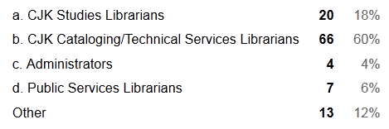
Part Three--5. Your position or work specialization

Slide 11
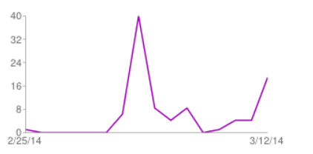
Number of daily responses
Notes:
-51 responses received at the day one and most from the cataloging librarians implemented RDA already
-More responses coming from public services librarians after a few days

Slide 12
Observations
Most institutions implemented RDA, contributing original bibliographic records (38%) with 24% contributing authority records
More responses coming from the institutions implemented RDA rather than the ones without implementing RDA yet
Many libraries are planning to implement in 6 months (33%) but many libraries (59%) still uncertain or with certain reasons to implement later
Major reasons to postpone RDA implementation are related to training and administrative supports as well as waiting for RDA rules more stable and best practices available

Slide 13
Observations
Prioritization
  CJK examples are so important for us!!!
  General issues gain more attention such as CJK numerals
  Authority records seem to gain less attention, esp. best practices for authorized access points
  Serials and rare books still received many votes for their significant value of collections
Most responses (60%) coming from CJK cataloging/TS librarians, but still receiving 40% responses from non-TS librarians

Slide 14
Part Two
The Known Issues of RDA:
analyzing the impact on users/ resources discovery &
strategies of solutions

Slide 15





Forest vs. Trees: will RDA help us see the forest for the trees?
Notes:
May RDA bloom like cherry blossom beautifully! We have to do detailed work for cataloging and authority control, but hopefully can see the forest for the trees as well!
As one of RDA goals is to help users identify and discover the resources, we have to consider rule interpretation and best practices in the perspectives of resources discovery, don’t we?

Slide 16
Most votes go to more general issues
CJK examples for each format (like DCEAM for AACR2)
CJK numerals (follow-up with LC responses, e.g. Arabic numbers vs. Romanized forms)
Serials: major & minor changes; CEG, Appendix O, updates on examples
Note: category 1 & 2 have received most votes and are more self-evident, so they won’t be elaborated as follows.

Slide 17
Top 3--Serials: major and minor changes
First five words for CJK titles
  ISSN discussion paper
  Adding more CJK-specific categories for minor changes, e.g. adding or deleting jurisdiction terms such as Sheng(省), Shi(市), Xian(县), etc.
Pros
  Keep minor changes on the same record
  Creating or searching for less bibliographic records if no major scope change for this title
Cons
  More mixed practices: first 5 words—mechanically easy
  Less consistencies: some treated as major and some minor, e.g. the interpretation of scope change
Updating CJK examples in CEG (CONSER Editing Guide), Appendix O

Slide 18
Top 5—To update the rules of CJK rare books according to RDA
Cataloging Guidelines for Creating Chinese Rare Book Records In Machine-Readable Form (revised 2009)
  10.2: Use Chinese terms and romanization to transcribe distinctive functions (e.g., bian zhuan for editor, jiao for collator) after the romanized and Chinese character personal name/date(s). Describe some functions conventionally (e.g., ke for publisher, ke gong for block-cutter, shou cang for collector)
    Option 1--Keep current practice
      7001 劉希賢, $e 刻工.
      7001 Liu, Xixian, $e ke gong.
    Option 2—Adopt RDA English terms: propose new terms if not in Appendix I
      7001 劉希賢, $e engraver. (rather than block-cutter)
      7001 Liu, Xixian, $e engraver. (rather than block-cutter)
    Option 3
      7001 劉希賢, $e 刻工.
      7001 Liu, Xixian, $e engraver.
  An international initiative
    To develop the guidelines on Relationship designators for Chinese rare books in conjunction with experts in Mainland China, Hong Kong and Taiwan
  A wider standard community—DCRM community
    Adding relationship designators to the Open Metadata Registry

Slide 19
Shall we update the rules of CJK rare books according to RDA?
Descriptive cataloging guidelines for pre-Meiji Japanese books (2011)
  The guidelines do not have any provision for access points at all and intentionally limited to description.
  Update the guidelines (collaboration with CJM) according to RDA?
Korean rare books: a brief draft was made in 2005 and has not been updated to RDA yet
Key questions:
  Will these relationship designators (either in English or CJK) helpful for users?
  PCC: only creator required but contributors optional
  DCRM-RDA Task force: final report

Slide 20
Authorized Access Points: receiving less votes
*Geographic Names (RDA16.2.2.12 alternative)
*Religious title or terms of honour (RDA9.4.1.9)
*Chinese government agencies (RDA11.2.2.14.2/LCRI24.18)
*Taiwanese corporate names (LC-PCC PS for RDA16.4)

Slide 21
RDA Geographic Names
Chinese geographic names
  Implementation proposal for implementation RDA 16.2.2.12 Alternative
    Stage 1: for newly created geographic NAR, follow new instructions, e.g. Qianxi Xian (Guizhou Sheng, China)
    Stage 2: work with LC/PCC to develop guidelines on the retrospective conversion of established names, e.g.
      Hangzhou Shi (Zhejiang Sheng, China)
    Others: maintenance issues
Japanese and Korean geographic names
  Will CEAL CJM and CKM implement this?

Slide 22
Religious titles or terms of honour
RDA9.4.1.9--Other Term of Rank, Honour, or Office
  Record other titles of the person indicative of rank, honour, or office if the terms appear with the name. Record the term in the language in which it was conferred or in the language used in the country in which the person resides.
  Example: Captain, Reverend, Sir
CJK: da shi, fa shi, shi, etc.
  “da shi”: a religious rank or title?
  CEAL:
    “Da shi (大师): either a religious title or general respectful address: determined case by case following authoritative reference sources.
    “Fa shi (法师): is more likely to be a religious title but the same instruction can be given.
    “Shi (释)” is an acquired Buddhist name equivalent to “last name.”
    Note: these terms have equivalents in Japanese and Korean.
  LC response (March 2013)
    Treat the term as a term of honour instead of a religious title if you don’t have evidence to the contrary; as a term of honour, it would only be added to break a conflict. Note that we would also propose that existing authority records that use “da shi” and “fa shi” should be treated as “acceptable” under RDA.
  Follow-up: CEAL best practice?

Slide 23
Chinese government names
Mixed practices in LCNAF for years (LCRI 24.18, type 1)
  Some entered subordinately but some not
How do you search Chinese government agency names?
  Have you seen the following mixed practices?
    Yichun Shi gong an jiao tong jing cha zhi dui (伊春市公安交通警察支队)
      Will you search under “Yichun Shi (China). Gong an jiao tong jing cha zhi dui” or differently?
      Comparison: Ningxia Huizu Zizhiqu cheng shi she hui jing ji diao cha dui (宁夏回族自治区城市社会经济调查队)
    Gaocheng Xian Taixi da dui li lun xiao zu (藁城县台西大队理论小组)
      Will you search under “Gaocheng Xian (Hebei Sheng, China). Taixi da dui. Li lun xiao zu” or differently?
    Xizang Zizhiqu ke xue ji shu ting (西藏自治区科学技术厅)
      Will you search under “Xizang Zizhiqu ke xue ji shu ting” or differently?
      Comparison: China. $b Shen ji shu. $b Ban gong ting (审计署办公厅)
Notes:
For years, some access points have been entered subordinately and some not entered subordinately. All these inconsistencies won’t help search the data in the LC/NAF and may lost one of main function to retrieve all related access points.

Slide 24
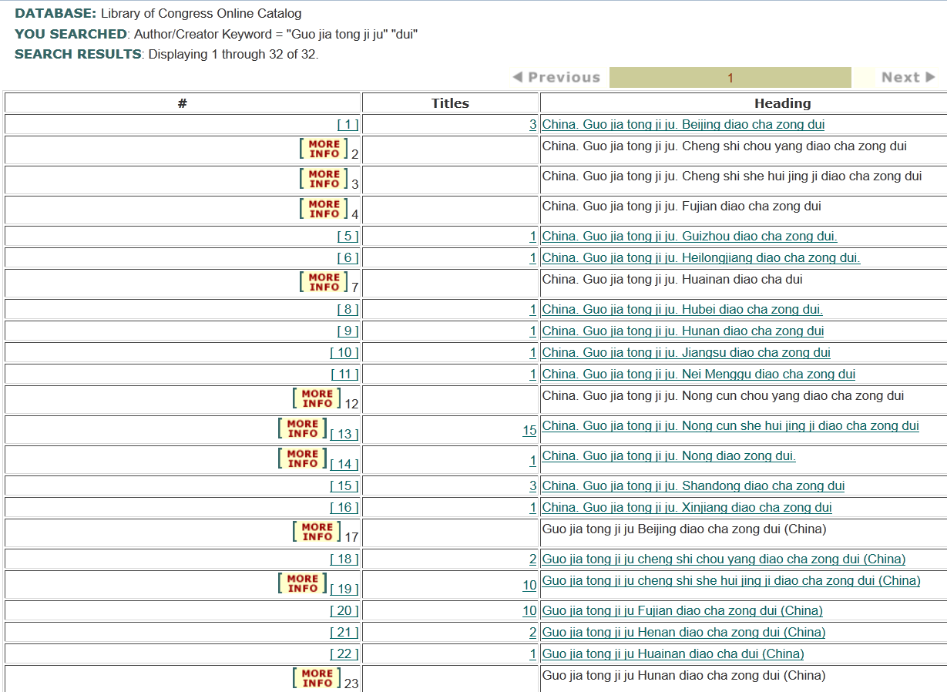

Slide 25
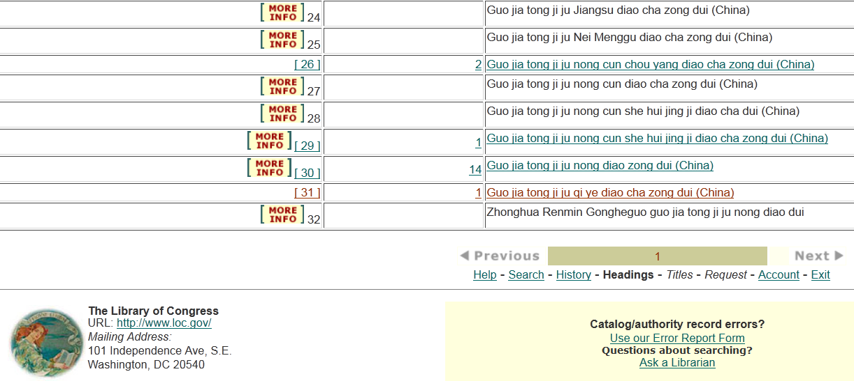
Notes:
-11 access points entered subordinately and 9 entered not subordinately
-Authorized access points are underlined, so the ones without underline are variant forms (cross references)

Slide 26
Chinese government names: recommendations
Design a reference tool with instructions
  Lack of an authoritative and updated reference book on Chinese government names and official websites with limited information, esp. no history of name changes, it is usually difficult in determining its relationships among different names
Propose a Chinese list
  With LC-PCC PS for RDA 11.2.2.14.2—“Terms that Normally Imply Administrative Subordination”, there is a list of English, French and Spanish terms, but there is no Chinese list which we need it for the definition and clarification for Chinese terms.
Further research:
  A related rule for Type 2 or 11.2.2.14.2 is also difficult to handle. Further discussion on this related rule may need to be done as well.

Slide 27
How do you search Taiwanese corporate bodies/government agencies?
According to LC-PCC PS for RDA 16.4 for Taiwan,
  Use “China (Republic : 1949-)” as the authorized access point for the government of this name. Use “Taiwan” for the province of Taiwan only as a location qualifier.
  Do you know how to apply this rule?
  A question raised at the Listserv, but most felt hard to follow this rule …
Have you noticed the inconsistency of Taiwanese access points for years?
  Guo li zhong yang tu shu guan (China) [國立中央圖書館]→ Guo jia tu shu guan (Taipei, Taiwan) [國家圖書館]
  Guo shi guan (China : Republic : 1949- ) [國史舘]
    Guo shi guan (Beijing, China) → Qing shi guan (Beijing, China) [清史馆]
    Guo shi guan (China) → Guo shi guan (China : Republic : 1949- )
  Question: will users search them with these qualifiers?

Slide 28
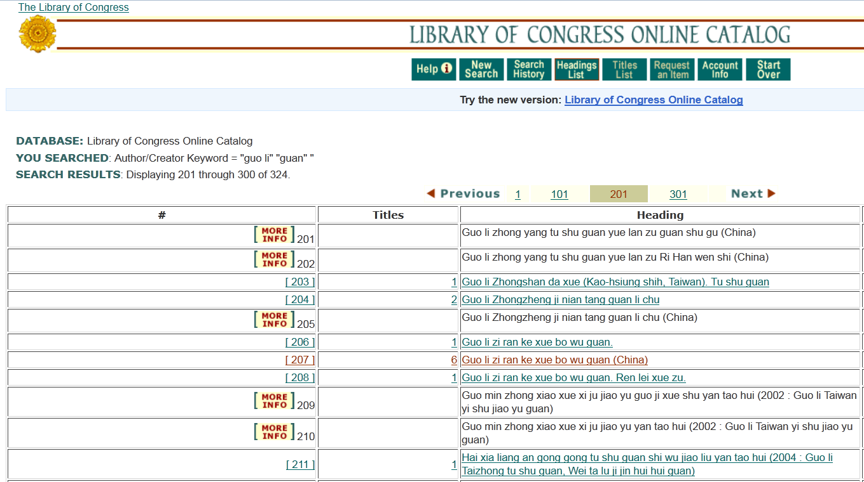

Slide 29
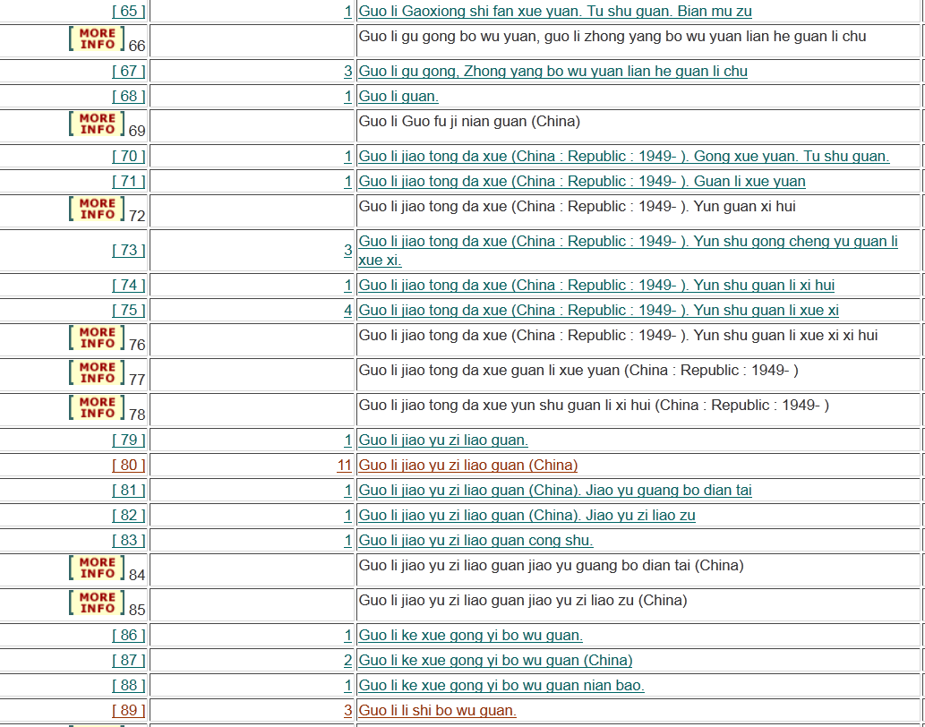

Slide 30
Points to ponder
Shall we make authorized access points (e.g. corporate body names) more consistent in both bibliographic and authority records?
If the form of authorized access points (e.g. corporate body names) remain so inconsistent,
  Does it defeat the purpose of authority control?
  Are these access points helpful or more confusing for our users?

Slide 31
Personal collection with title ---集/文集/ 全集:
CJK best practice needed?
On piece: 그녀가 보인다 : 金宣宰 小說集
  AACR2:
    245 10 그녀가 보인다 : $b 金宣宰 小說集.
  RDA 2.4.1.8 instruction—”If a noun or noun phrase occurs with a statement of responsibility, treat the noun phrase as part of the statement of responsibility”
    LC/PSD interpretation: 그녀가 보인다 / $c 金宣宰 小說集.
    Due to the CJK languages different from English, some CEAL members’ interpretation or preference: 그녀가 보인다 : $b 金宣宰 小說集
    Does this rule change helpful for users’ discovery?
    Do we need to establish CEAL best practice for this rule interpretation or request “alternative for CJK languages” for more flexible rule interpretation?
Notes:
LC/PSC response to 中上健次集, if recording 245 “集”, it needs 246 for “中上健次集”.

Slide 32
Next steps
CTP Subcommittee on RDA
  Establish task groups to study and propose best practices for certain issues, including some members from Asia
    For CEAL to review and comment
    Propose to ALA/JSC/LC-PCC/ISSN, etc.
  Categories
    CJK examples (DCEAM & CEG)
    Rule revisions, e.g. alternative for CJK languages
      CJK numerals
      CJK serials
      Personal Collections
      Taiwan
    CEAL best practices
      Rare books
      Chinese government agencies
  Goals:
    An international initiative and a wider standard community

Slide 33
CTP subcommittee on RDA
Dec. 2013-Nov. 2015
Membership:
Charlene Chou (Chair, U Washington), Erica Chang (Hawaii), Erminia Chao (BYU, AV materials), Jee-Young Park (Chicago), Mieko Mazza (Stanford), Rob Britt (U Washington, laws & public services), Shi Deng (UC San Diego), T.J. Kao (Yale)
Ex-officio: Shi Deng, CTP chair
Consultant: Hideyuki Morimoto (Columbia)
Liaisons: Sarah Elman (Columbia, CJK NACO Project liaison); Jessalyn Zoom (LC, LC liaison)

Slide 34
Questions or Comments?
Thank you!

