Slide 1


Open Discovery Initiative (ODI) Recommendations to Content Providers and Library Professionals
Laura Morse
Director, Library Systems
Harvard University
Council on East Asian Libraries 2016 Annual Meeting
March 29, 2016

Slide 2
Workshop Agenda
  Overview of ODI History and the Recommended Practice
  Small Group Discussion
  Report Out / Open Discussion
  Q&A

Slide 3
Survey Says – Attendee Goals for Discovery Systems
  Allow users to effectively find and access resources across locally owned, licensed, or open access portions of collections, for all formats of material, whether in print or online/digitized
  All this and make it convenient, seamless, and well organized, too!

Slide 4
Setting Context for the Discussion
  Library mission statements align with providing broad and comprehensive access to information to users.
  The Harvard Library advances scholarship and teaching by committing itself to the creation, application, preservation and dissemination of knowledge.
  The UC San Diego Library, ranked among the nation's top 25 public academic libraries, plays a critical role in advancing and supporting the university's research, teaching, patient care, and public service missions. The world-renowned research for which UC San Diego is known starts at the UC San Diego Library, which provides the foundation of knowledge needed to advance cutting-edge discoveries in a wide range of disciplines, from healthcare and science to public policy and the arts.
  University of Hawai‘i at Mānoa Library: Our faculty and staff serve as the human connection between people and the knowledge resources that they need to succeed. We acquire, organize, preserve, and provide access to information resources and are active partners in the University’s mission to promote information literacy. The Library provides a sustainable learning environment that meets the space, computing, and information needs of the UHM academic community. The Library is a premier resource for Hawaii, Pacific and Asia-related research. It facilitates access to knowledge throughout the world and contributes unique content to global networked information resources.
  The Getty Research Institute is dedicated to furthering knowledge and advancing understanding of the visual arts and their various histories through its expertise, active collecting program, public programs, institutional collaborations, exhibitions, publications, digital services, and residential scholars programs. Its Research Library and Special Collections of rare materials and digital resources serve an international community of scholars and the interested public. The Institute's activities and scholarly resources guide and sustain each other and together provide a unique environment for research, critical inquiry, and scholarly exchange.
  The mission of the University of Toronto Library is to foster the search for knowledge and understanding in the University and the wider community. To this end, we shall provide innovative services and comprehensive access to information founded upon our developing resources as one of the leading research libraries in the world.
  KU Libraries advance discovery, innovation and learning for KU, for the state of Kansas and for a rapidly expanding community of world scholars. We equip our students for a knowledge-driven, global society, and we support research and scholarly communication through collaborative opportunities at KU and beyond.
Notes:
Laura will do a live demo of a selection of current tools in use.

Slide 5
Setting Context for the Discussion
  Content provider mission statements align with library goals.
  SSAP is committed to producing classics of broad and long-lasting influence both within academia and beyond, and increasingly, both inside and outside of China. In addition to books in a wide range of topics in sociology, history, law, education, environment, economics, linguistics and other disciplines, SSAP has spearheaded and made great strides in serial publications and multimedia products.
  CIBTC has always shouldered the task of disseminating the fine culture of the Chinese nation, promoting cultural exchanges between China and the rest of the world, expanding international trade of publications and other cultural products.
  CNKI specific objectives 1. large-scale integration of integrated knowledge and information resources, improve the comprehensive and overall added value of the use of resources. 2. construction of knowledge diffusion and dissemination of resources on the Internet value-added services platform, resource sharing for the whole society, digital learning, knowledge innovative information conditions. 3. The construction of knowledge the depth of resources development and utilization platform to provide information means knowledge management and knowledge services to all sectors of society. 4. Create an internet publishing market environment and commercial mechanisms release of knowledge resources to produce publications department, promoting cultural publishing, and industrial modernization by leaps and bounds.
Notes:
Laura will do a live demo of a selection of current tools in use.

Slide 6
Setting Context for the Discussion
  Discovery Service Provider missions also align with these goals.
  EBSCO EDS - brings together the most comprehensive collection of content—including superior indexing from top subject indexes, high-end full text and the entire library collection—all within an unparalleled full-featured, customizable discovery layer experience.
  Ex Libris Primo – a one-stop system that helps a library expose the richness of its collections, engage users with an up-to-date experience, and assist them in obtaining all of the libraries local and remote resources
  OCLC WorldCat Local - provides access to more than 1.9 billion electronic, digital and physical resources in libraries around the world, through a single search of WorldCat and a central index that represents more than 2,200 e-content collections.
  ProQuest Summon - increases the value of your library by delivering an unprecedented research experience. More than a single-search box, the service makes your collection more discoverable and provides unique ways for users to connect with librarians. The result is a rich research experience that presents results without bias, increases resource usage, strengthens the library’s role in the research process, and meets user expectations.
Notes:
Laura will do a live demo of a selection of current tools in use.

Slide 7
Setting Context for the Discussion
  Why do we need a workshop, then?
  What are the challenges? Let’s start first with a quick review of
  research history.
Notes:
Laura will do a live demo of a selection of current tools in use.

Slide 8
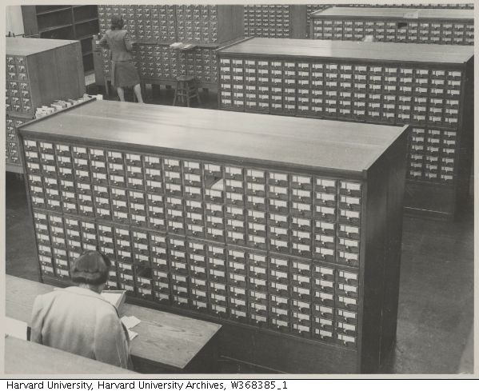
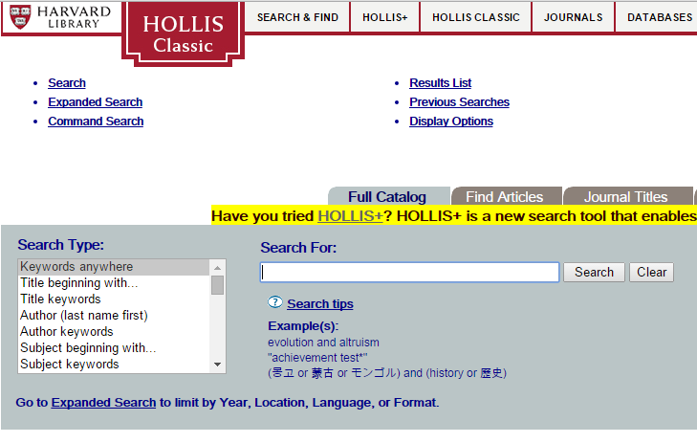
We have come a long way, quickly.
Notes:
Add in some visuals

Slide 9
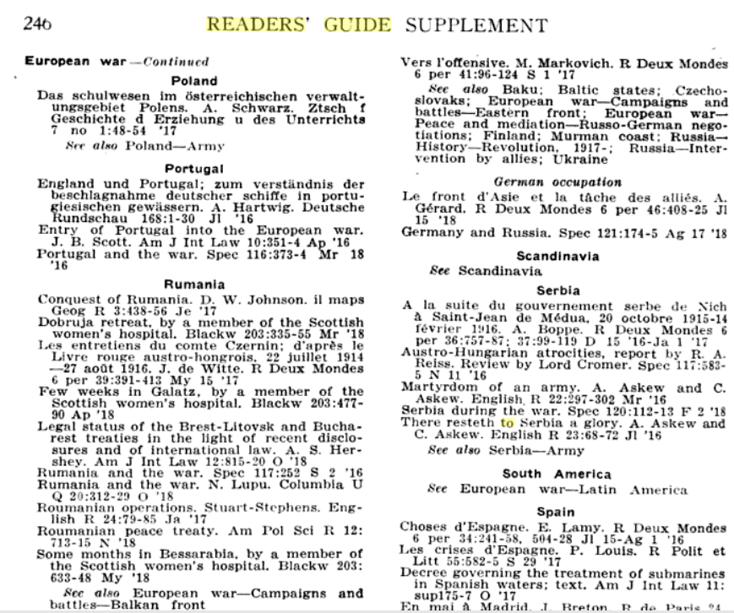
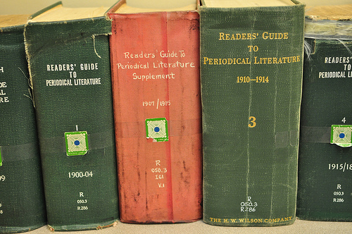
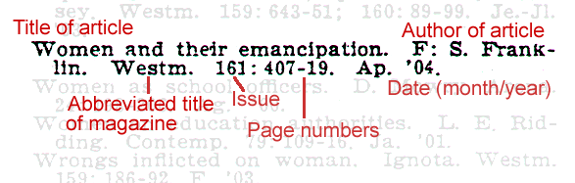
We have come a long way, quickly.
Notes:
Add in some visuals

Slide 10
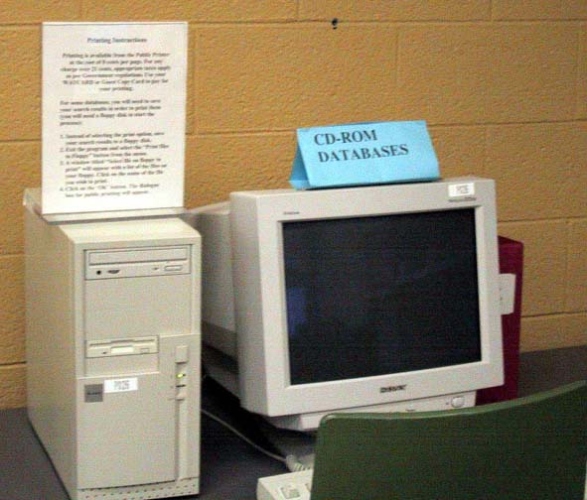
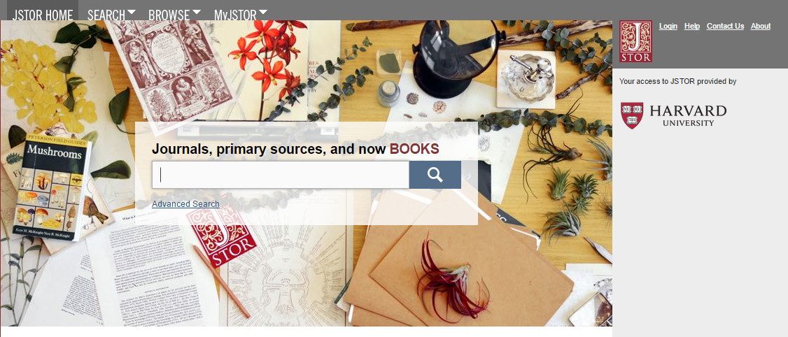
We have come a long way, quickly.
Source: University of Waterloo Library
Notes:
Add in some visuals

Slide 11
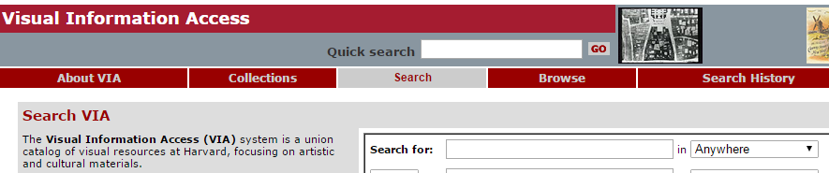
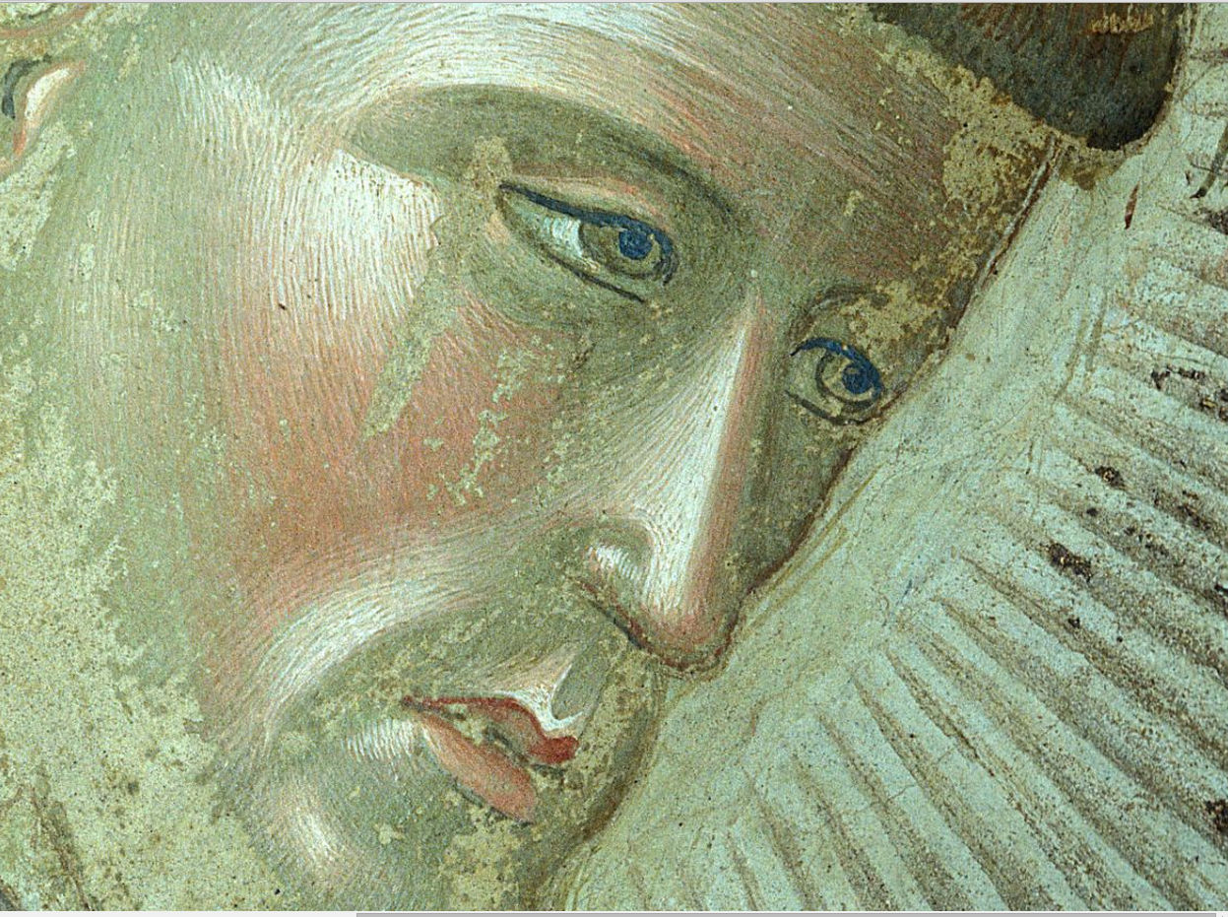
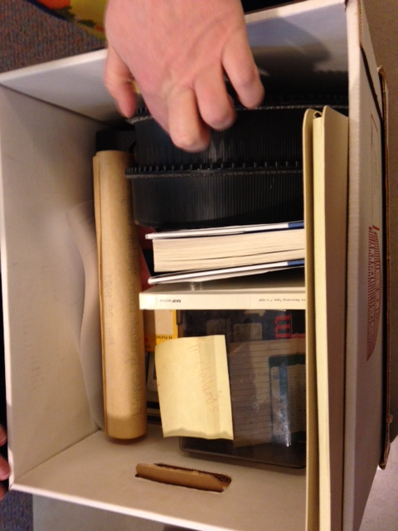
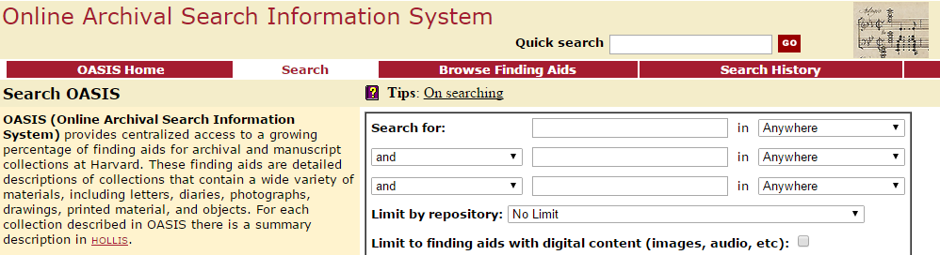
We have come a long way, quickly.
Visual Image and Archival Collections in standalone catalogs
Notes:
Add in some visuals

Slide 12
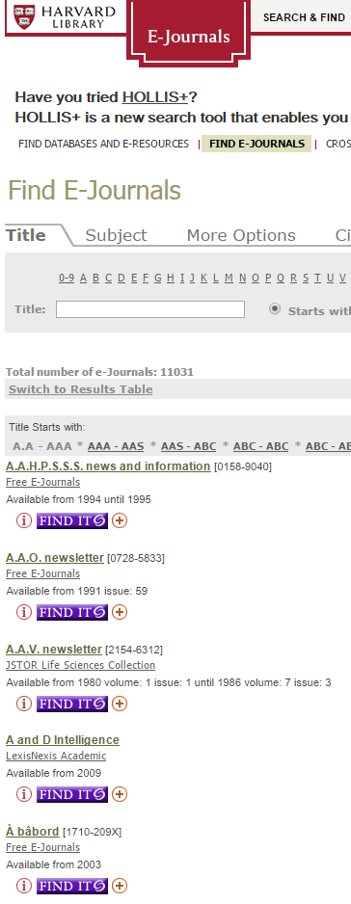
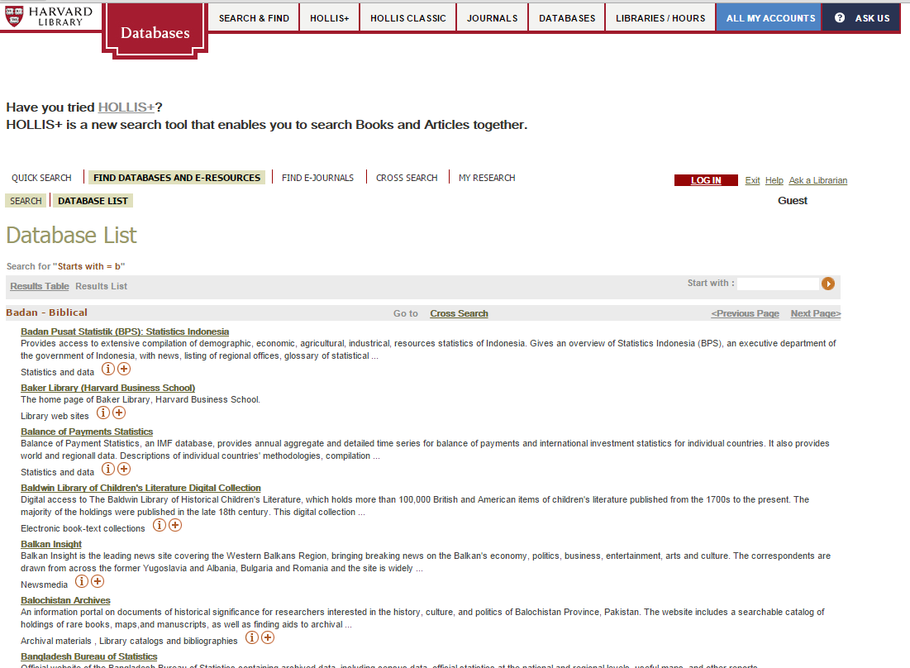
Back in those Days of Silos
Many independent front doors to research . . . but users had lower expectations at that time.
remains the case today
Notes:
Add in some visuals

Slide 13
Back in the Days of Silos
Then came the rise of effective internet search engines, and the desire for a single search box
Notes:
Add in some visuals

Slide 14
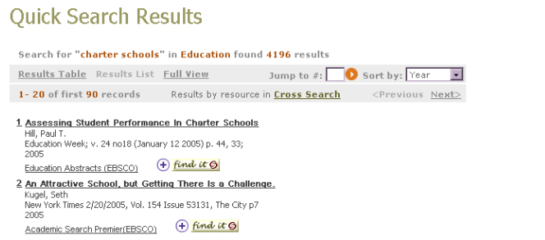
Early Days – Federated Search
Method for searching multiple disparate content sources with one query. Federation of searching involves restructuring queries to appropriate forms and sending them to multiple remote search engines. Results are coordinated and displayed to the user.

Slide 15
Early Days – Federated Search
Benefits
  Search multiple platforms at once
  Content lived in native systems, no need for duplication
The not so great . . .
  Not efficient
  Results incomplete & confusing
  Indexing inconsistent
User demand increased for a better solution . . . .

Slide 16
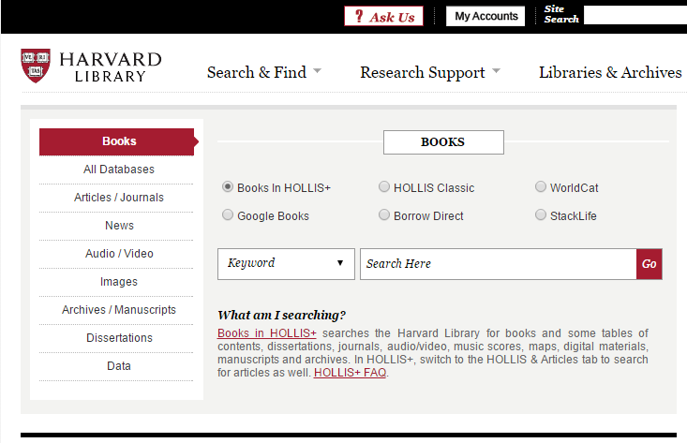
Library Challenges for Discovery
First, finding materials.
  Variety of research tools to FIND desired content
  Tools cross both library catalogs, databases, and external systems like google
Notes:
Laura will do a live demo of a selection of current tools in use.

Slide 17
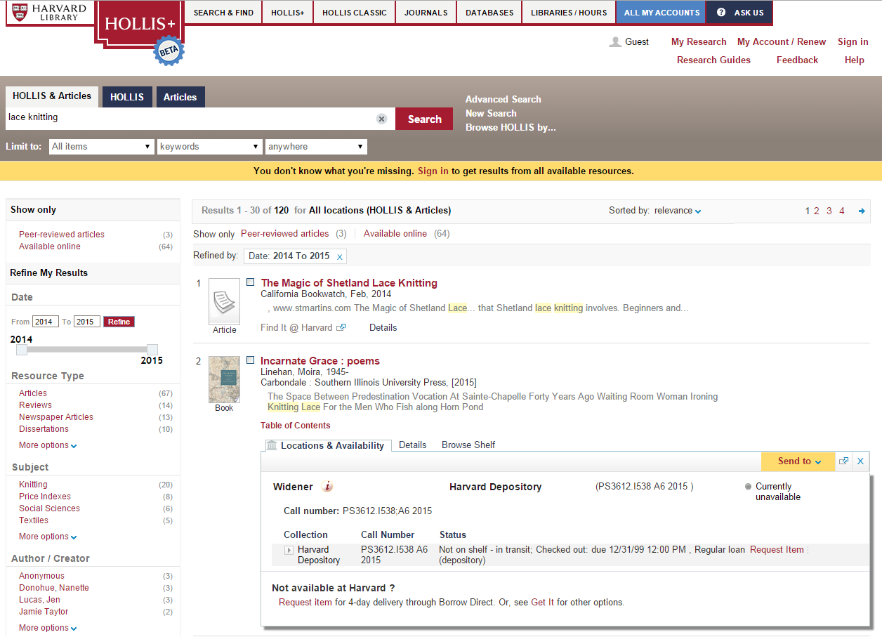
Library Challenges for Discovery
Then, accessing content, once found.
Notes:
And graphic here

Slide 18
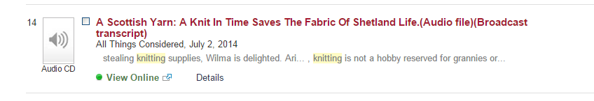

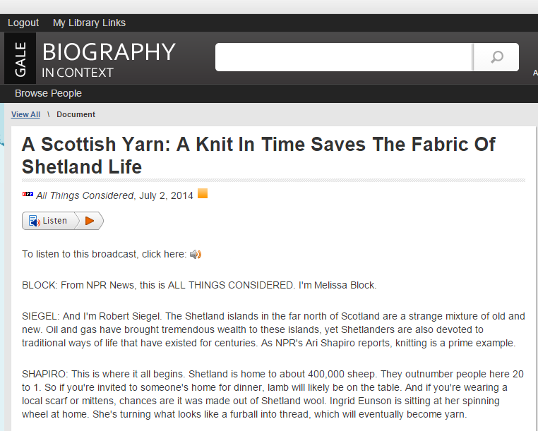
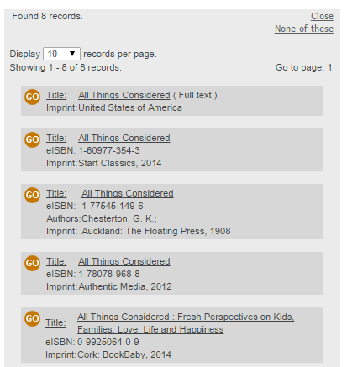
Library Challenges for Discovery
Then, accessing content, once found.
1.
2.
3.

Slide 19
Survey Says – Attendee Challenges Reported
  Multitude of interfaces
  Quality of search results
  Variations in metadata standards used across formats and across content sources
  Variations in quality of metadata
  Special concerns related to proper indexing and handling for CJK materials, both for transliterated and original scripts
Notes:
Laura will do a live demo of a selection of current tools in use.

Slide 20
Index Based Discovery
Mega-aggregate index of broad range of content
Consistent indexing across searches based on a consistent set of metadata for all item types, as well as full text content when available
Relevancy ranking possibilities
Branded Discovery Services emerged to address this need, but success required access to robust metadata across all types of records
Notes:
Note that the challenge also is removal of some level of control for content providers in branding, etc

Slide 21
Library Single Search Box
Blend of disparate types of data
  Library catalogs
  Article information
  Additional content
Benefits
  Single place for searching wide scope of materials
  Ability to drill down (via facets/search limits) to particular materials
  Relevancy ranked results
But, not all desired content was from the libraries catalogs . . .

Slide 22
The Context for ODI
Based on a meeting at ALA Annual Conference in New Orleans on Sunday, June 26, 2011. Recognition of the following trends and issues:
  Emergence of Library Discovery Services solutions
    Based on index of a wide range of content
    Commercial and open access
    Primary journal literature, e-books, and more
  Adopted by thousands of libraries around the world, and impact millions of users
  Agreements between content providers and discovery providers ad-hoc, not representative of all content, and opaque to customers. These can vary even between relationships of content providers and discovery providers
Notes:
This variability confusing to libraries.

Slide 23
Recommended Practice
Open Discovery Initiative: Promoting Transparency in Discovery (NISO RP-19-2014) - June 26th, 2014
  Vocabulary
  NISO Recommended Practice
  Standard to evaluate conformance with recommended practice
Notes:
Note that mechanisms for evaluation are being developed now, with potential enhancements coming in future releases

Slide 24
What is it?
A technical recommendation outlining data elements to be exchanged, including recommendations for data formats, method of delivery, usage reporting, frequency of updates and rights of use
A way for libraries to assess content providers’ participation in discovery services
A model by which content providers work with discovery service vendors via fair and unbiased indexing and linking

Slide 25
Why it matters
Simplifies the process of data exchange between participating discovery vendors and content providers
Ensures participating discovery vendors are following fair and unbiased indexing and linking practices
Mitigates technical and legal issues that might hinder broader participation by content providers or potential discovery service creators

Slide 26
ODI Standing Committee
The Open Discovery Initiative Standing Committee was formed following approval of the Recommended Practice published by NISO on June 25, 2014
We are charged with the following tasks:
  • Promotion and education of ODI Recommended Practice for all stakeholders
  • Provide support for content providers and discovery service providers during adoption and completion of conformance checklists
  • Provide a forum for ongoing discussion related to all aspects of discovery platforms for all stakeholders
  • Consider next steps for items deemed out scope from the original ODI Work Group Recommended Practice
  • Identify emerging needs in the open discovery space and determine appropriate courses of action
  • Make recommendations to the D2D topic committee on further work items required to fulfill the goals of the Open Discovery Initiative

Slide 27
ODI Standing Committee Roster
Libraries
Publishers
Service Providers
Marshall Breeding, Independent Consultant
Ken Chad, Ken Chad Consulting, Ltd.
Laura Morse, Harvard University
Ken Varnum, University of Michigan
Jason Price, SCELC
Dave Whisenant, Florida Virtual Campus
Lettie Conrad, SAGE Publications
Susan Hillson, APA
Karen McKeown, Cengage Learning
Elise Sassone, Springer
Julie Zhu, IEEE
Scott Bernier, EBSCO Information Services
Mike Showalter, OCLC
Rachel Kessler, Ex LIbris

Slide 28
ODI Recommended Practice - Content Providers
Participation – provide core metadata and full-text/original content, as well as full text and enriched content
Core metadata elements – basic citation metadata (author, title, publisher, date, type, format, etc)
Enriched content – indexing data (included A&I data like subject headings), full text or transcript, abstracts/description
Disclosure – provide information to libraries related to level of participation
Technical formats – use existing standards to facilitate data exchange

Slide 29
ODI Recommended Practice - Discovery Providers
Disclosure – provide key information in a consistent, usable form to libraries about content indexed to facilitate evaluation
Linking – linking and relevancy methods should not introduce bias to particular content providers; libraries should determine linking choices; annual disclosure related to neutrality
Data transfer – use existing protocols and provide documentation, preferences, and indication on impact on different processes to content providers

Slide 30
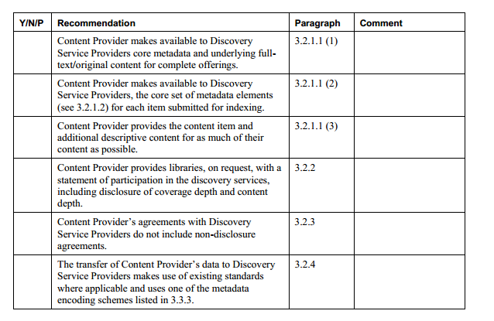
ODI Recommended Practice - Conformance Disclosure
Content Provider Conformance Checklist – Appendix B

Slide 31
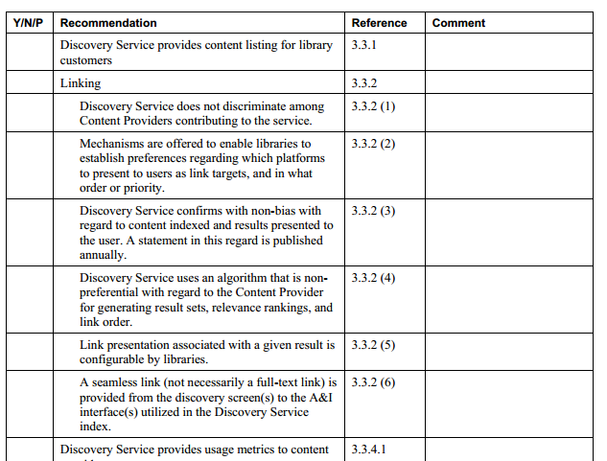
ODI Recommended Practice - Conformance Disclosure
Discovery Service Provider Conformance Checklist – Appendix C

Slide 32
ODI Recommended Practice - Conformance Disclosure
Provide support for content providers and discovery providers during adoption
  Conformance Checklists
    Content Provider
    Discovery Service Provider
  Conformance Statement Directory
    http://www.niso.org/workrooms/odi/conformance/
    Credo
    EBSCO
    Ex Libris
    IEEE
    Gale
    ProQuest
    Sage Publication

Slide 33
ODI Initiatives – Library Responsibilities
What can libraries do to ensure that discovery services meet user and institutional needs? Answer, a lot!
  New guidelines are available on the ODI website:
    http://www.niso.org/workrooms/odi/library_talking_points/
What can libraries do to ensure that Licensed Content is available discovery systems? Answer, a lot!
  New guidelines are available on the ODI website:
    http://www.niso.org/workrooms/odi/library_talking_points/
Notes:
Will go through the web materials in detail during this time!

Slide 34
Why do libraries care about ODI?
CONTENT, CONTENT, CONTENT
Discovery system can only be effective if the depth and breadth of indexed content matches the libraries collections
If discovery systems do not get timely feeds of rich metadata/full text from content providers, libraries are not able to expose their collections to users.
All content providers (including aggregators) need to provide rich quality data to all discovery systems equally!

Slide 35
Why should Content Providers/Aggregators Care?
USE, USE, USE
If content is not “findable” via library “front door”, access and use will go down.
Much use of discovery systems is for known item searching.
If not included in discovery, serendipitous exposure of materials in native platforms is missed, which may impact development of advanced information seeking skills

Slide 36
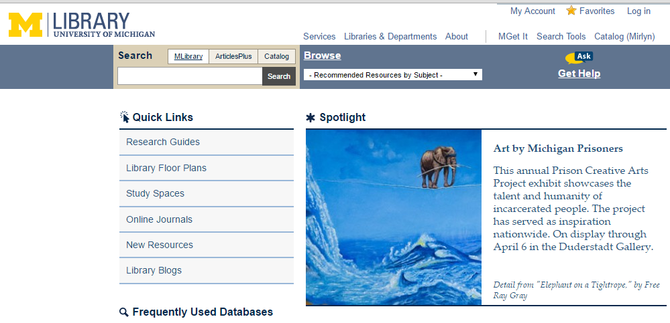
Library Front Doors

Slide 37
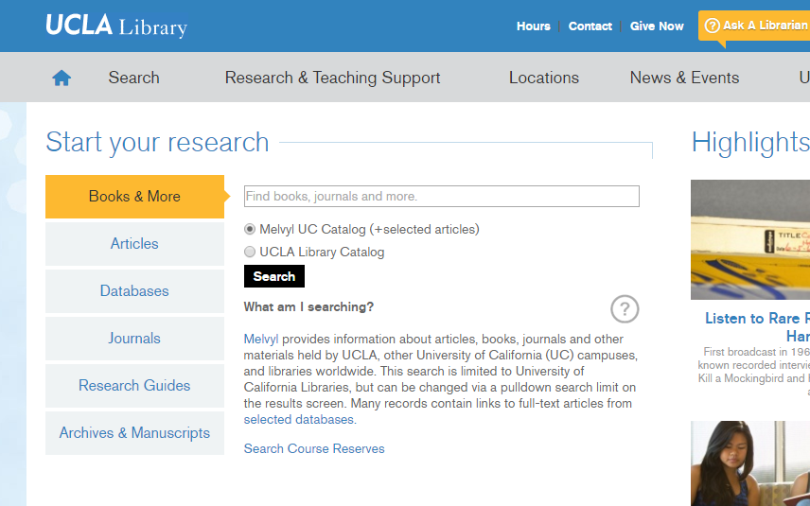
Library Front Doors

Slide 38
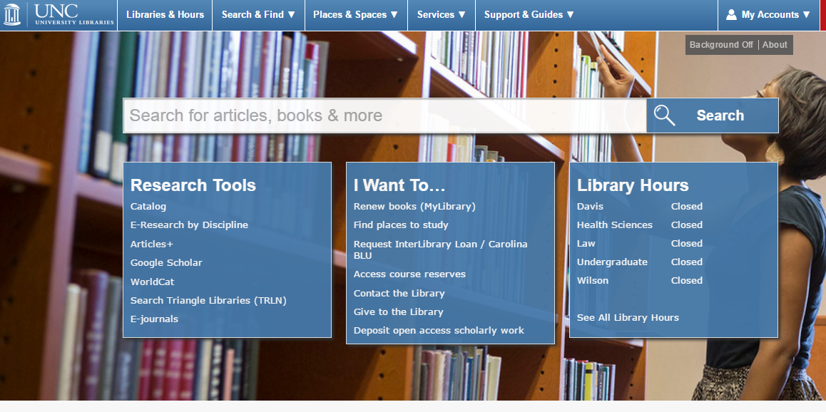
Library Front Doors

Slide 39
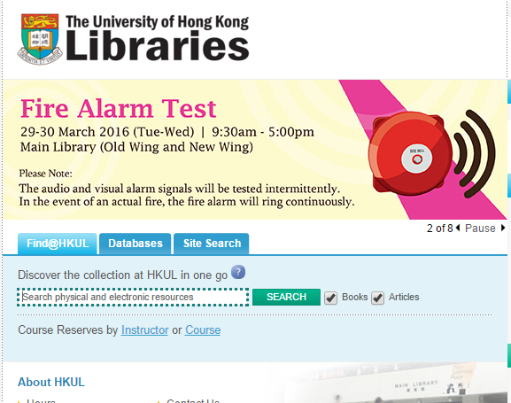
Library Front Doors

Slide 40
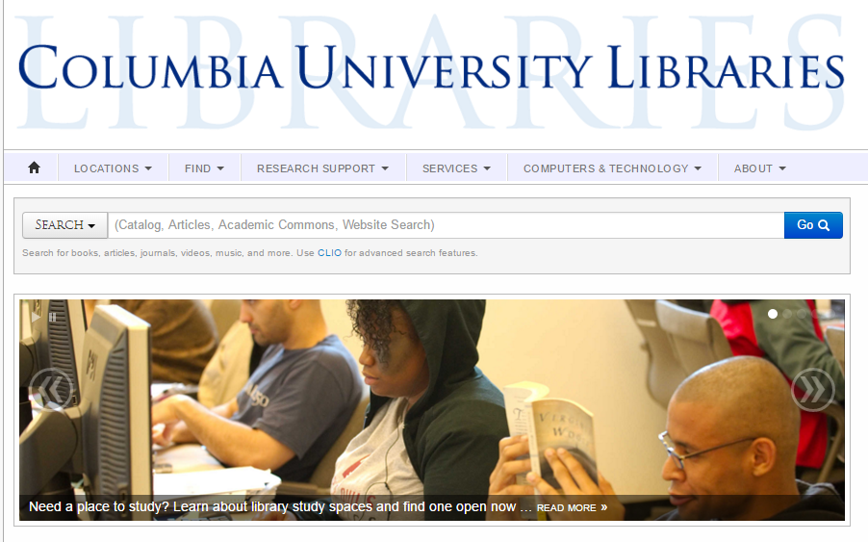
Library Front Doors

Slide 41
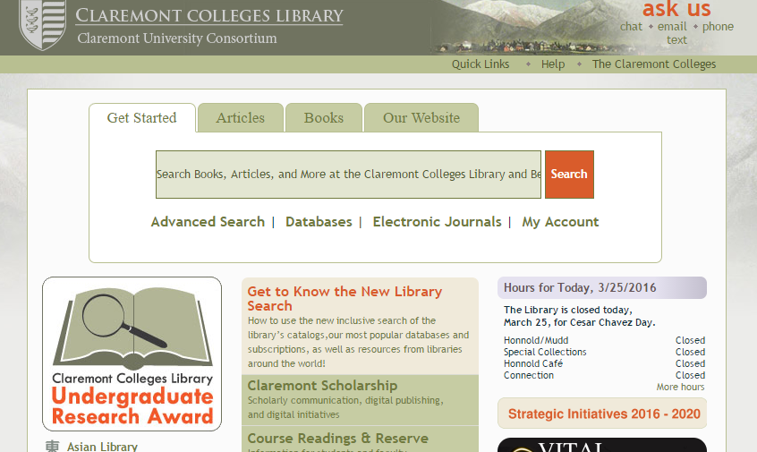
Library Front Doors

Slide 42
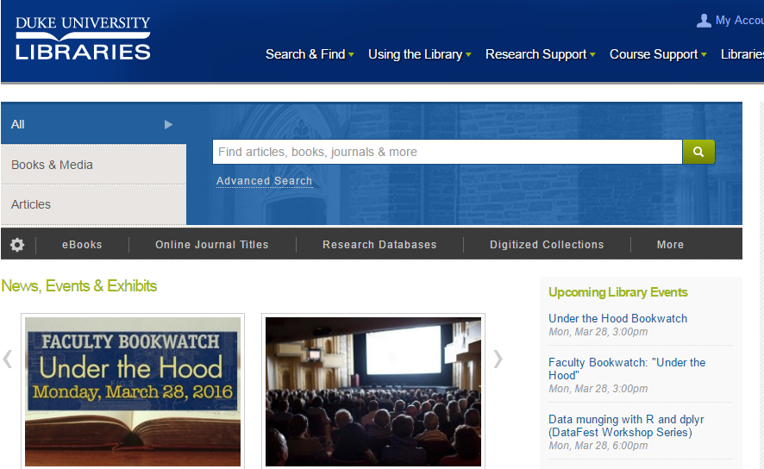
Library Front Doors

Slide 43
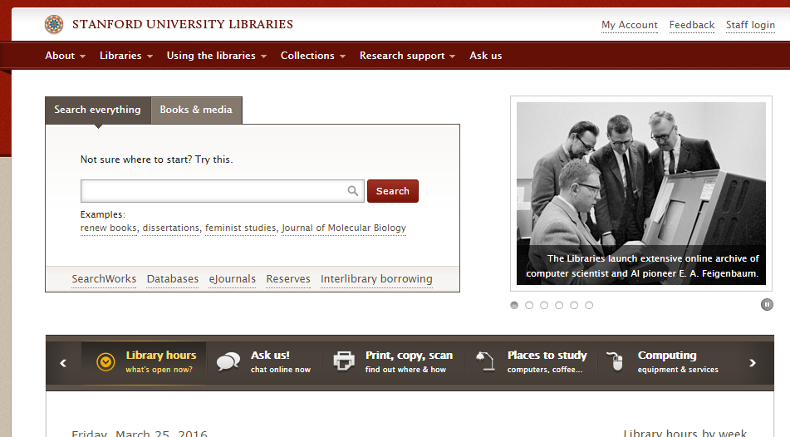
Library Front Doors

Slide 44
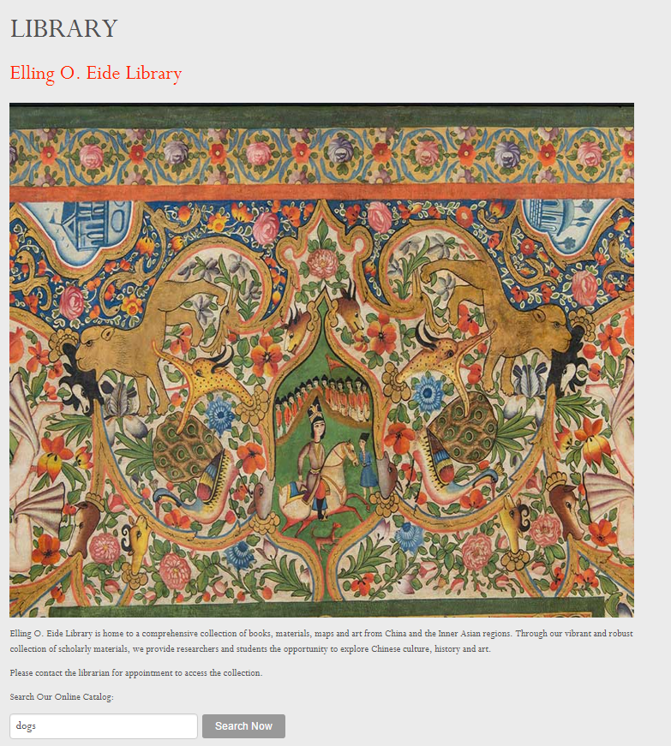
Library Front Doors

Slide 45
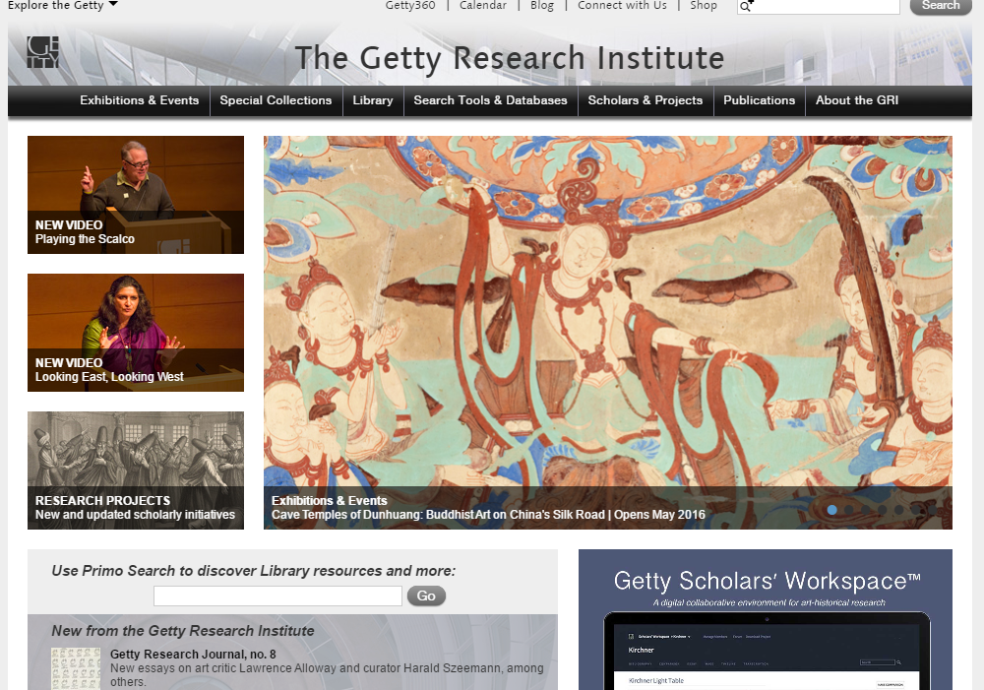
Library Front Doors

Slide 46
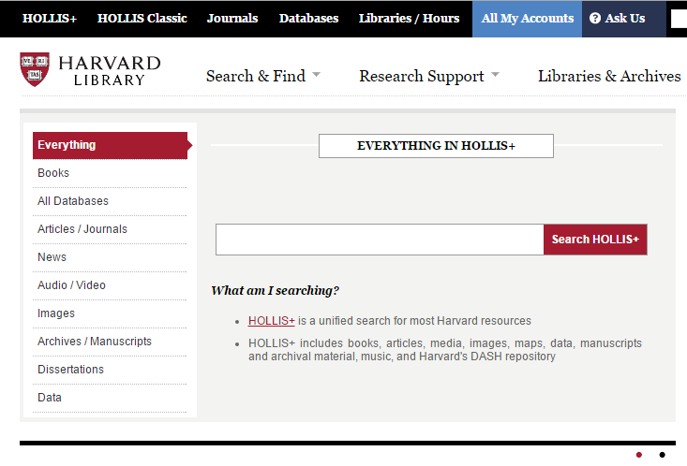
Library Front Doors

Slide 47
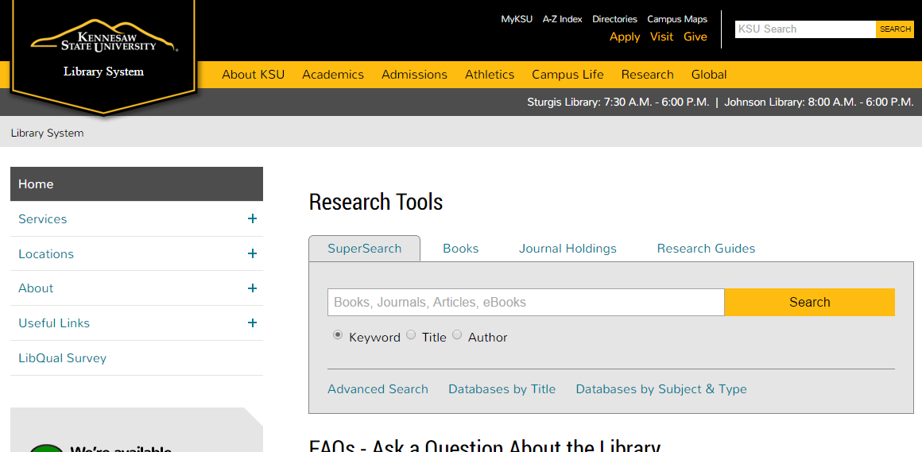
Library Front Doors

Slide 48
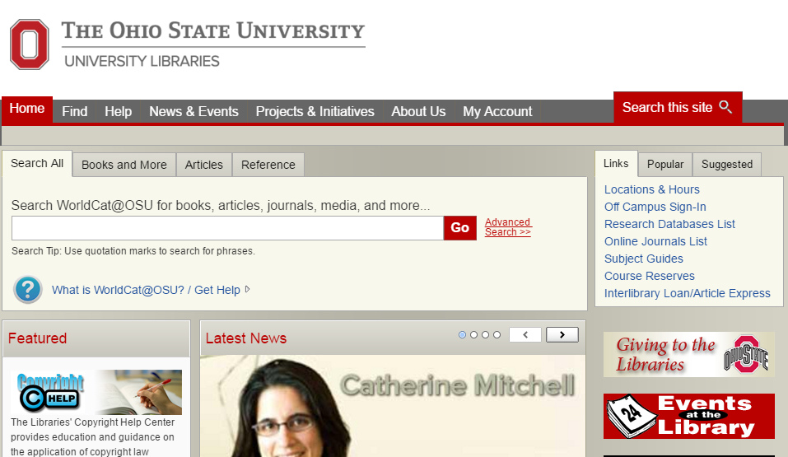
Library Front Doors

Slide 49
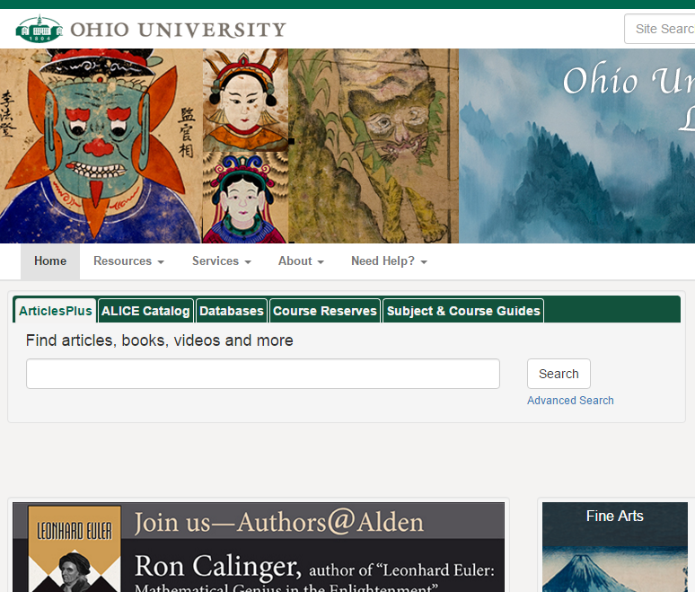
Library Front Doors

Slide 50
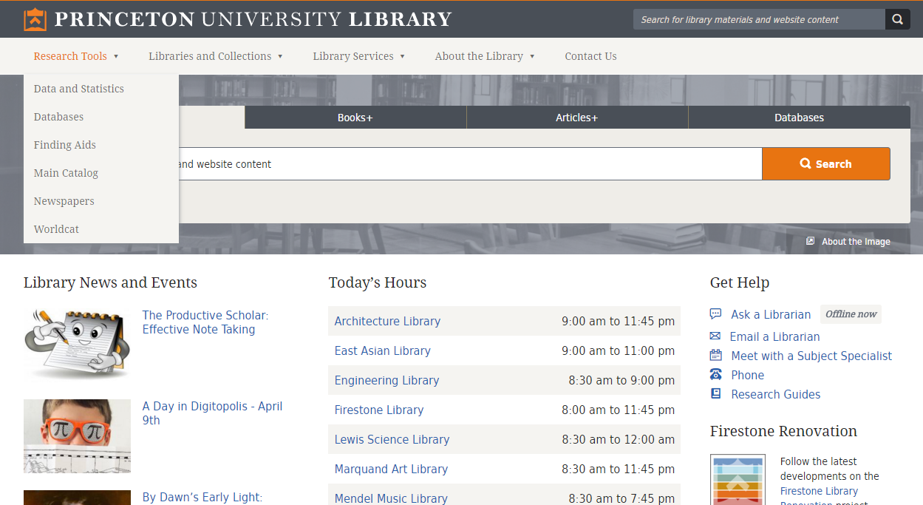
Library Front Doors

Slide 51
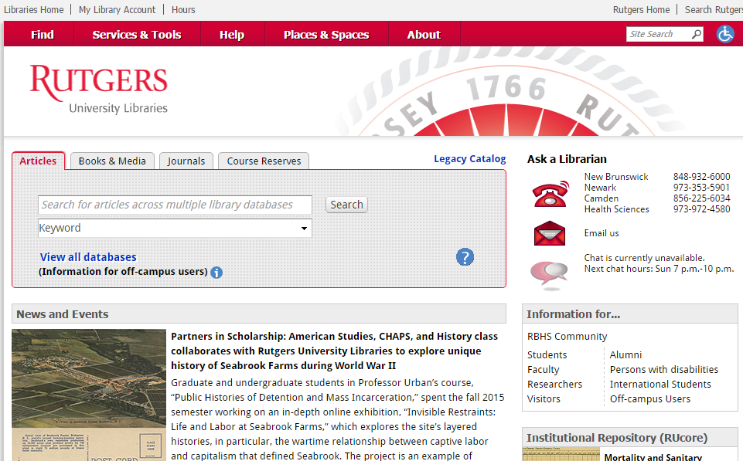
Library Front Doors

Slide 52
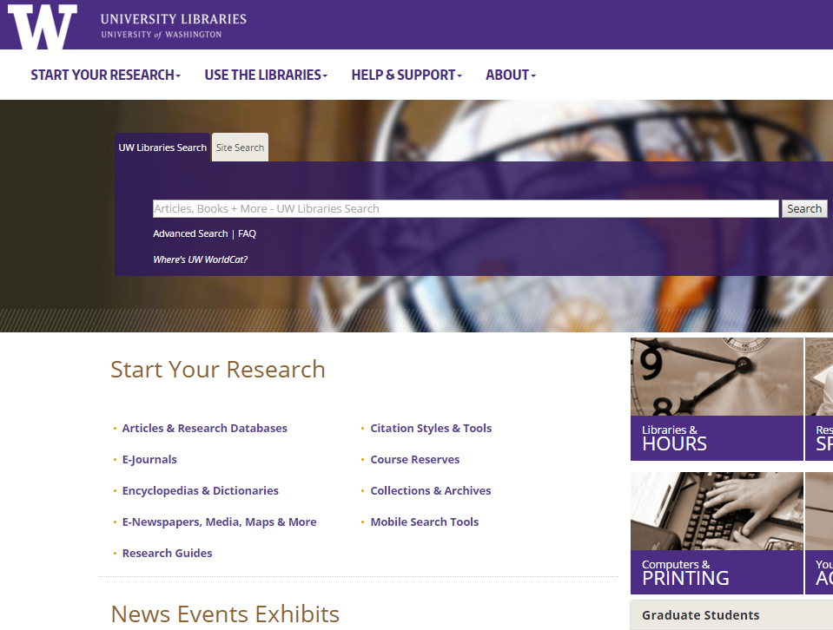
Library Front Doors

Slide 53
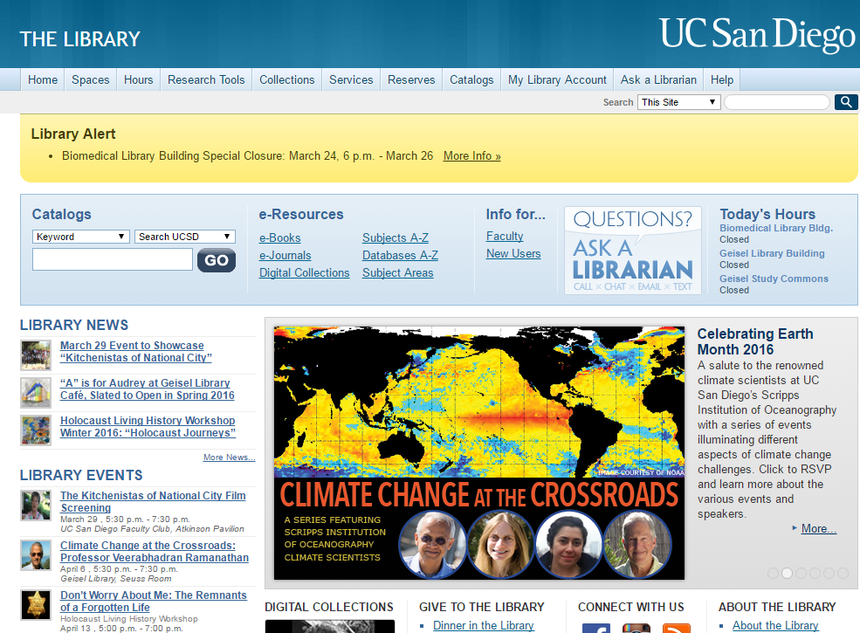
Library Front Doors

Slide 54
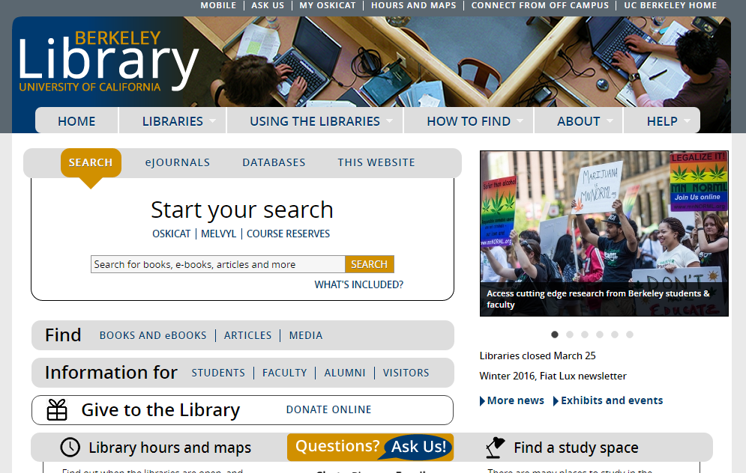
Library Front Doors

Slide 55
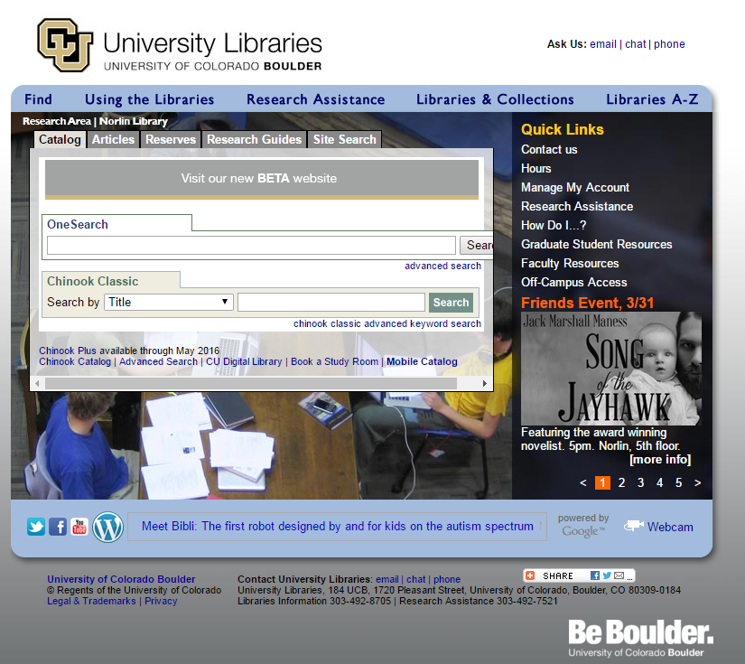
Library Front Doors

Slide 56
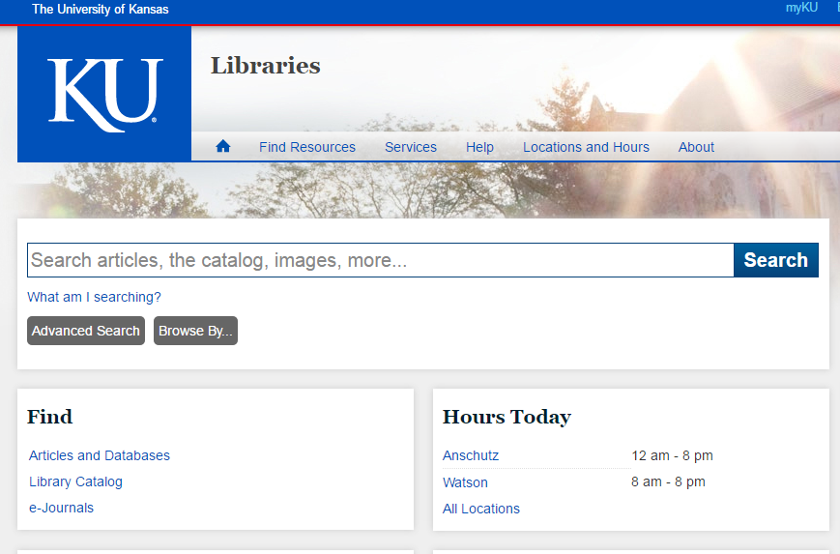
Library Front Doors

Slide 57
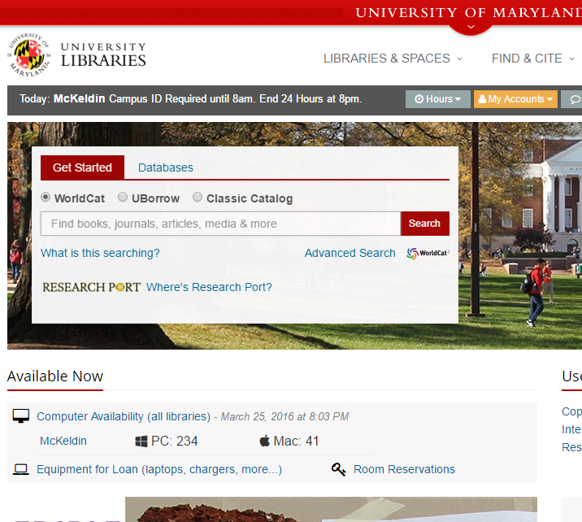
Library Front Doors

Slide 58
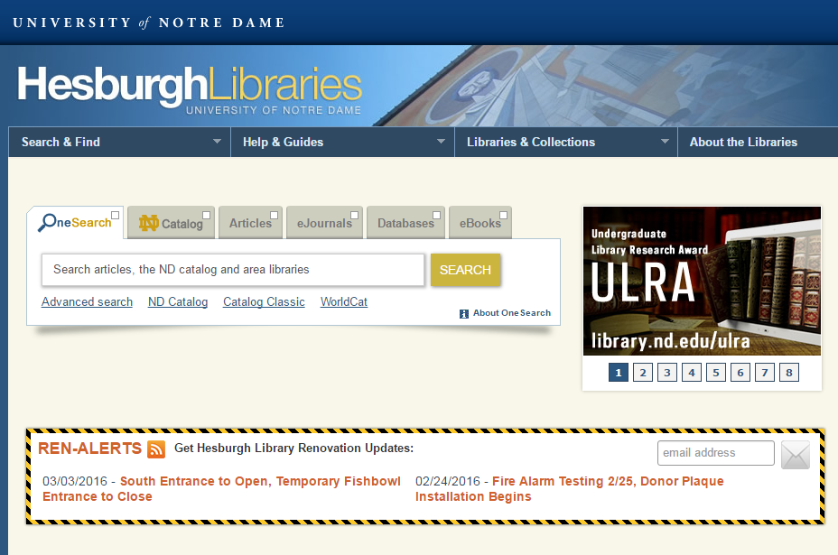
Library Front Doors

Slide 59
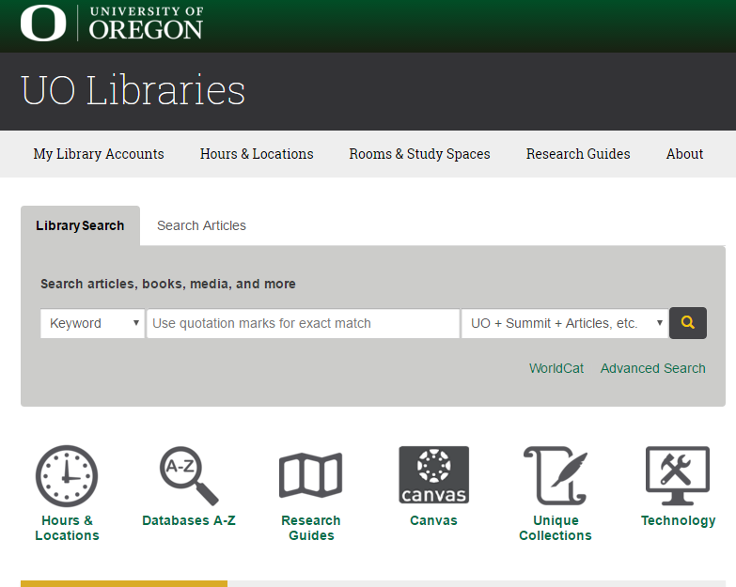
Library Front Doors

Slide 60
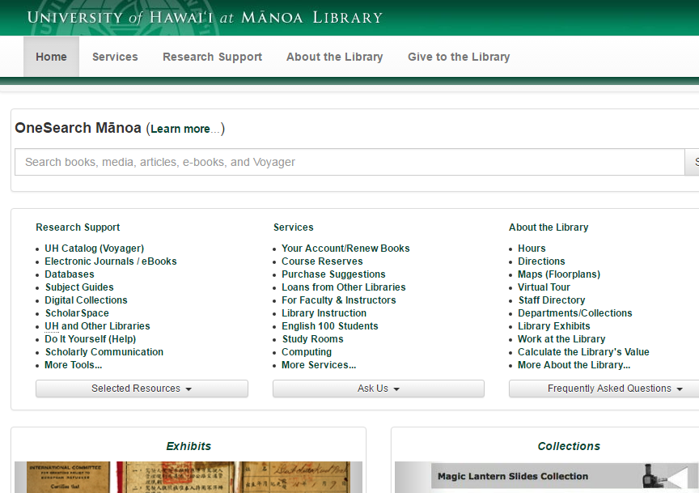
Library Front Doors

Slide 61
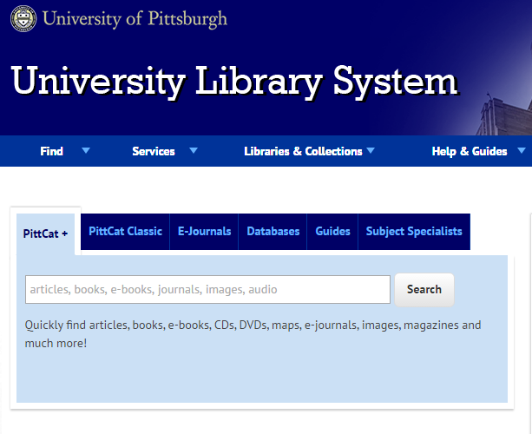
Library Front Doors

Slide 62
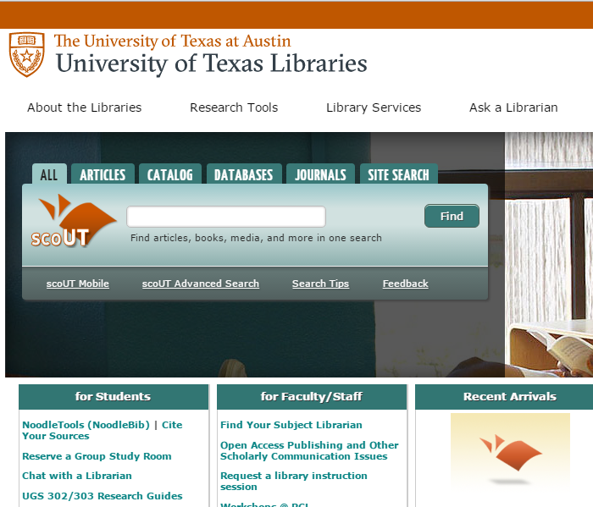
Library Front Doors

Slide 63
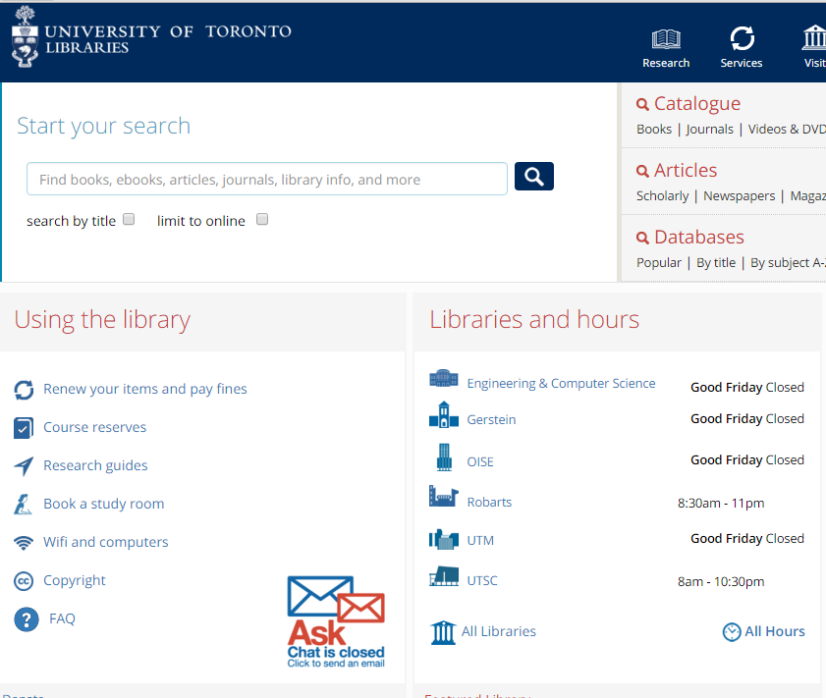
Library Front Doors

Slide 64
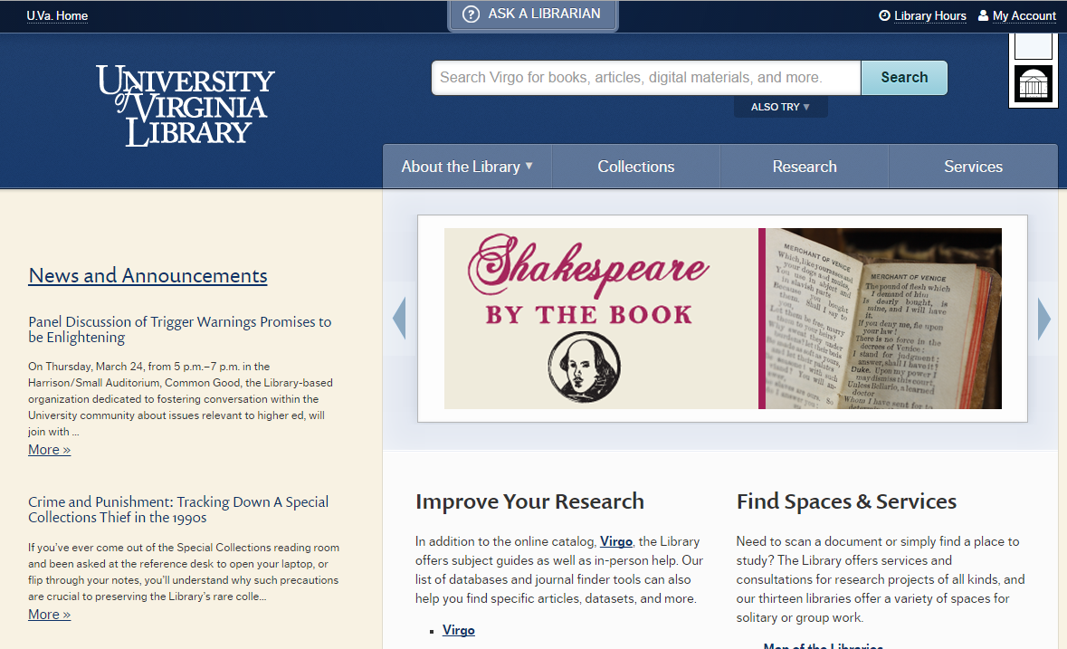
Library Front Doors

Slide 65

Library Front Doors

Slide 66
Small Group Discussion
What current challenges do you think can be overcome with ODI work to date?
  What actions are required by each stakeholder group to move this work forward?
  What actions can you take?
  Are there other currrent topics ODI should address?
Looking forward into the future, what features are most important for 2018? 2021? Beyond?

Slide 67
Themes from Discussion
In the current information ecosystem, metadata increasingly flows from publishers to local systems. Quality metadata stems from investment in resources. Many publishers who invest in metadata see it as an asset; some smaller publishers may not have the resources to create or distribute quality metadata. There was concern that some providers may be most driven by profit, not by library user needs. Communication is needed to help ensure the message of ODI and library needs are heard. Note, publishers in the room noted their willingness to take part in these conversations.

Slide 68
Themes from Discussion
CEAL represents specialized community with unique needs related to non-roman data. There are concerns around quality of data and ability to advocate for more quality. In addition, current discovery systems do not seem to be optimized to CJK specific needs, and do not appear to include mapping tables or other functions to help with the metadata structure needs for this community.
There was desire for an “International ODI” to help further define the issues and to propose solutions, or for the current group to increase efforts to reach out to international publishers. The group encouraged ODI to continue to work on making the ODI concepts more accessible and sharing more across the community.

Slide 69
Themes from Discussion
Concerns were raised related to protection of subscribed content within discovery tools. It should be noted that discovery systems do not provide underlying content, but provide links to content provided through other platforms. Access to this linked content is controlled by the owners. In addition, most discovery systems have the facility to limit search of metadata and full text to mutual subscribers, if the content providers wants to index or display metadata only to authenticated customers.

Slide 70
ODI Participation
Review NISO RP-19-2014, Open Discovery Initiative: Promoting Transparency in Discovery
Download NISO RP-19-2014 PDF
On the web: http://www.niso.org/workrooms/odi
Help with Conformance Checklist
  http://www.niso.org/workrooms/odi/conformance
Library Materials
  http://www.niso.org/workrooms/odi/library_talking_points/
Twitter: @NISO_ODI
Via email, subscribe: http://www.niso.org/lists/opendiscovery/

Slide 71
Questions?
Thank you!
Laura Morse
laura_morse@harvard.edu
Director, Library Systems
Harvard University
Contact ODI Standing Committee
odi-sc@list.niso.org

